Slide 1
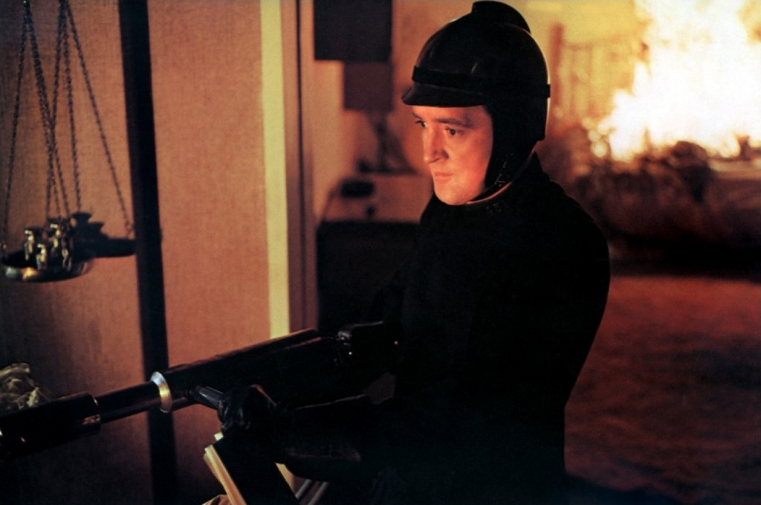
“It was a pleasure to burn.”

Slide 2
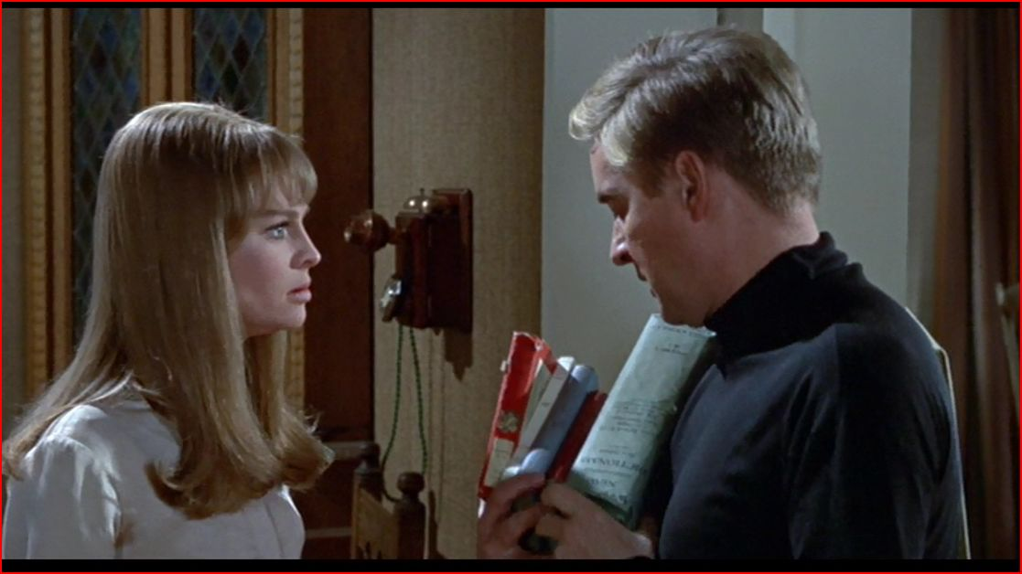
“I want to look at them, at least look at them once.”

