Slide 1
Active and Passive Voice

Slide 2
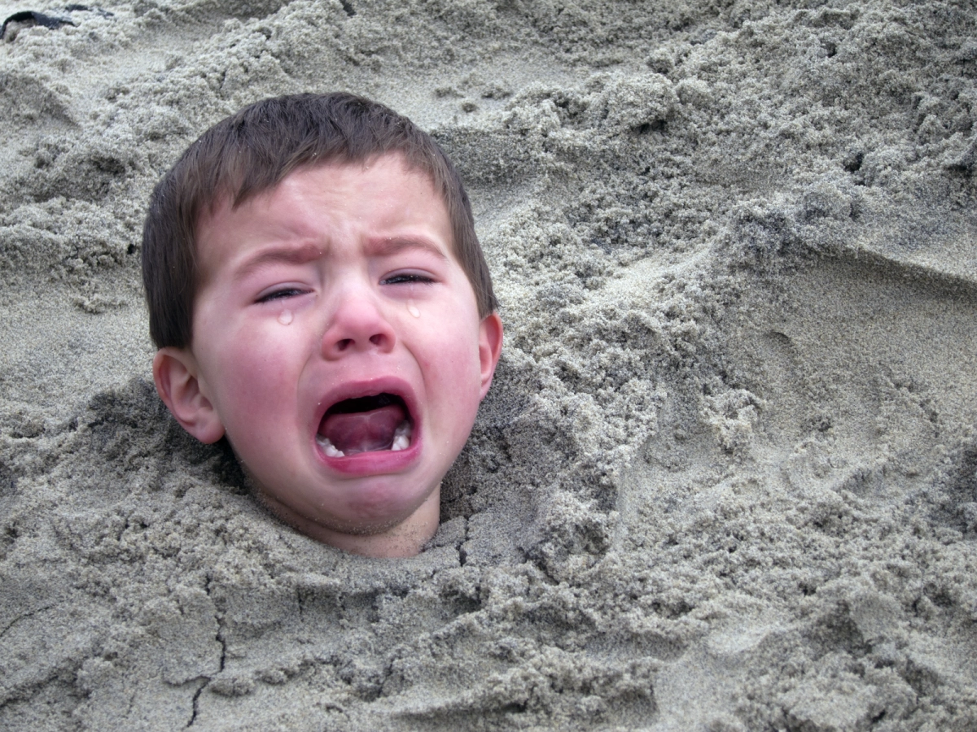
Active Voice
When writing sentences, paragraphs, or essays, students should always try to write in the ACTIVE VOICE. Active voice occurs when the subject of the sentence is doing the action.
Sally buried Billy in the sand.

Slide 3
Sally buried Billy in the sand.
The subject of the sentence, Sally, is doing the action, buried. This means the sentence is active voice.
Do not think strictly of the verb itself, but of the action it implies.

Slide 4
Passive Voice
The alternative to active voice is PASSIVE VOICE. Passive voice is when the subject is being acted upon by some other person, place, or thing, and is therefore not doing the action the verb indicates.
Ex.:
Billy was buried in the sand by Sally.

Slide 5
Billy was buried in the sand by Sally.
The subject of the sentence, Billy, is NOT doing the action, buried. This means the sentence is passive voice.
Do not think strictly of the verb itself, but of the action it implies.

Slide 6
So . . .
ACTIVE:
PASSIVE:
Sally buried Billy in the sand.
Billy was buried in the sand by Sally.
Active: Subject doing the action
Passive: Subject NOT doing the action

Slide 7
Also, any sentence in which is, am, are, was, or were is the main verb will always be passive voice.
For example:
We are happy to be on vacation.
Are, the verb of this third example sentence, is the main (only) verb, so the sentence is passive voice. It is called a LINKING VERB. Some other common linking verbs are become, appear, seem, look, sound, taste – all depending on how they are used, of course!

