Slide 1
Finding sources
Do you know anyone with a working knowledge of your topic?
Are they an expert?
Are they a scholar?
Are they a witness?
Use the internet
Use your library – QHHS, AVC, city, or other
Talk to librarians about how / what / where to research
Browse the “reference” section of the library to know what’s there
Search for magazine or newspaper articles, not just books
Check the bibliographies of the sources you’ve already found
For books, read online reviews – often books are compared, favorably or otherwise, to books of a similar topic

Slide 2
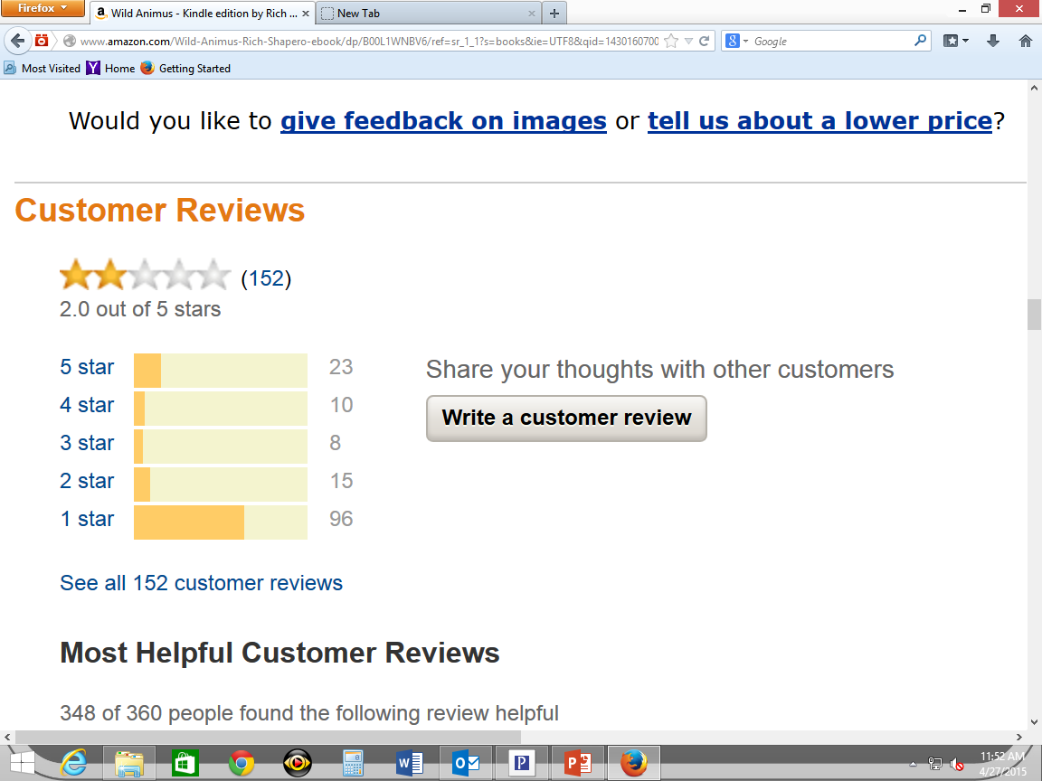
63% of all reviewers gave it one star.

Slide 3
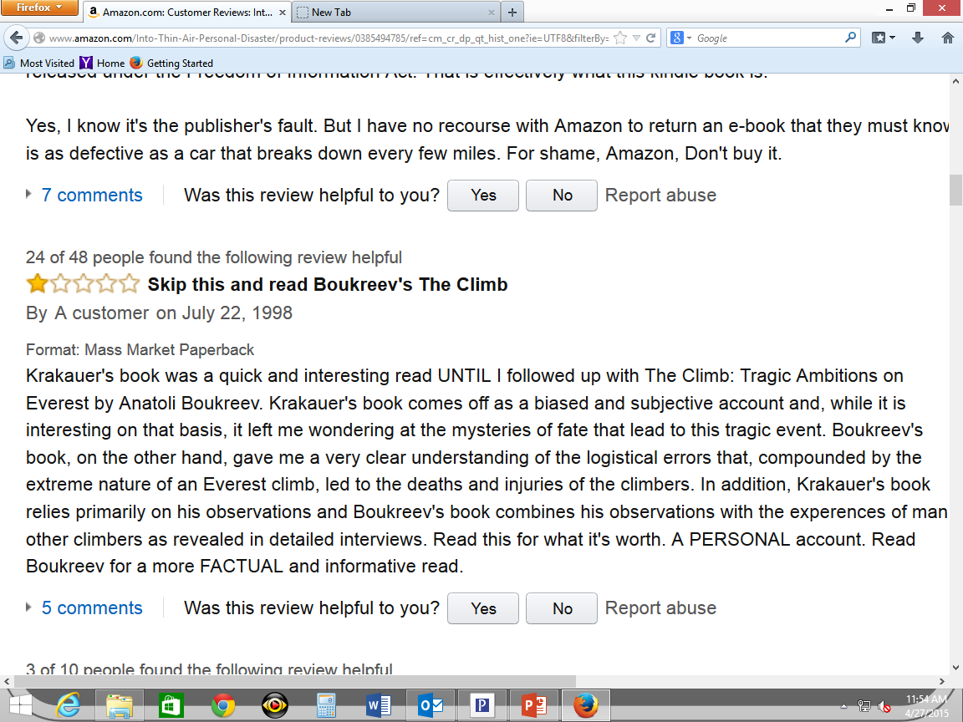

Slide 4
Evaluating sources
Understanding the author / source
For any source, read the author’s biography
For a book, read the introduction, where an author might tell you his or her credentials and purpose
Is the author a scholar / enthusiast / expert, or a reporter / neophyte / observer? Information can often be found at the beginning or end of an article (see example, next slide)

Slide 6
Evaluating sources
Understanding the author / source
For any source, read the author’s biography
For a book, read the introduction, where an author might tell you his or her credentials and purpose
Is the author a scholar / enthusiast / expert, or a reporter / neophyte / observer? Information can often be found at the beginning or end of an article
How current is the source? (see example, next slide)

Slide 7
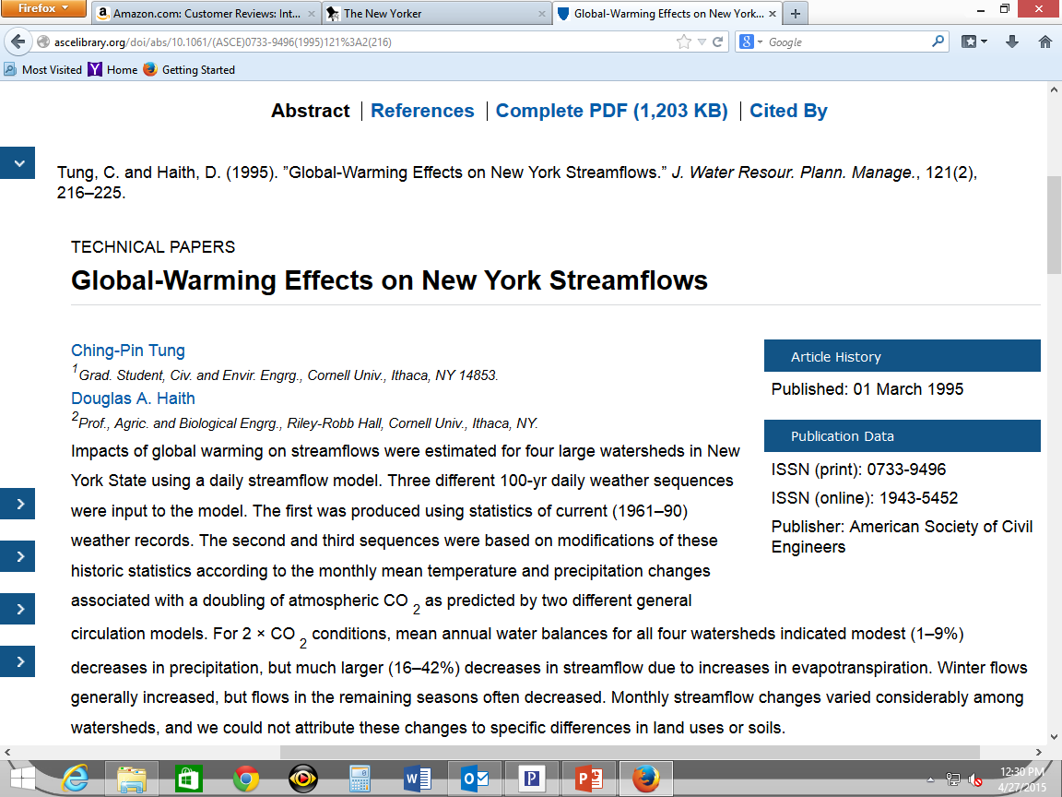

Slide 8
Evaluating sources
Understanding the author / source
For any source, read the author’s biography
For a book, read the introduction, where an author might tell you his or her credentials and purpose
Is the author a scholar / enthusiast / expert, or a reporter / neophyte / observer? Information can often be found at the beginning or end of an article
How current is the source?
If you can, find online reviews of the material
Does the article appear in a credible source?
( www.ihatetornadoes.com ; www.tornadoesarejustaformofgovernmentcontrol.com )

Slide 9
Evaluating online sources
Previous information still applies – see Google Classroom for worksheet
And . . .
Is it connected to a credible source?
Does it project a politically biased air?
Are the articles just the ravings of a lunatic?
Does the site make unsubstantiated claims?
Does it use overly casual or inappropriate language?
Does it have many grammatical or punctuation errors?

