Slide 1
Notes from Class-April /May
Relativism
Language
Feminism
Philosophy of History

Slide 2
Do we know? Five Rival Epistemologies
Philosophical positions | Is Knowledge Possible? | Does reason provide us with knowledge of the world independently of experience? | Does our knowledge represent reality as it really is?
Skepticism | No | - | -
Rationalism | Yes | Yes | Yes
Empiricism | Yes | No | Yes
Constructivism | Yes | Yes | No
Relativism | Yes | No | No
Source: William F. Lawhead, The Philosophical Journey: an Interactive Approach (London: Mayfield,
2000), p. 69.

Slide 3
Is Knowledge Possible?
The Skeptic: It is impossible to justify our beliefs. We know nothing.
The Rationalist: Yes, it is possible, through a priori reasoning. Knowledge is independent of experience. We can rationally, deductively, justify our beliefs.
The Empiricist: Through sense experience, we gain knowledge. Moreover, this knowledge accurately characterizes the world, really. However, we still have doubts about the conjunction of perception and reality.
The Kantian Constructivist: Knowledge is not already in the mind, nor passively received from experience. The Mind constructs knowledge out of experience. We never really know reality, we only know our understanding of reality. Because human beings basically have the same ways of thinking, universal knowledge is possible.
The Relativist: Knowledge is possible, but it is relative to the individual or group. It is neither universal nor objective.

Slide 4
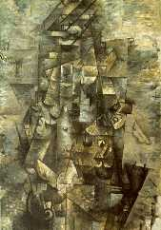
Figure 1: Georges Braques, Man with a Guitar. 28 Feb 2005.
<http://www.artchive.com/artchive/B/braque/man_guit.jpg.html>.

Slide 5
Does it make sense to search for the truth?
This assumes that there is a truth…
Objectivism:the claim that there is one set of universal truths or facts about the world and that these truths are independent of us
-Rationalism
-Empiricism
-Kantianism (constructivism)
Relativism: the claim that there can be no universal objective knowledge of reality because all knowledge is relative to individuals or one’s culture. However, unlike skeptics there is
“subjective truth.”

Slide 6
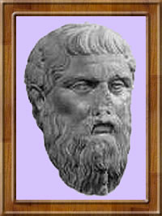
Each one of us is a measure of what is and what is not; but there is all the difference in the world between one man and another just in the very fact that what is and appears to one is different from what is and appears to the other. Protogaras (Greek Sophist)

Slide 7
“There is no objective truth about the matter, there are only different opinions, and one opinion is just as true as another?”

Slide 8
Kinds of Relativism
Individual (Subjective) Relativism
Cultural Relativism
Historical Relativism

Slide 9
Examples of Relativism
“That may be true for you, but it’s not true for me.”
“Beauty is in the eye of the beholder.”
“When in Rome, do as the Romans do.”
“Different strokes for different folks.”
Can you think of more examples?

Slide 10
Relativist Realities: Individual or Cultural?
“I never steal, unless I am hungry.”
“How can you say that you are not being mean? You sure are mean when you tie my pony tail to my backpack!”
“Columbus discovered America.”
“Terrorist vs. Freedom Fighter
Which one was George Washington?

Slide 11
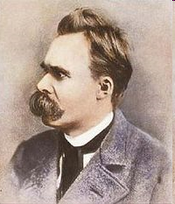
Friedrich Nietzsche
What do you think?
1844-1900

Slide 12
Argument
Argument:
Conscious thinking is based on instinct
What matters is if your thinking is life-promoting
Theory is really just autobiography
Philosophers are really more like lawyers than truth-tellers
#42
Evaluation

Slide 13
As a path to knowledge,
does Gender matter?

Slide 14
Sex vs. Gender
Biological Differences
Psychological-social differences
Social Roles

Slide 15
Feminist Epistemology
Emphasizes the role of gender in shaping how we think and how society is structured
Focuses on the historical and social forces that have excluded women from full participation in the intellectual and political realms
Strives to produce a society that recognizes women as both different and equal

Slide 16
Feminist Critique of Philosophy
Questions whether there is only one human nature
Questions objectivity as a premise of much philosophy
Questions whether knowledge can be impersonal
Emphasizes the importance of knowledge as communal and not individual
Example: Work of Carol Gilligan: In a Different Voice: Psychological Theory and Women’s Development
Men and Women address ethical questions with different sets of criteria
Men employ a judicial model: emphasizing equality, justice, rights, impartiality, objectivity, universal principles and logic
Women employ a more person-centered approach stressing care, compassion, trust, mercy, forgiveness, preventing harms, and feelings
* Caused by differences in socialization

Slide 17
Developments in Feminist thought
First Wave– Equity Feminists (maintain the status quo with more equality)
Second Wave—Gender Feminists (transform society)
Essentialists– there is a fundamental female nature
Nonessentialists– Gender is culturally learned

Slide 18
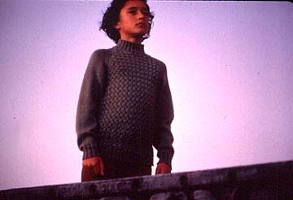
First Wave Example: What epistemological issues did you perceive in this movie?
Whale Rider
Pai’s story: 33:50

Slide 19
Jean Kilbourne’s Advertising’s Image of Women
Considerations
Template for Research
Kilbourne’s Research Question:
Methodology:
Hypotheses:
Conclusions:
Strengths and Weaknesses of Kilbourne’s argument

Slide 20
Is language a way of knowing?
Defining language
method of communication
use of symbols

Slide 21
Views of language
Words, strain, crack, and sometimes break, under the burden.
T.S. Eliot
Whenever two or more human beings can communicate with each other, they can, by agreement, make anything stand for anything.
S.I. Hayakawa
There are those who would never have been in love, had they never heard about love.
LA Rochefoucauld

Slide 22
Language as Communication
Sender
Message
Receiver
>>>>>
>>>>

Slide 23
Language as Communication
To express emotion
to drown out silence
to enjoy the sounds of language
to establish a feeling of belonging
to establish relationships
to affect others’ emotions
to affect others’ behavior
to suggest insights
to communicate ideas and facts

Slide 24
Language as Symbolic of Reality
The medium of communication influences the message
The choice of words influence
inferences
how we categorize the world
“The map is not the territory”
S.I. Hayakawa

Slide 25
Linguistic Relativism: Language as Constitutive of Reality
“The Limits of my language means the limits of my world”
Ludwig Wittgenstein
Defining ourselves
Race and the Census department
Pet Owners vs. Pet guardians
Propaganda and War

Slide 26
What do you think?
The interdependence of thought and speech makes it clear that languages are not so much a means of expressing truth that has already been established, but are a means of discovering truth that was previously unknown. Their diversity is a diversity not of sounds and signs but of ways of looking at the world.[
Karl Kerenyi

Slide 27
“When I use a word,” Humpty-Dumpty said in a rather scornful
tone, “it means just what I choose it to mean--neither more
nor less.”
“The question is,” said Alice, “whether you can make words
mean different things.”
“The question is, “ said Humpty-Dumpty, “which is to be
master--that’s all!”
Lewis Carroll

Slide 28
Language
I won't use words again They don't mean what I meant They don't say what I said They're just the crust of the meaning With realms underneath Never touched Never stirred Never even moved through If language were liquid It would be rushing in
Suzanne Vega

Slide 29
Nothingness
I woke up at night and my language was gone
No sign of language nor writing no alphabet
Nor symbol nor word in any tongue
And raw was my fear—like the terror perhaps
Of a man flung from a treetop far above the ground
A shipwrecked person on a tide-engulfed sandbank
A pilot whose parachute would not open
Or the fear of a stone in a bottomless pit
and the fright was unvoiced unlettered unuttered
And inarticulate O how inarticulate
And I was alone in the dark
A non-I in the all-pervading gloom
With no grasp no leaning point
Everything stripped of everything
And the sound was speechless and voiceless
And I was naught and nothing
Without even a gibbet to hang unto
Without a single peg to hang onto
And I no longer knew who or what I was
And I was no more
Aharon Amir

Slide 30
The Role of Language
What is the message of the poem? Do you agree?
Does language empower or does language enslave?
Choose one IB area of knowledge. Would the poem’ s message be true for that area of knowledge? Give an example.

Slide 31
Discussion: Philosophy of Language
Symbolic view of language: Language a conveyor of meaning, a vehicle for sending a message
Relativistic view of language: Language creates meaning, shaping understanding.
Consider these points of view about language. Using examples, share your point of view. Draw on your understanding of more than one language.

Slide 32
Quote from Orwell’s 1984
Don’t you see that the whole aim of Newspeak is to narrow the range of thought? In the end we shall make thoughtcrime literally impossible, because there will be no words in which to express it. Every concept that can ever be needed, will be expressed by exactly one word, with its meaning rigidly defined and all its subsidiary meanings rubbed out and forgotten. Already, in the Eleventh Edition, we’re not far from that point. But the process will still be continuing long after you and I are dead. Every year fewer and fewer words, and the range of consciousness always a little smaller. Even now, of course, there’s no reason or excuse for committing thoughtcrime. It’s merely a question of self-discipline, reality-control. But in the end there won’t be any need even for that. The Revolution will be complete when the language is perfect. Newspeak is Ingsoc and Ingsoc is Newspeak,’ he added with a sort of mystical satisfaction. ‘Has it ever occurred to you, Winston, that by the year 2050, at the very latest, not a single human being will be alive who could understand such a conversation as we are having now?

Slide 33
Ted Talk
Lera Boroditsky How Language Shapes the Way We think
https://www.ted.com/talks/lera_boroditsky_how_language_shapes_the_way_we_think

Slide 34
Epistemological considerations raised by Kilbourne’s video
To what extent is our self-image shaped by the world around us?
To what extent is our happiness dependent on the approval of others?
Who defines our gender roles?
Are there objectively defined general roles or is all defined socially.
Are the Marxists right in defining much of capitalist culture as promoting “false consciousness”

Slide 35
Misunderstandings?
Hyperlink: Personal account
Short Reflections: Hyperlink

Slide 36
Anorexia Nervosa
Hyperlink: Hypothesized Causes of Eating Disorders
Defined: Individuals with anorexia nervosa are unwilling or unable to maintain a body weight that is normal or expectable for their age and height (most clinicians use 85% of normal weight as a guide). Individuals with anorexia nervosa typically display a pronounced fear of weight gain and a dread of becoming fat although they are dramatically underweight. Concerns and perceptions about their weight have a extremely powerful influence and impact on their self-evaluation.
Defined:
Occurs in one out of 100 adolescent females
50:1 ratio of females to males
Causes: psychological, biological, cultural
Perception that one is too fat causes excessive dieting and exercise

Slide 37
What is the epistemological status of history?
Choices:
Empirical: Yes, there are such things as facts!!
No, Columbus did not get to India. Sorry.
Rational: there are laws in history just like in geometry (objective)
“The strong do what they can, the weak suffer what they must” --Thucydides
Relativistic: It is all based on perspective (subjective)
George Washington: Freedom Fighter or Terrorist? We are American, so therefore freedom fighter.
Kantian: Mixture of fact/reason that is universally understood
Populist movements develop in times of economic dislocation when demagogues, for the purposes of aggregating political power, exploit fears by creating an in-group and an out-group
Skeptical: it is hard to understand history. History is written by the winners, so it should be questioned.

Slide 38
Epistemological Issues
Analytical issues
Idiographic vs. Nomothetic history–
Idiographic: to what extent is each historical story unique and lessons cannot be gleaned from them?
Nomothetic: to what extent does history follow patterns that can be understood and applied to the present
If patterns are they linear or cyclical?

Slide 39
Related to idiographic v. nomothetic explanations
Free Will v. Determinism
To what extent are there law-like explanations for what we do or do we have choices?

Slide 40
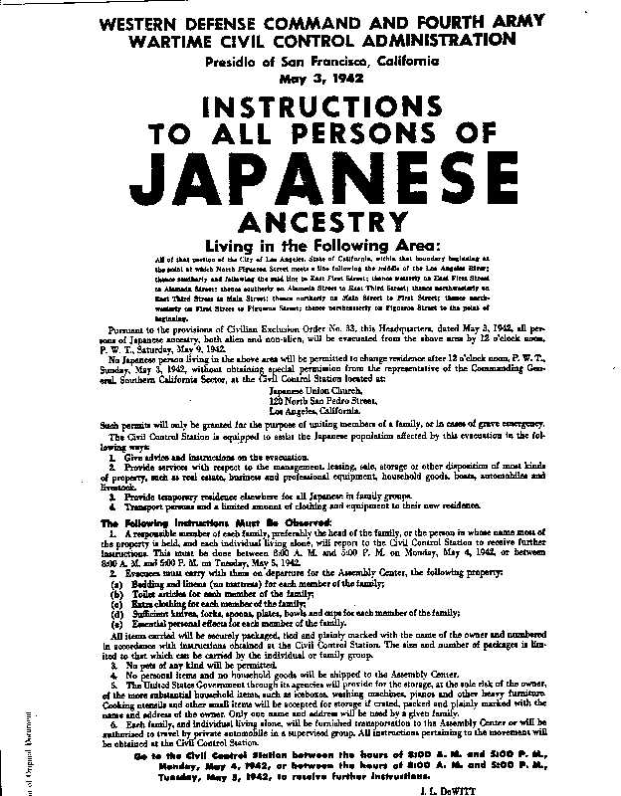
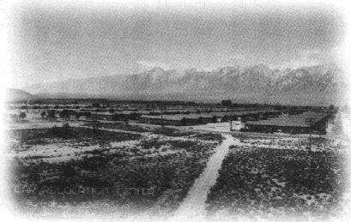
Analyze historiography of POV video
Manzanar War Relocation Center - Owens Valley, California

Slide 41
Korematsu v. United States (1944)
During World War II, Presidential Executive Order 9066 and congressional statutes gave the military authority to exclude citizens of Japanese ancestry from areas deemed critical to national defense and potentially vulnerable to espionage. Korematsu remained in San Leandro, California and violated Civilian Exclusion Order No. 34 of the U.S. Army.
Did the President and Congress go beyond their war powers by implementing exclusion and restricting the rights of Americans of Japanese descent?

Slide 42
Watch the documentary about Fred Korematsu
Analyze the historiography of the documentary:
Assumptions about the study of history
Methods
Explanations employed
2. What is successful about this history? What criticisms do you have?

Slide 43
Analyze one piece of evidence from the history of you or your family
What is it is origin?
What is its content? (description)
What purpose did it have for its author/creator?
What value does it have to the historian?
What limitations does it have for the historian?

Slide 44
Share in small groups family history evidence
Class presentations

Slide 45
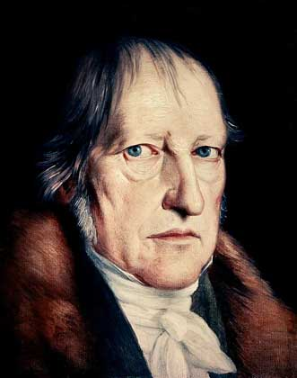
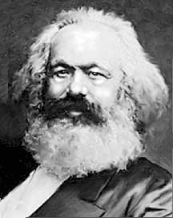
What drives history?
Idealistic vs. Material Explanations of History
Georg Wilhelm Friedrich Hegel
Karl Marx

Slide 46
Methodological Question
What kind of historical methodology is appropriate? What causal arguments are being made? Examples:
History as a procession of leaders: leadership matters
Social history: follow what the common person experienced, social movements matter
Oral history: emphasis on interviews, subjectivism
Documentary history: evidence matters

Slide 47
Best Practices for Historians
Know the paradigms that have been employed to study the subject under investigation.
Be aware of the paradigm that you are using and its strengths and weaknesses.
Subject your work to critical review by others.

Slide 48
History: Choices
Branches: Examples
Methods: Examples
Biographical
Political
Economic
Diplomatic
Intellectual
Women’s history
Ethnic History
Art history
Cultural
Document analysis
Oral history
Quantitative

Slide 49
Reflection for the IA
What methods are you using to address question?
What challenges do you face?
Validity questions
Biases
Significance
What are you learning about the study of history from your experience?

Slide 50
TOK Final
Think of an event that you observed or you experienced from which an epistemological (knowledge question) arose.
What is the question that struck you?
How did you answer the question?
Discuss one or more epistemological schools (skepticism, empiricism, rationalism, Kantianism, etc) that you used to address the question.
How well do you believe you addressed the question that you asked? How might you answer the question better in the future?
Final parameters: Typed, 300 to 600 words, MLA style, use references if citing particular philosophers, events, etc, individual assignment, upload to google classroom by June 5 1:00, 200 points (one grade lower per day, not accepted after Friday at 1:00)
You may ask each other for clarification about test, but you should not collaborate.

