Slide 1
“Several authors and editors I respect counseled me not to write the book as quickly as I did; they urged me to wait two or three years and put some distance between me and the expedition in order to gain some crucial perspective. Their advice was sound.”
--Jon Krakauer

Slide 2
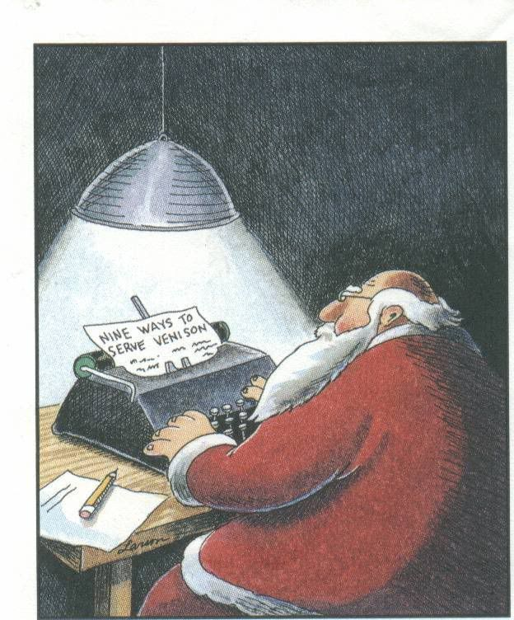

Slide 3
1. What does this cartoon say?
2. What clues in the picture tell you this?
3. Look closer at each detail. Does every detail add to the overall story of message of the picture?

Slide 4
For the following questions, answer on your sheet of paper and write down what you read in the text specifically that gave you your answer.

Slide 5
1. How many people died in the event Krakauer writes about?

Slide 6
2. What is the author’s stated purpose for going on this expedition to climb Mt. Everest?

Slide 7
Note: Questions 1 & 2 have answers that can be found in a specific place in the text. Giving specific facts are important for a writer of nonfiction.

Slide 8
3. What is the author’s main purpose for writing the book about his expedition to Mt. Everest?

Slide 10
4. What were the difficulties Krakauer encountered in writing the book?

Slide 11
Note: Questions 3 & 4 also have answers that can be found in the text, but the answer is broad and spread out over a number of different places. It is your job when reading to draw all of these pieces of information together (synthesize).

Slide 12
5. We learn by the end of the second paragraph of the introduction that several people died. In a novel (fiction) we likely wouldn’t learn the end result so early. Why is nonfiction different in that respect?

Slide 13
Note: Understand the purpose of nonfiction. It is not trying to fool you or trick you. It starts with something known and wants to expand on it in detail, hopefully shedding new light on a known topic.

Slide 14
6. What details tell you how Krakauer personally views the events he recalls for us?

Slide 15
7. With nonfiction you always have to factor in an author’s bias. That said, why might Krakauer’s perspective be a good one from which to view these particular events?

Slide 16
8. With nonfiction you always have to factor in an author’s bias. Why might Krakauer’s perspective not be a good one from which to view these events?

Slide 17
Note: Understand the purpose of the author. He or she wants to accomplish something, whether it is to bring new knowledge to a known subject, or to present a person or an event in a specific light. Whether intentional or unintentional, “nonfiction = objectivity” is not always the case.

Slide 18
9. “There were many, many fine reasons not to go, but attempting to climb Everest is and intrinsically irrational act – a triumph of desire over sensibility.”
Explain this quote.

