Slide 1
Fahrenheit 451 reading schedule: note the page numbers are different for different publications. The line in the parentheses tell you where to stop.
Due Monday: 3-14 – 7-18 (“They had this machine”)
2. 14-31 – 18-35 (“One two three four five six seven days: the firehouse”) * a few different times “1,2,3,…” starts paragraph
3. 31-48 – 35-52 (“He had chills and fever in the morning”)
4. 48-68 – 52-72 (end of Part I: The Hearth and the Salamander)
5. 71-93 – 73-95 (“He was eating a light supper at nine”)
6. 93-110 – 95-113 (end of Part II: The Sieve and the Sand)
7. 113-139 – 115-141 (“He was three hundred yards downstream”)
8. 139-165 – 141-167 (end of Part III: Burning Bright)
I will get you the rest of the due dates Monday.

Slide 2
1. If you didn’t have to be at school today, and in fact did not ever have to come to school at all, what most likely would you be doing right now?

Slide 3
2. What would your life be like if all you had to do was have fun – if that were your sole “obligation”?

Slide 4
3. What kind of society would we have if all anyone ever had to do was have fun? Explain your answer.

Slide 5
4. What sort of progress would our society or our world see, if that were the case?

Slide 6
5. What if it wasn’t your definition of fun that you had to live by, but someone else’s definition, and their definition was much different than yours?

Slide 7
1. If you didn’t have to be at school today, and in fact did not ever have to come to school at all, what most likely would you be doing right now?

Slide 8
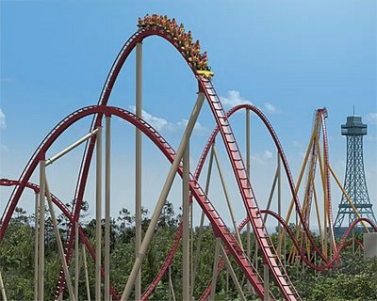
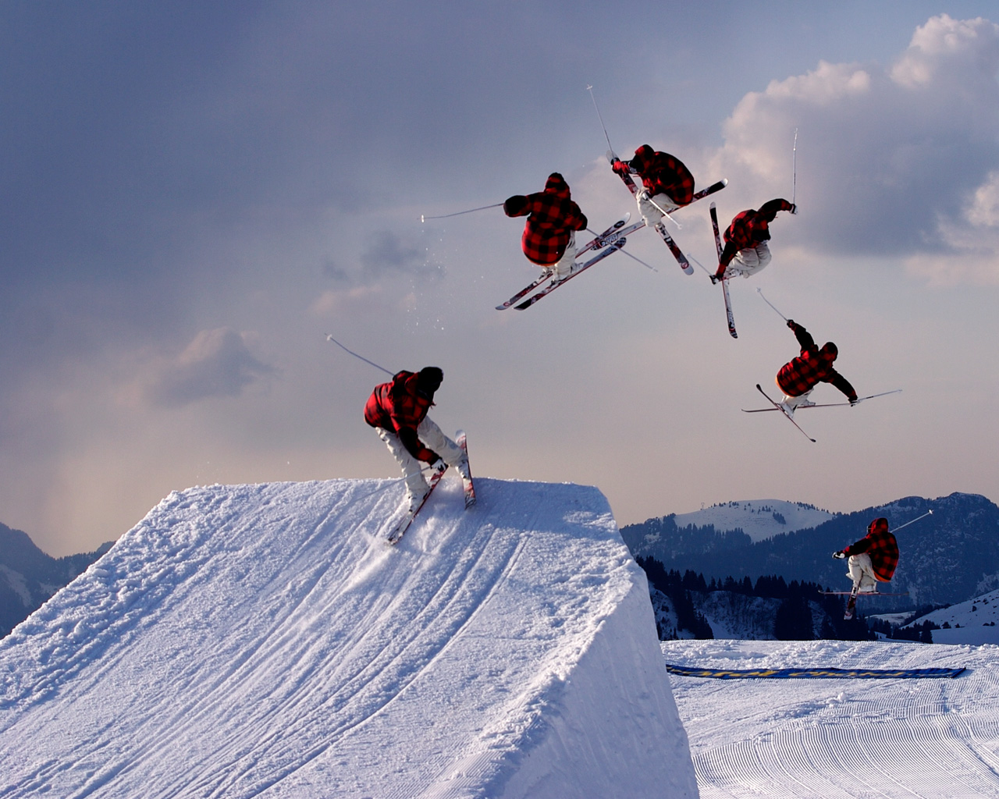
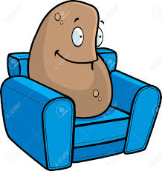
2. What would your life be like if all you had to do was have fun – if that were your sole “obligation”?

Slide 9
Orwell: “Nearly all creators of Utopia have resembled the man who has toothache, and therefore thinks happiness consists in not having toothache. They wanted to produce a perfect society by an endless continuation of something that had only been valuable because it was temporary.”

Slide 10
Q. Are you happy?
A. Very happy. Perfectly happy.
Q. How do you amuse yourself?
A. Conversation with friends, and other spirits.
Q. What else?
A. Nothing else. Nothing else is necessary.
Q. What do you talk about?
A. About how happy we are; and about friends left behind in the earth, and how to influence them for their good.
Q. When your friends in the earth all get to the spirit land, what shall you have to talk about then?–nothing but about how happy you all are?
No reply. It is explained that spirits will not answer frivolous questions.
Q. How is it that spirits that are content to spend an eternity in frivolous employments, and accept it as happiness, are so fastidious about frivolous questions upon the subject?
No reply.

Slide 11
3. What kind of society would we have if all anyone ever had to do was have fun? Explain your answer.

Slide 12
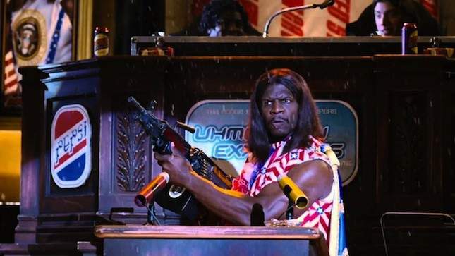
4. What sort of progress would our society or our world see, if that were the case?

Slide 13
5. What if it wasn’t your definition of fun that you had to live by, but someone else’s definition, and their definition was much different than yours?

