Slide 1
Choose 3 historical events: U.S. history or world history from 1980’s or earlier.
The space shuttle Challenger explosion (specific)
The Vietnam War (general)
D-Day (general)
Choose 3 historical figures – dead people only.
George Washington
Joan of Arc
Martin Luther King, Jr.
*Topics may not be about or related to pop stars, movie stars, or sports stars.*

Slide 2
The topic and book you choose now will be related to your topic later. That later topic will become your paper’s focus.
I will need to approve all topics and books.
Dates:
Have topic settled by this Friday, 4/7
Have book in hand by next Friday, 4/14
Have book finished by Friday, 4/28

Slide 3
You will create, research, and write a thesis based on your topic.
→ Into Thin Air
→ Preparing for the journey
→ Thesis: Preparation for the climb is as difficult as the climb itself.

Slide 4
Some things to consider:
Is there enough out there on my topic?
Is this a topic I can narrow down to something more specific?
Is this a topic that can lead to a thesis (an arguable opinion) in some way?
Is this a topic I am willing to spend a good amount of time on?

Slide 5
More things to consider:
Can you get the book in time?

Slide 6
Consider:
Can you afford the book?

Slide 7
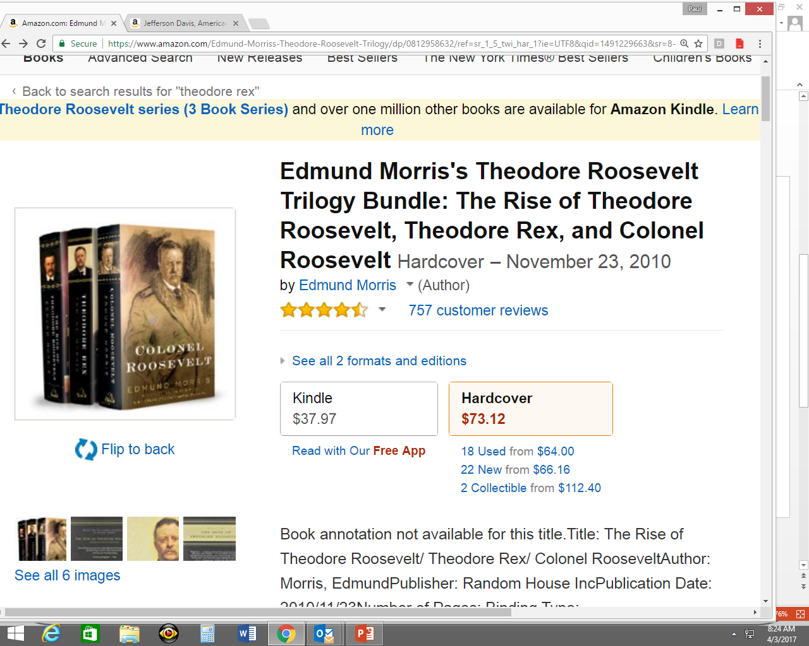

Slide 8
Consider:
If you will get it from a library, will you receive it in time?

Slide 9
Consider:
Can you have it read in time?

Slide 10
