Slide 1
Selected Slides for the Constitution Unit

Slide 2
The California Constitution
The California People: Initiatives, Referendum and Recall
Plural Executive
Governor
Lieutenant Governor
Attorney General
Secretary of State
Insurance Commissioner
Superintendent of Public Instruction
Treasurer
Controller
State Legislature
State Assembly(80)
State Senate (40)
State
Supreme
Court (7)
Term limit of 12 yrs
total in one or both
Bodies (Prop 28, June 2012)
Notes:
Quackenbush

Slide 3
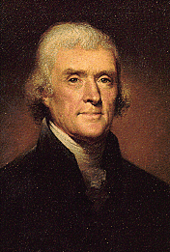
The Declaration of Independence
We hold these truths to be self-evident, that all men are created equal, that they are endowed by their Creator with certain unalienable Rights, that among these are Life, Liberty and the pursuit of Happiness. --That to secure these rights, Governments are instituted among Men, deriving their just powers from the consent of the governed, --That whenever any Form of Government becomes destructive of these ends, it is the Right of the People to alter or to abolish it, and to institute new Government, laying its foundation on such principles and organizing its powers in such form, as to them shall seem most likely to effect their Safety and Happiness.

Slide 4
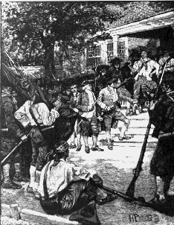
Shays’ Rebellion
Rebellion (1786-87) in Massachusetts against Courts to prevent trial and imprisonment of debtors.
Led by Daniel Shays, revolutionary war hero.

Slide 5
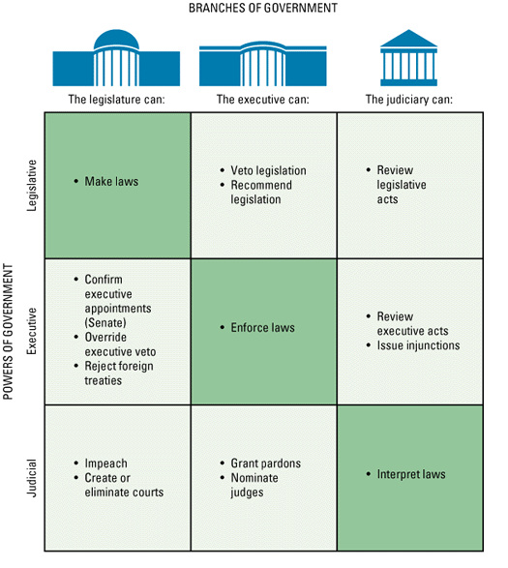
Separation of Powers creates Checks and Balances Consequence: A System of “Shared Powers”

Slide 6
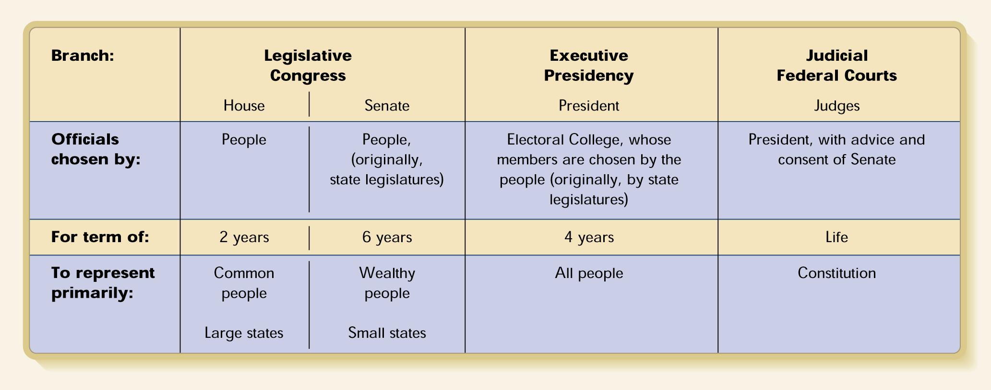
Figure 2.1 Separation of Powers
Separation of powers, as envisioned by the Founders, means not only that government functions are to be performed by different branches but also that officials of these branches are to be chosen by different people, for different terms, and to represent different constituencies.

Slide 7
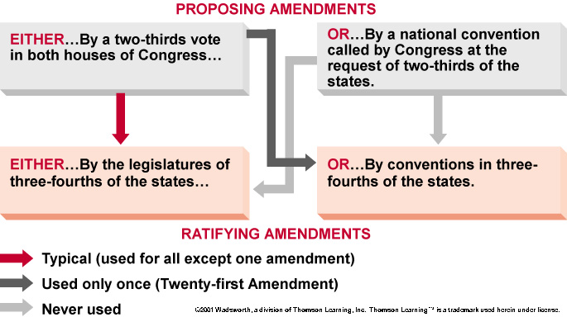
The Formal Constitutional Amending Procedure

