Slide 1
The End of Apartheid
1976-1994

Slide 2
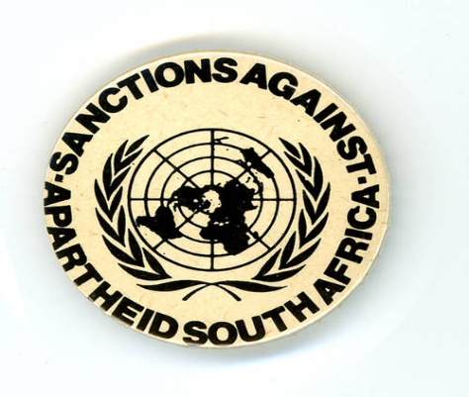
Factors that led to change
Internal Factors
Immense amounts of violence
External Factors
Isolation from international community
Expelled from Olympic Movement
Suspended from the General Assembly sessions of the UN
Growing overseas support for international anti-apartheid movement’s call for sporting, academic and cultural boycotts
Economic sanctions

Slide 3
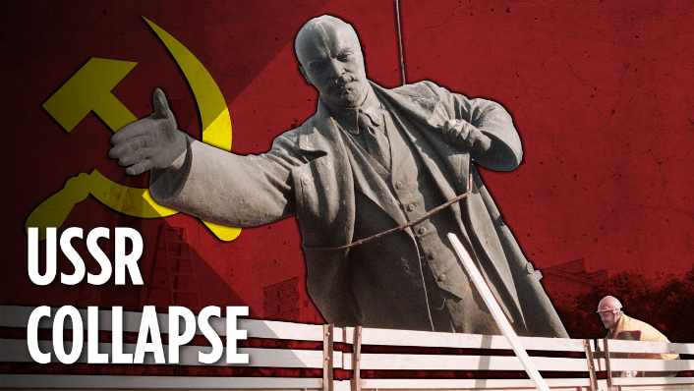
Factors that led to change
External Factors
Collapse of the Soviet Union
Lost support from Western leaders (Thatcher and Reagan) who has been reluctant to issue sanctions due to perceived value in fight against Communism
ANC lost backing from its strongest supporter, USSR

Slide 4
New Constitution
State cracked down in order to crush opposition
Banned Black Consciousness organizations
Police given power to imprison suspects indefinitely without a trial
New Constitution in 1983
Tricameral Parliament
Separate house for Coloured and Indians to have representation
Other two house retained most of the power
Africans still totally excluded

Slide 5
Opposition to Constitution
New Constitution spurred protests and anger
United Democratic Front (UDF) formed
Number of organizations joined together to form a non-racial org.
Membership of 3 million
Organized boycotts and work stayaways
UDF urged people to reject the Constitution
Fewer than 20% of coloured and Indian voters took part in election in 1984

Slide 6
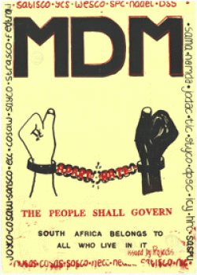
Increased Turmoil
Government declared a state of emergency to patrol townships which had erupted after the passage of the Constitution
Thousands were killed by police and army, but protests continued
1989: UDF and Congress of South African Trade Unions (COSATU) formed the Mass Democratic Movement (MDM)
Launched a nationwide defiance campaign to put more pressure on the govt.
Govt responded with no action...

Slide 7
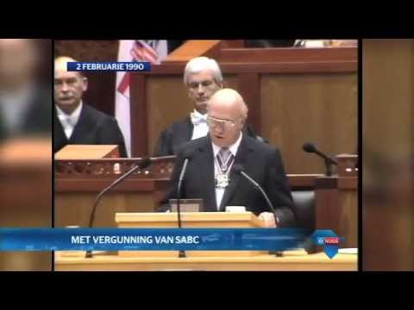
Breakthrough: 1990
February 2, 1990 F.W. de Klerk announced
Unbanning of ANC and other parties
Unconditional release of political prisoners
Suspension of death penalty
Willingness to negotiate with ANC and other groups to create a democratic constitution
Nelson Mandela was release from prison, opposition leaders returned from exile, negotiations began

Slide 8
Constitutional Debates
ANC wants | Government Wants
Majority rule | Some form of power-sharing that would protect ‘minority interests’
New constitution created by a democratically elected assembly | National Party to play a leading role in the decisions about a new constitution

Slide 9
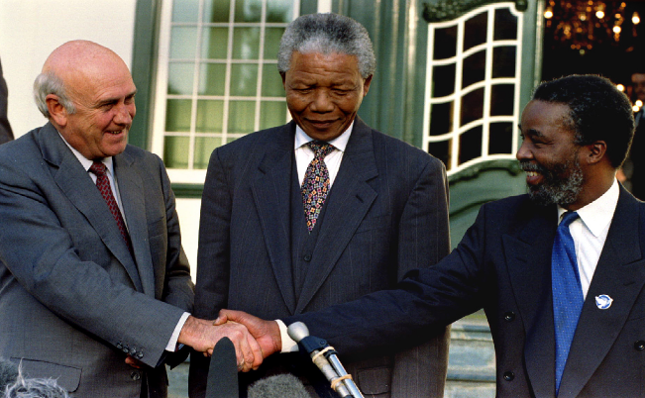
Constitutional Debates
December 1991, formal negotiations at a multiparty conference
Convention for a Democratic South Africa (CODESA)
Compromised and made the drawing up of a constitution a two-stage process

Slide 10
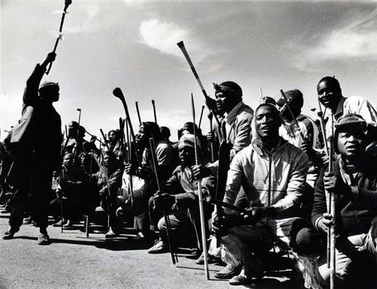
Violence halts progress
Negotiations broke down several times due to violence between 1990-1994
Protestors in the township of Sebokeng were shot by police (April 1990)
Inkatha supporters aided by police helped attack ANC members attending a funeral (1992)

Slide 11
Government of National Unity
Western govts. put pressure on to resume talks, UN sent observers to investigate the violence
Govt. agreed to release more prisoners and to ban use of traditional weapons at Inkatha rallies
ANC agreed to a govt. of ‘national unity’, which would include the National Party, for the first 5 years
1993-94: more violence to prevent a peaceful settlement

Slide 12
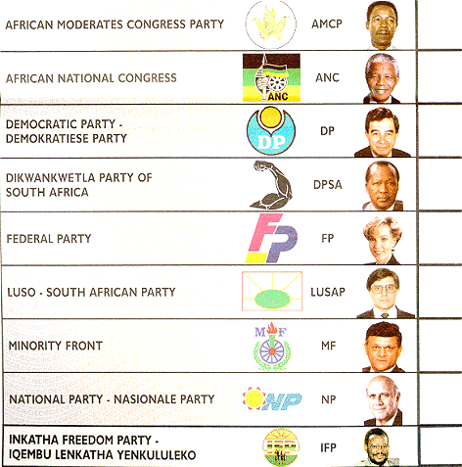
Democratic elections 1994
The first democratic election in which all South Africans over the age of 18 could vote was held
April 27-29, nearly 20 million people participated
Party | Number of votes | % of votes
ANC | 12,237,655 | 62.65
NP | 3,983,690 | 20.39
IFP | 2,058,294 | 10.54
FF | 424,555 | 2.17
DP | 338,426 | 1.73
PAC | 243,478 | 1.25

Slide 13
Attacking Apartheid
Truth and Reconciliation Commission (1996)
Led by Archbishop Desmond Tutu
Brands apartheid a crime against humanity
Also finds the ANC accountable for human rights abuses

