Slide 1
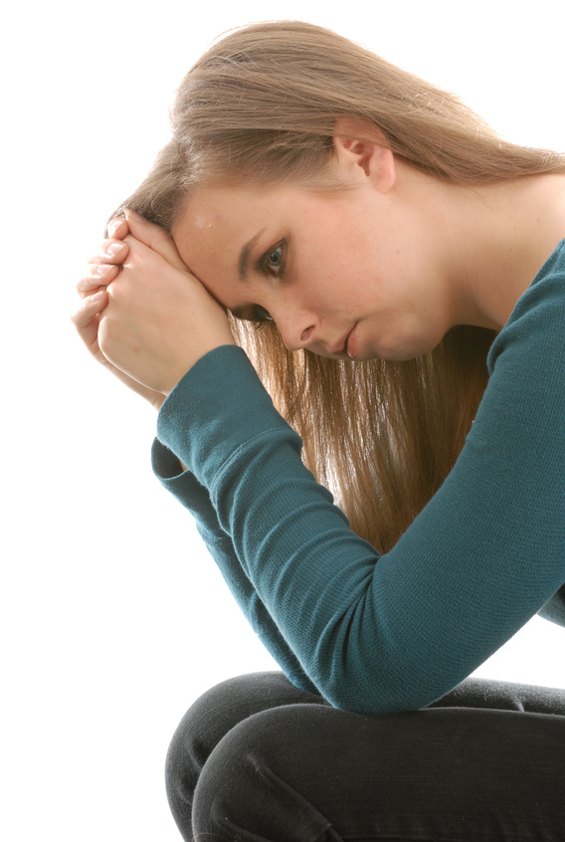
Despondent

Slide 2
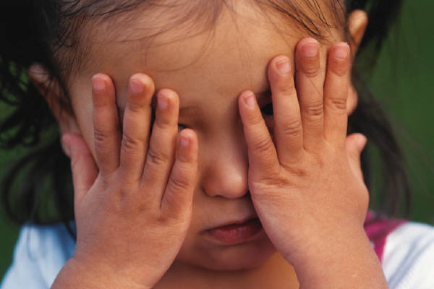
Despondent

Slide 3
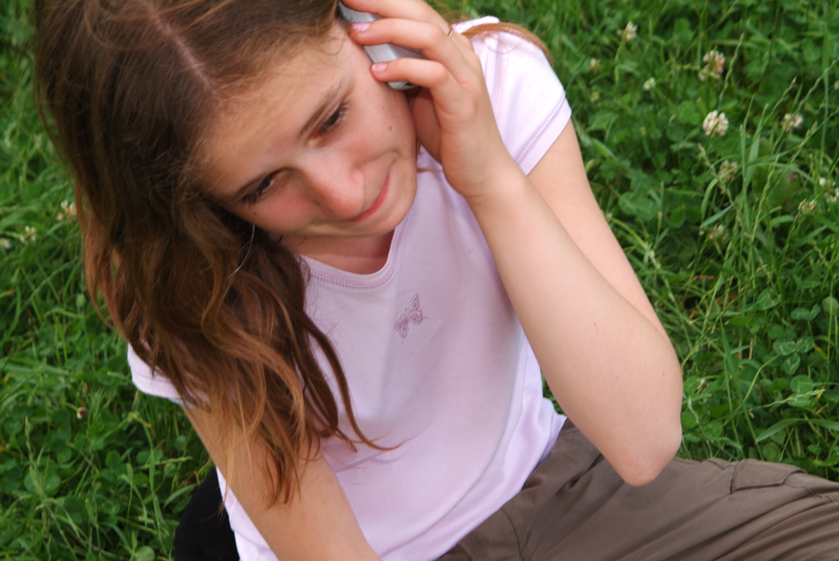
Despondent

Slide 4
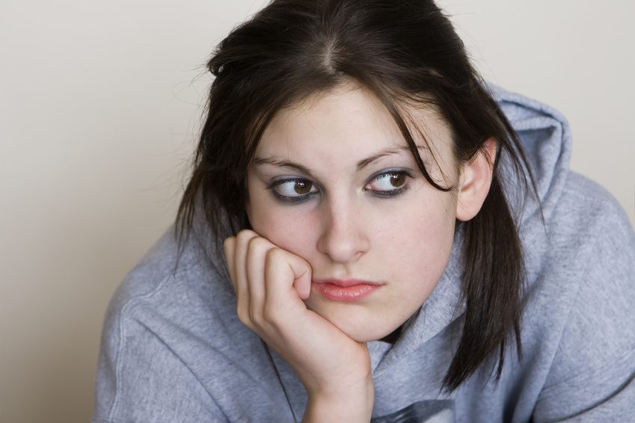

Despondent - (adj) [dih-spon-duhnt] depressed; gloomy
by Vic

Slide 5
Devious

Slide 6
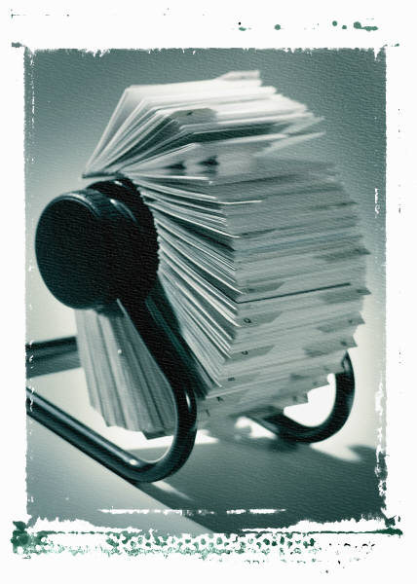
Devious

Slide 7
Devious

Slide 8
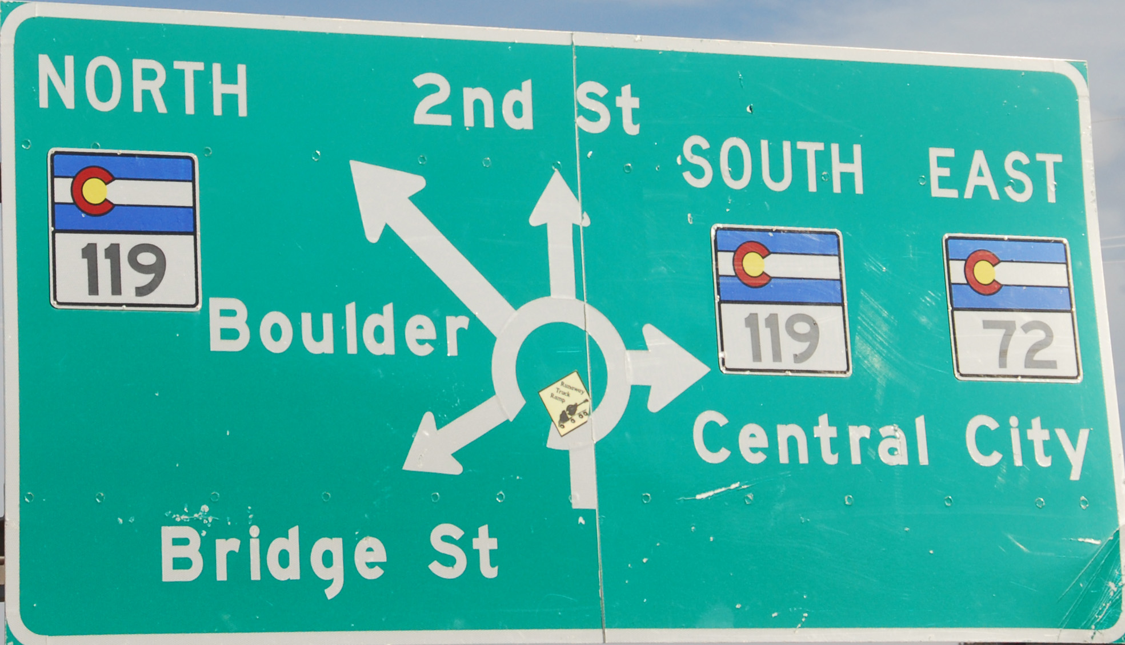

Devious – (adj) [dee-vee-uhs] roundabout; erratic; not straightforward
by Eric Kilby

Slide 9
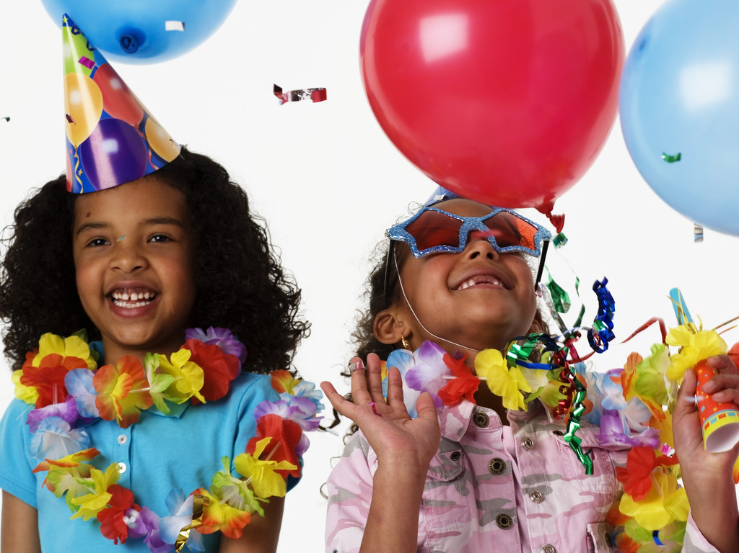
Exuberance

Slide 10
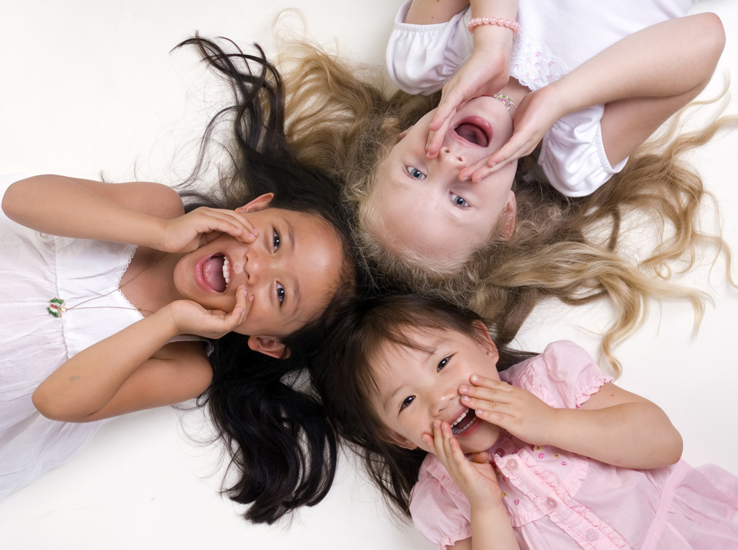
Exuberance

Slide 11
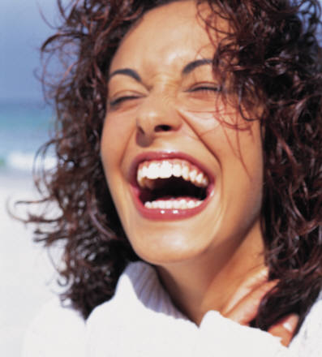
Exuberance

Slide 12
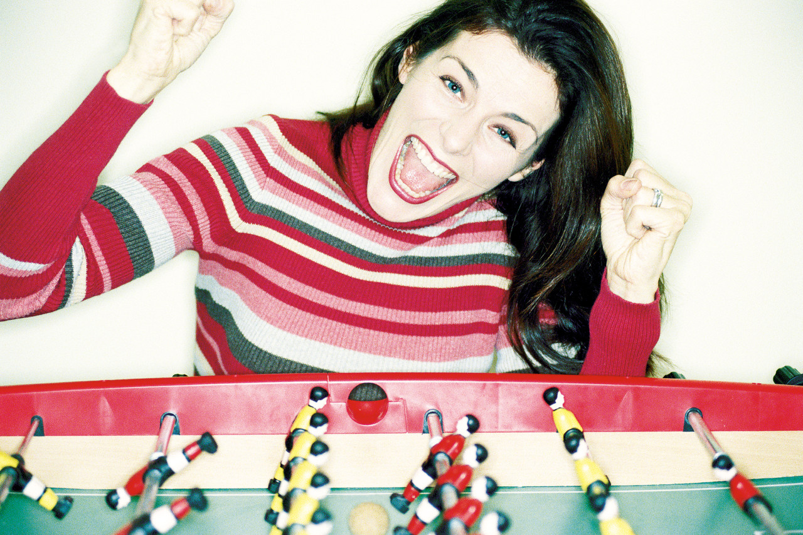
Exuberance – (n) [ig-zoo-ber-uhns] overflowing abundance; joyful enthusiasm

Slide 13
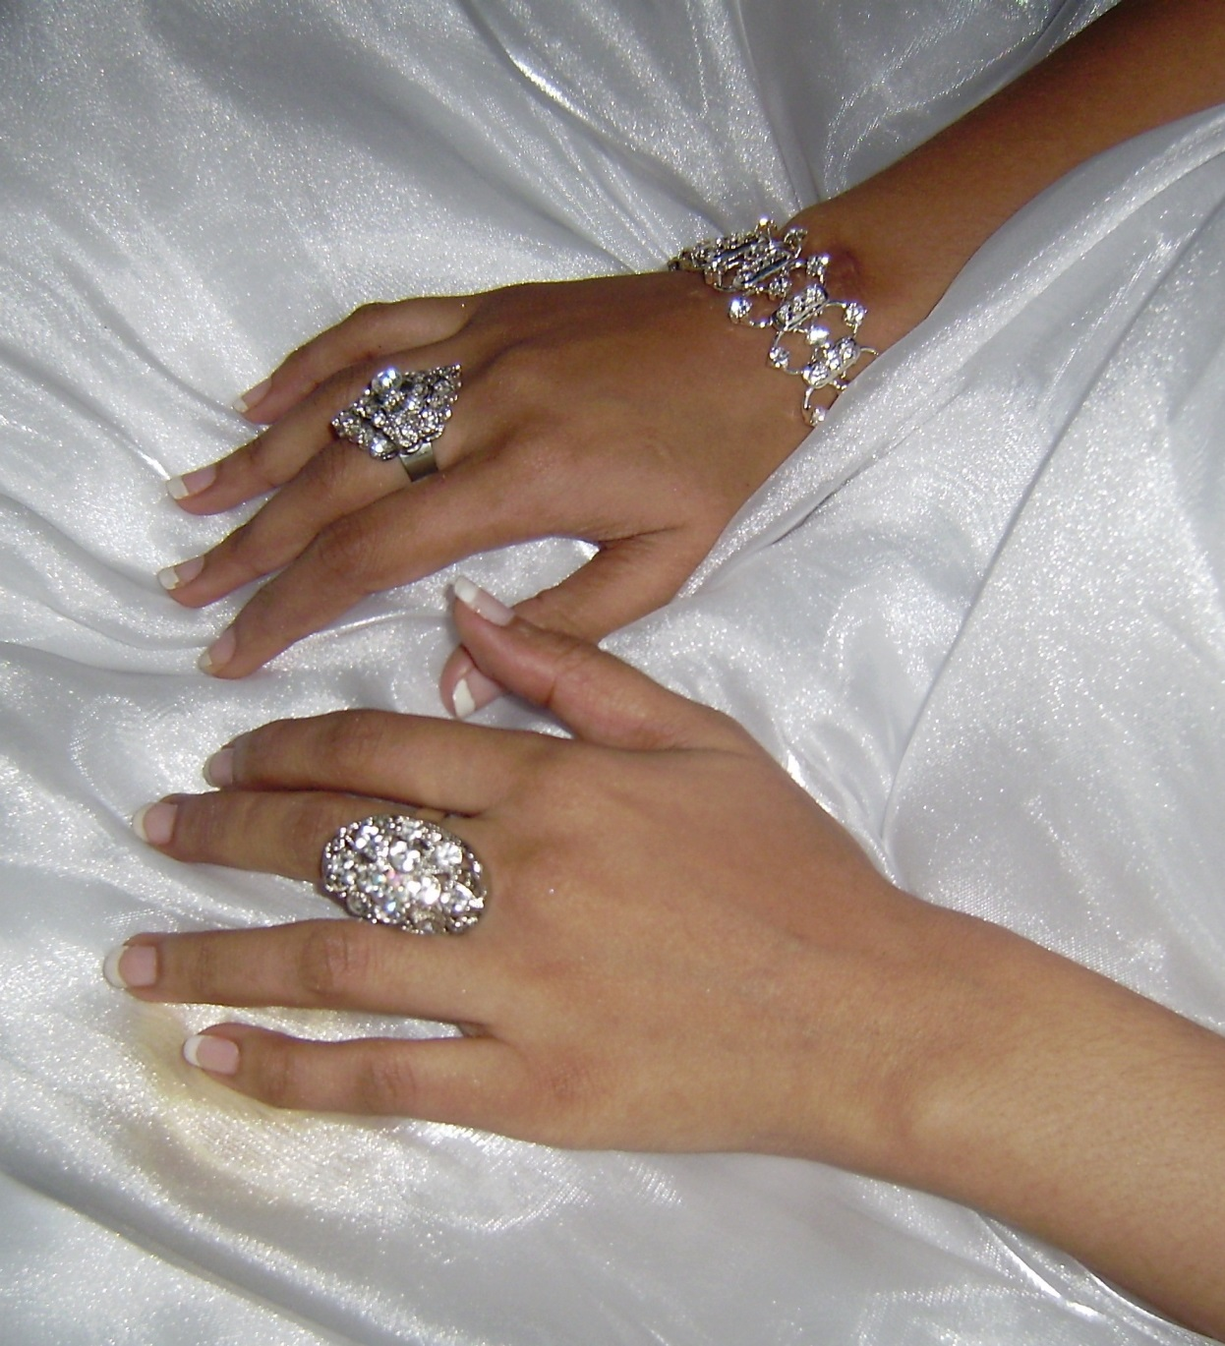
Ostentatious
by Ai-mee

Slide 14
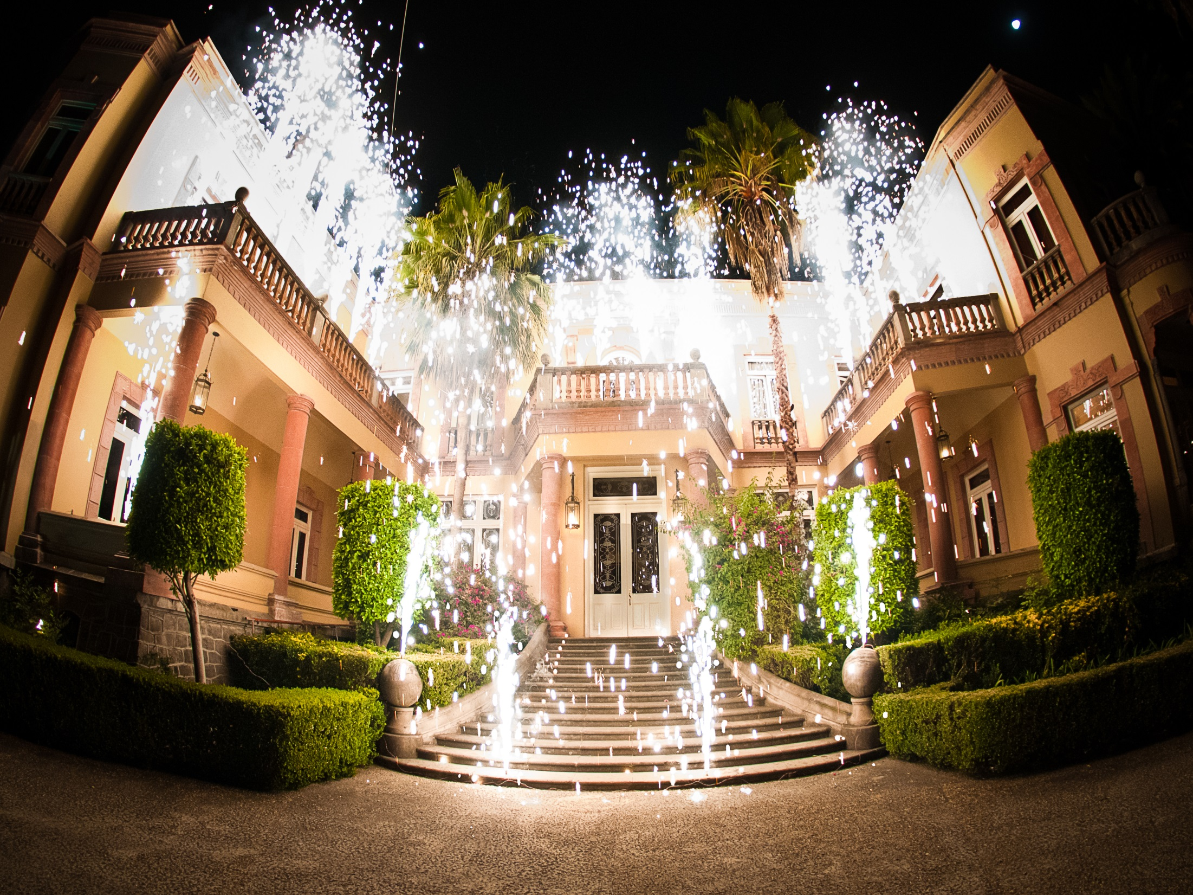
Ostentatious
by Eneas

Slide 15
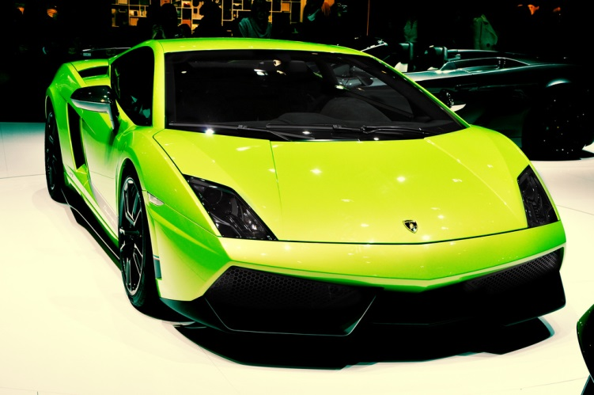
Ostentatious
by Design By Zouny

Slide 16
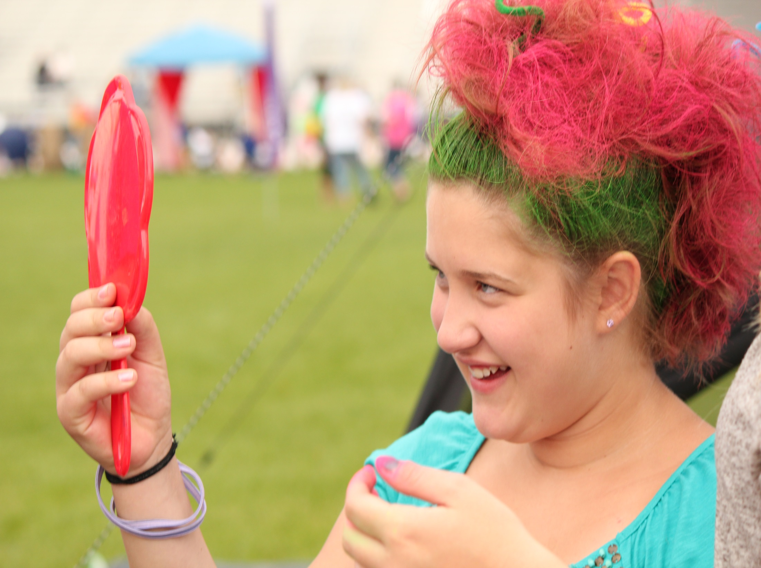
Ostentatious – (adj) [òss ten táysh'] showy; pretentious; trying to attract attention
by Lindsey Gira

