Slide 1
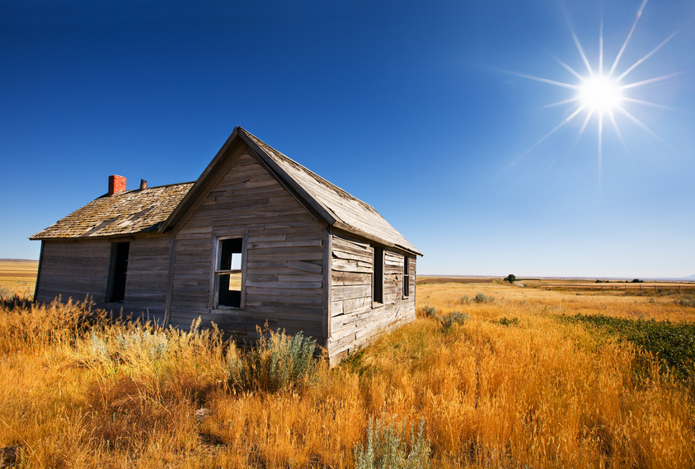
Abandon

Slide 2
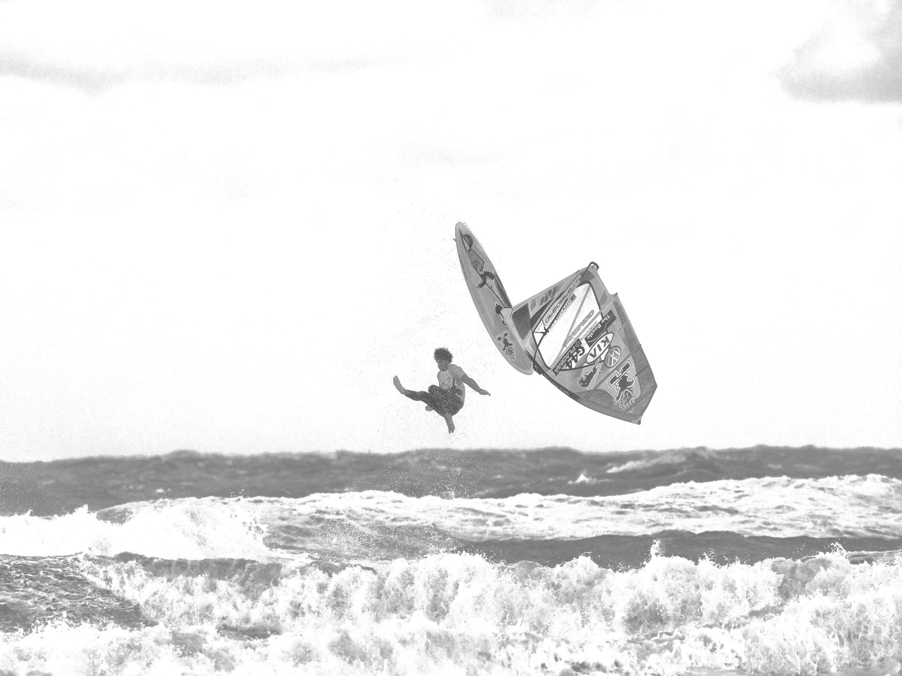
Abort
by Cold Hawaii World Cup

Slide 3
Abstract

Slide 4
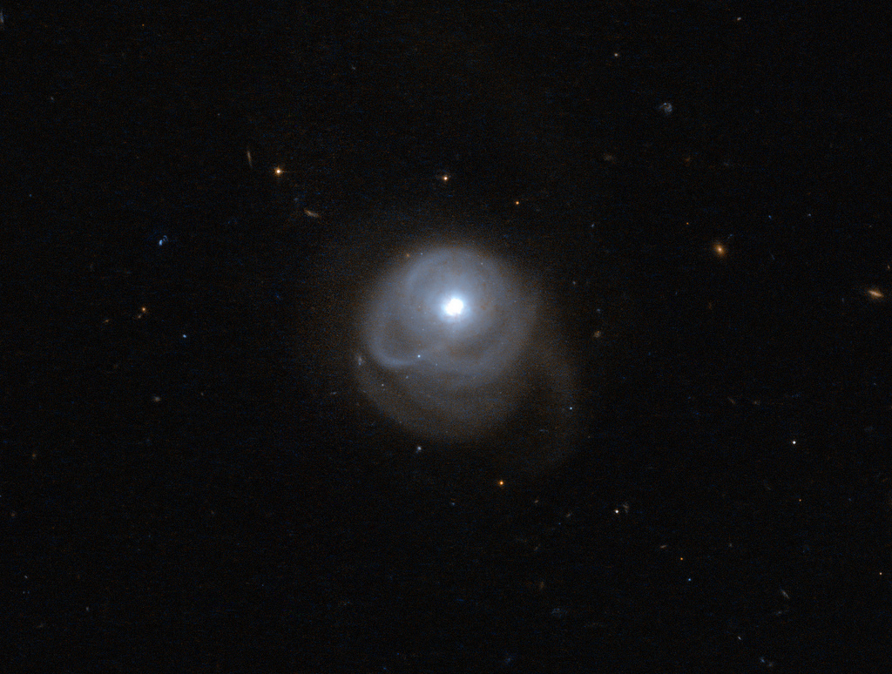
Ab = from, away, off.
by Hubble Space Telescope/ESA

Slide 5
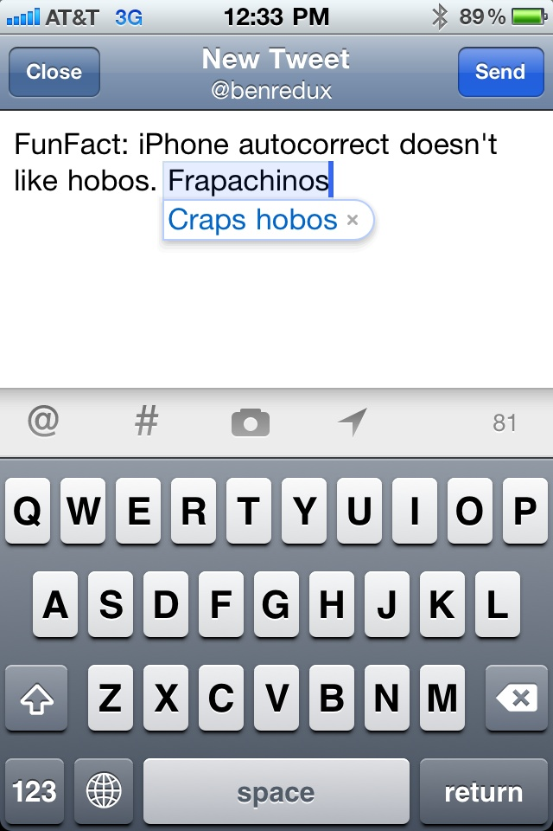
Autocorrect
by Benjamin Forrest

Slide 6
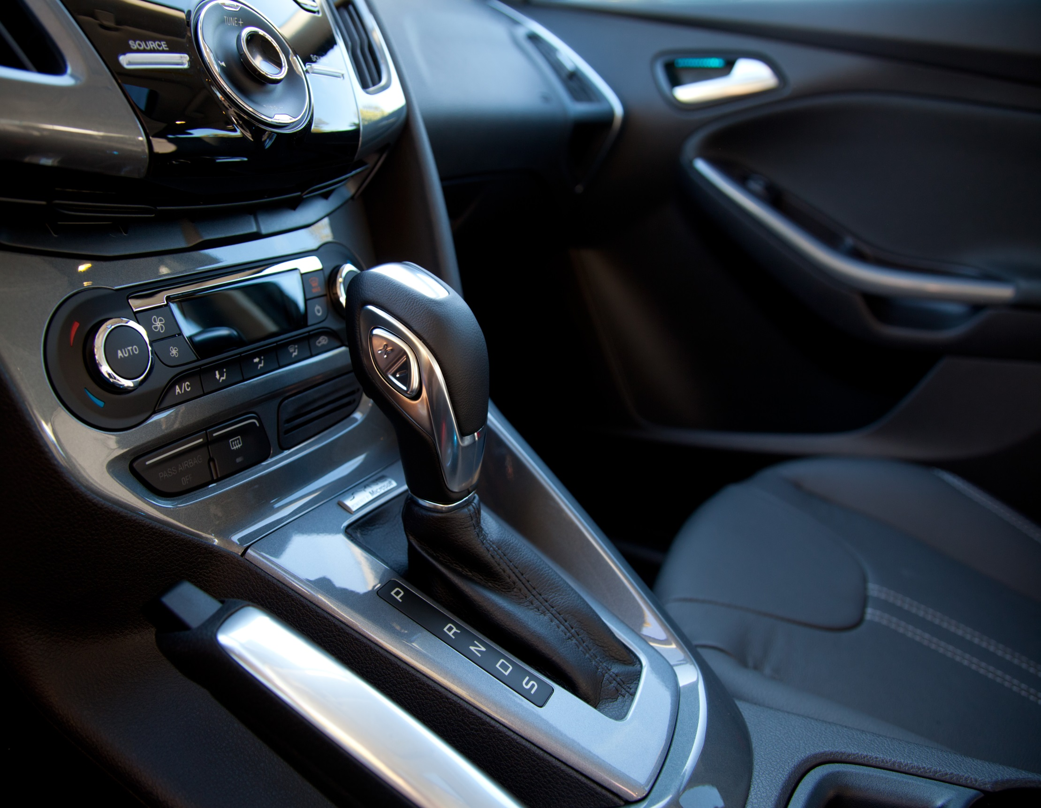
Automatic
by Robert Couse-Baker

Slide 7
Autograph
by Ardyiii

Slide 8
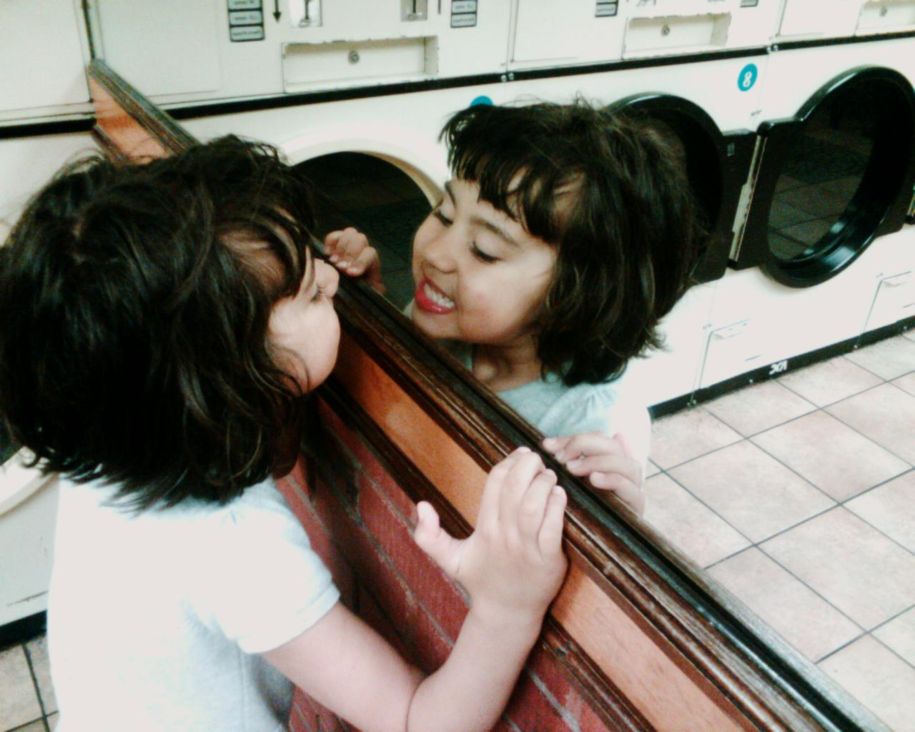
Auto = self, same, one.
by edenpictures

Slide 9
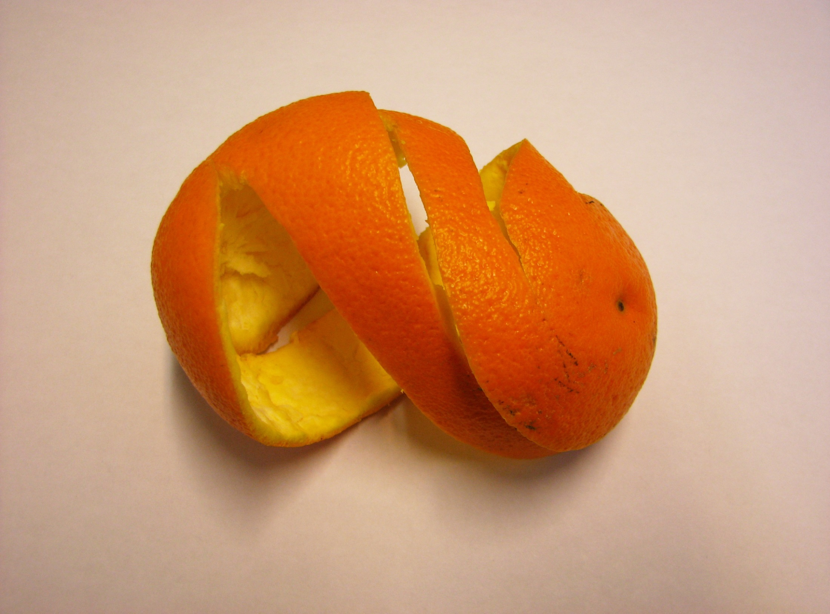
Pericarp
by fdecomite

Slide 10
Periodontal
by otfrom

Slide 11
Perimeter
by Gila Forest
by Vic

Slide 12
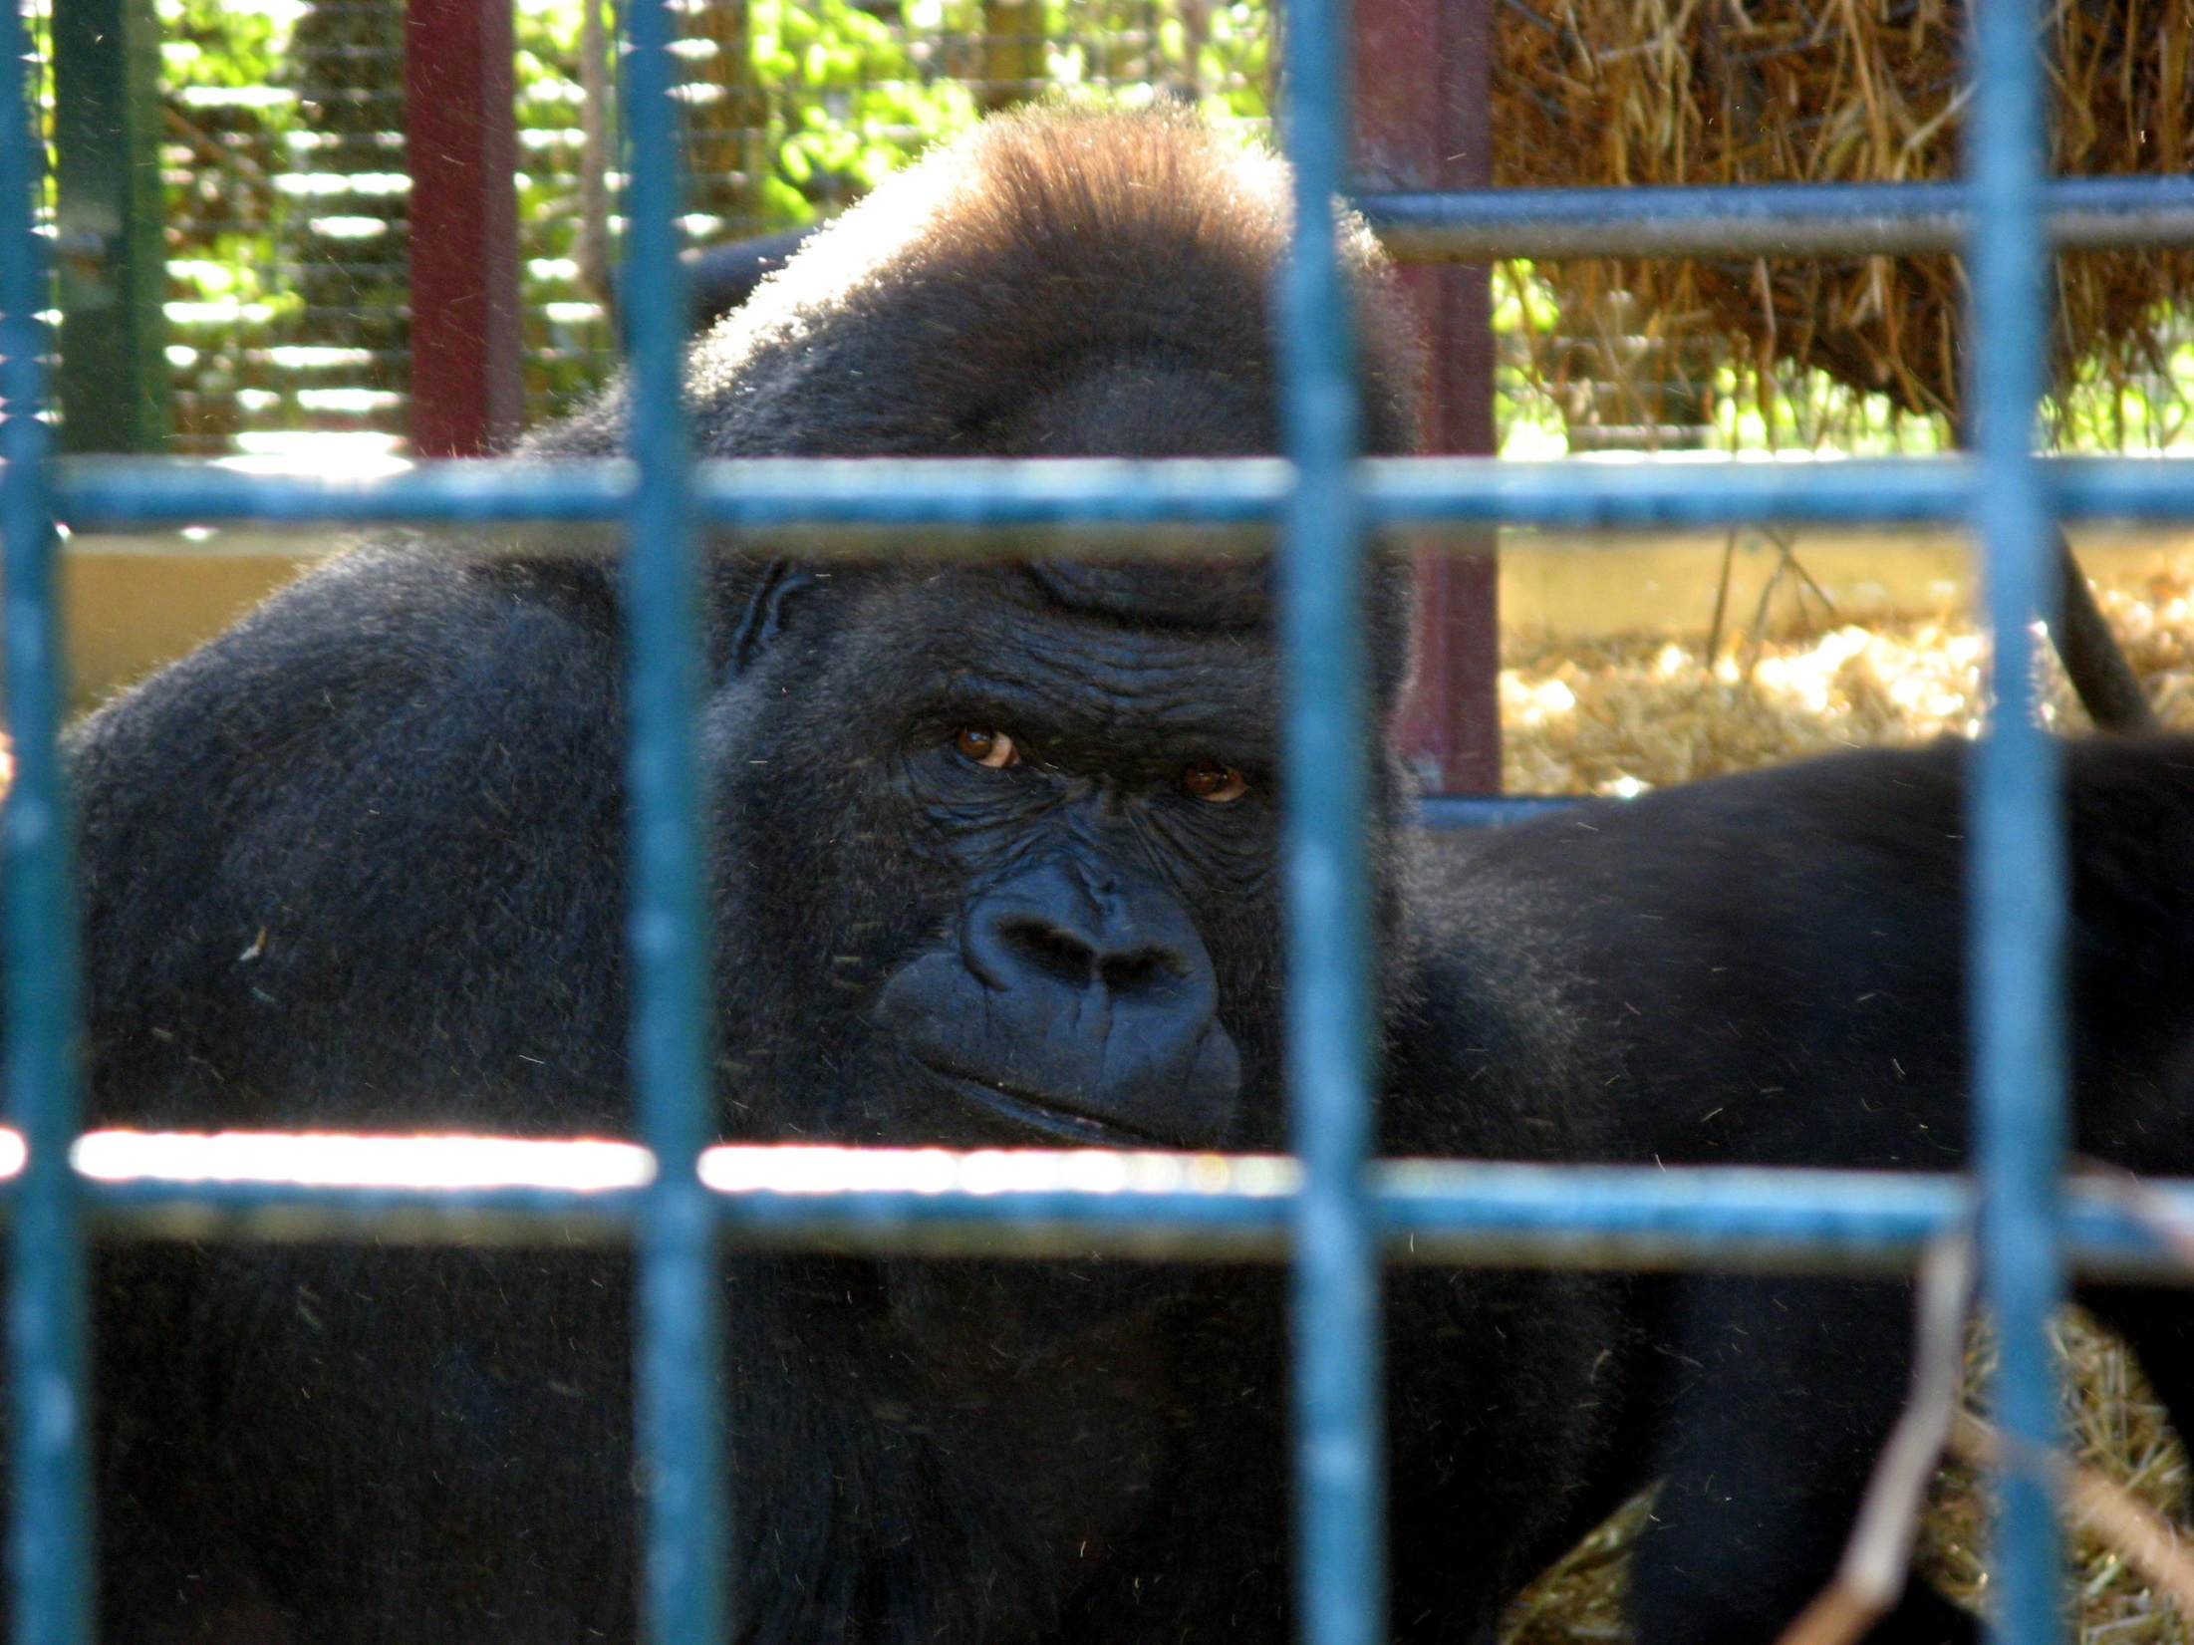
Peri – around, enclosing.
by suvodeb

Slide 13
Verbal

Slide 14
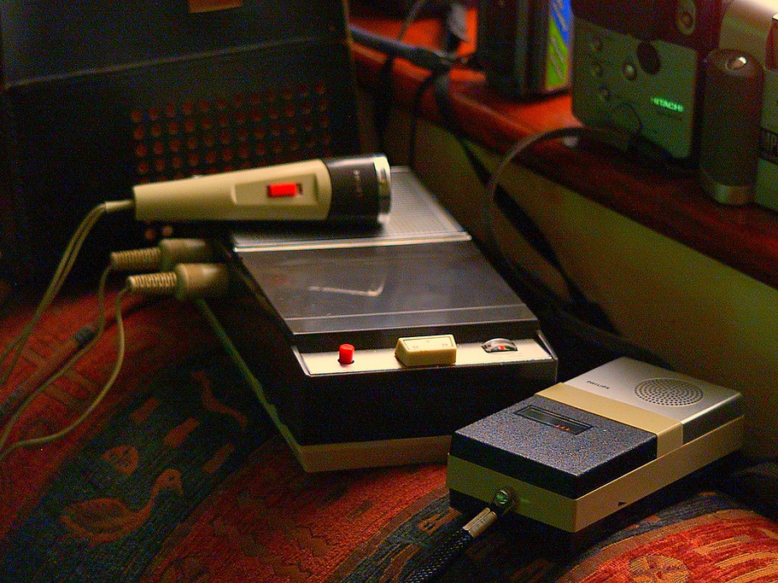
Verbatim
by spoondooley

Slide 15
Proverb
by thinboyfatter

Slide 16
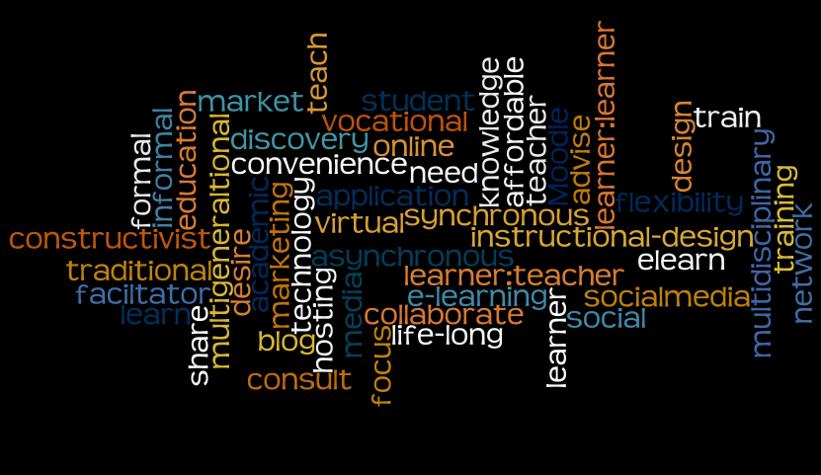
Verb = word
by couchlearner

