Slide 1
Week 20 Vocabulary

Slide 2
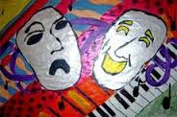
ambivalence
State of having contradictory or conflicting emotional attitudes

Slide 3
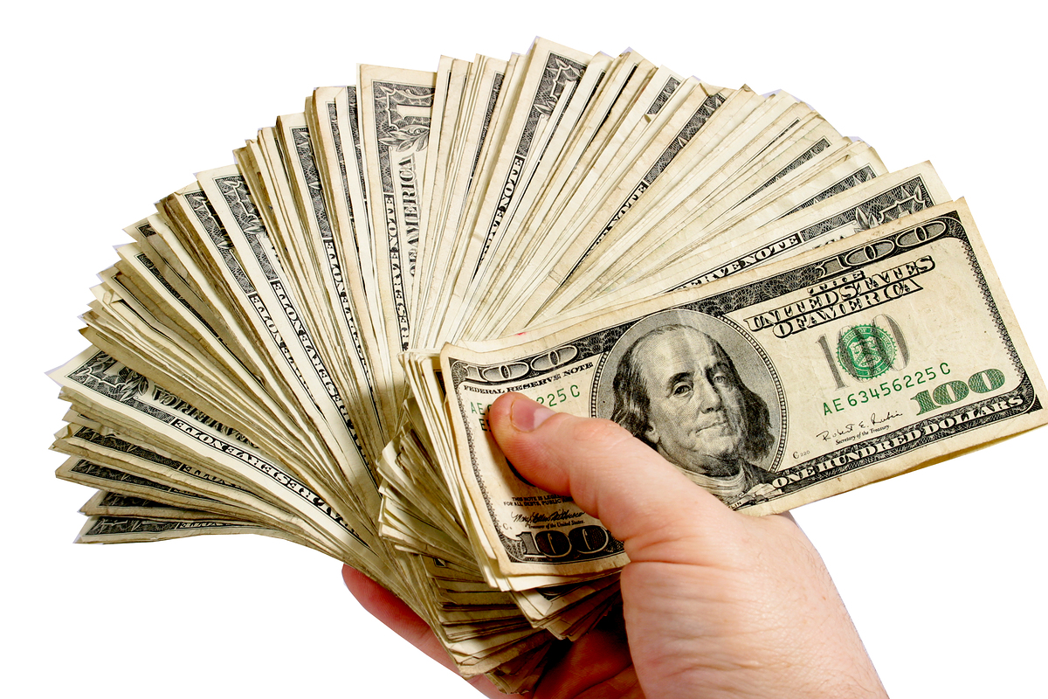
appraise
To estimate the monetary value of; determine the worth of; assess, to estimate the nature, quality, importance

Slide 4
conflagration
Great fire

Slide 5
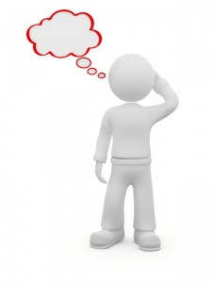
provincial
Limited in outlook; unsophisticated

