Slide 1
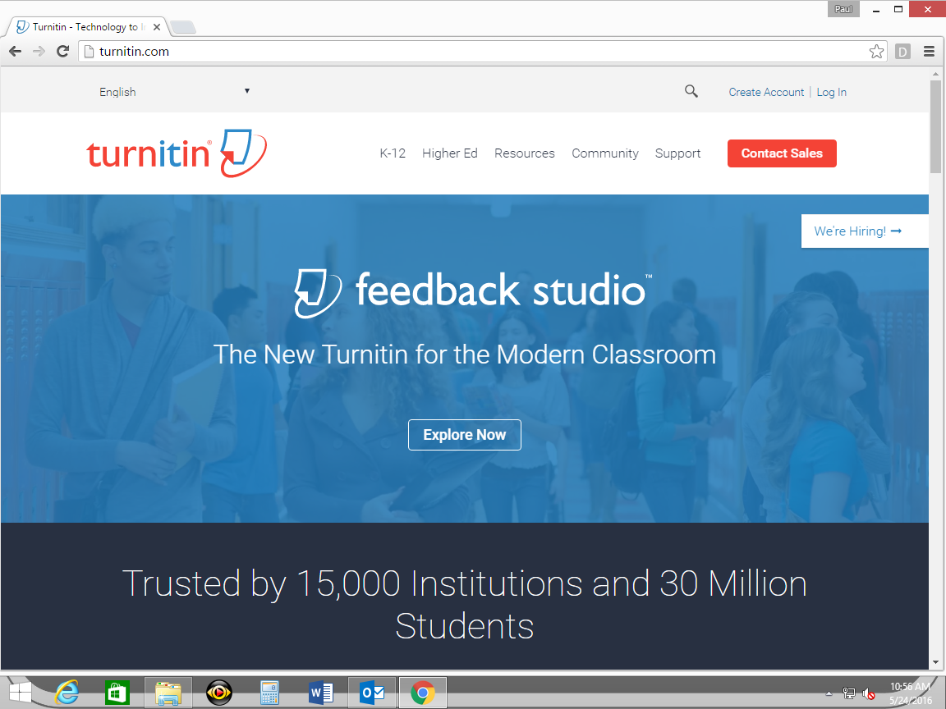

Slide 3
If you have used Turn It In before:

Slide 4
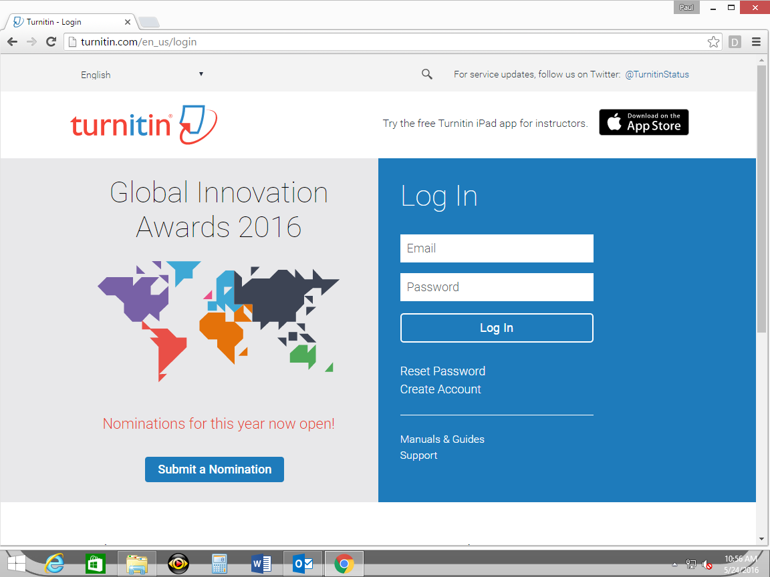

Slide 5
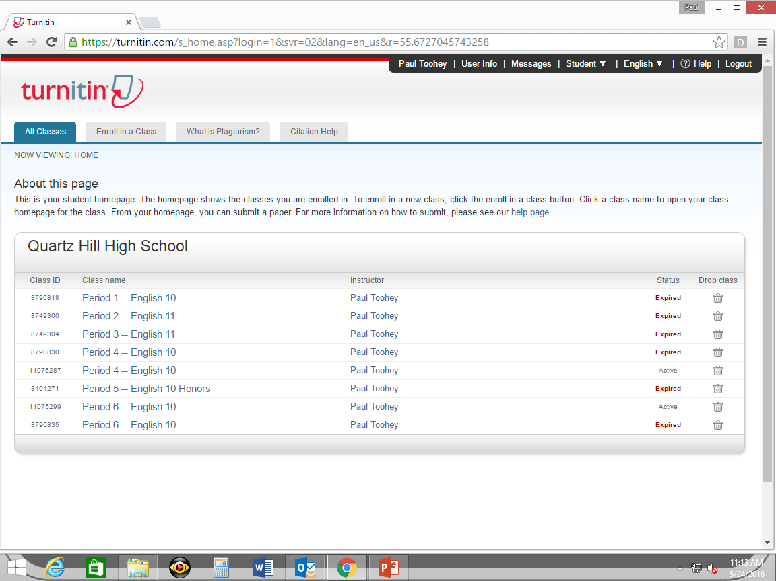
“Enroll in a class”
}
List of current classes;
find your class

Slide 6
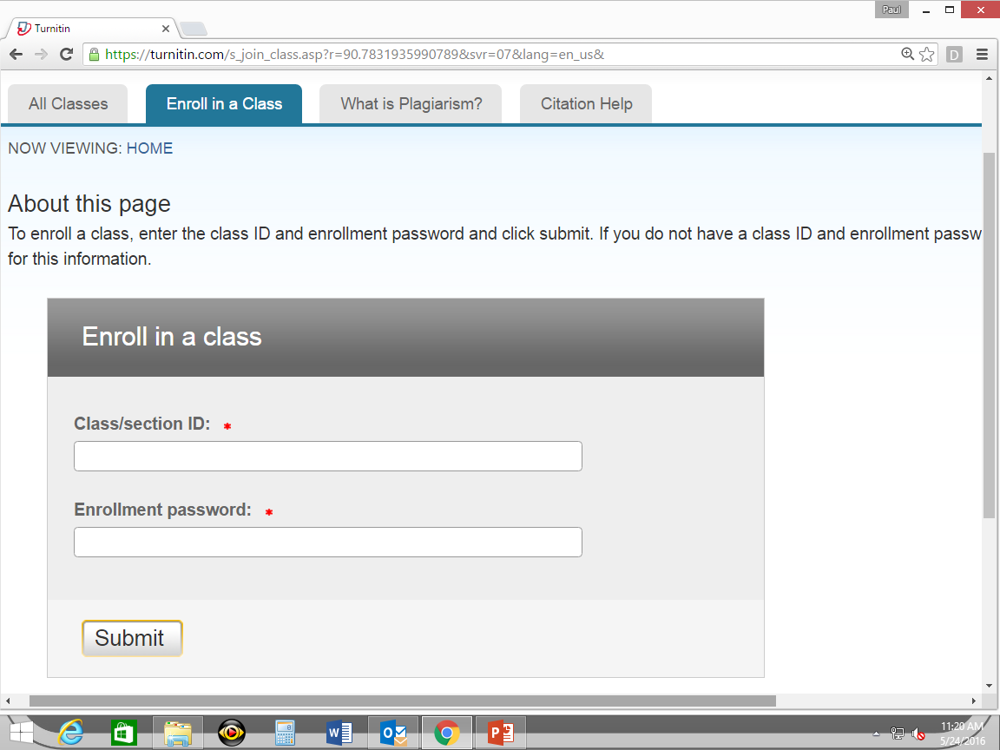
Period 4: 11075287
Period 6: 11075299
Period 4: period4
Period 6: period6

Slide 7
At this point, submit your paper and you’re done (we will get to that process shortly).

Slide 8
If you have NEVER used Turn It In before:

Slide 10
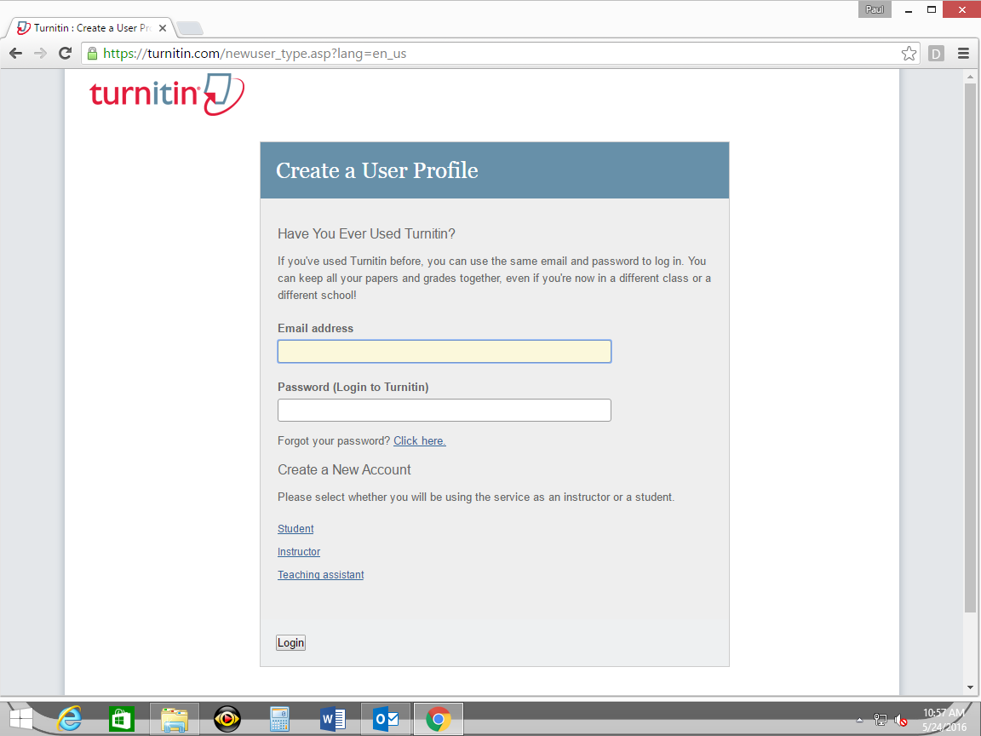

Slide 11
X

Slide 12
“Student”

Slide 13
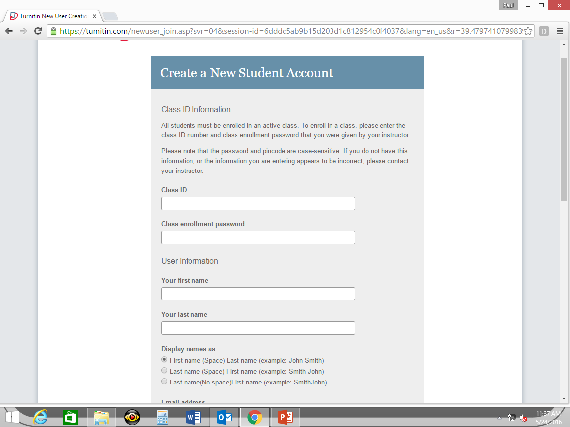
Period 4: 11075287
Period 6: 11075299
Period 4: period4
Period 6: period6
Scroll down to fill in the rest of the information, then click “I agree – create profile”

Slide 14
}
List of current classes;
find your class

Slide 15
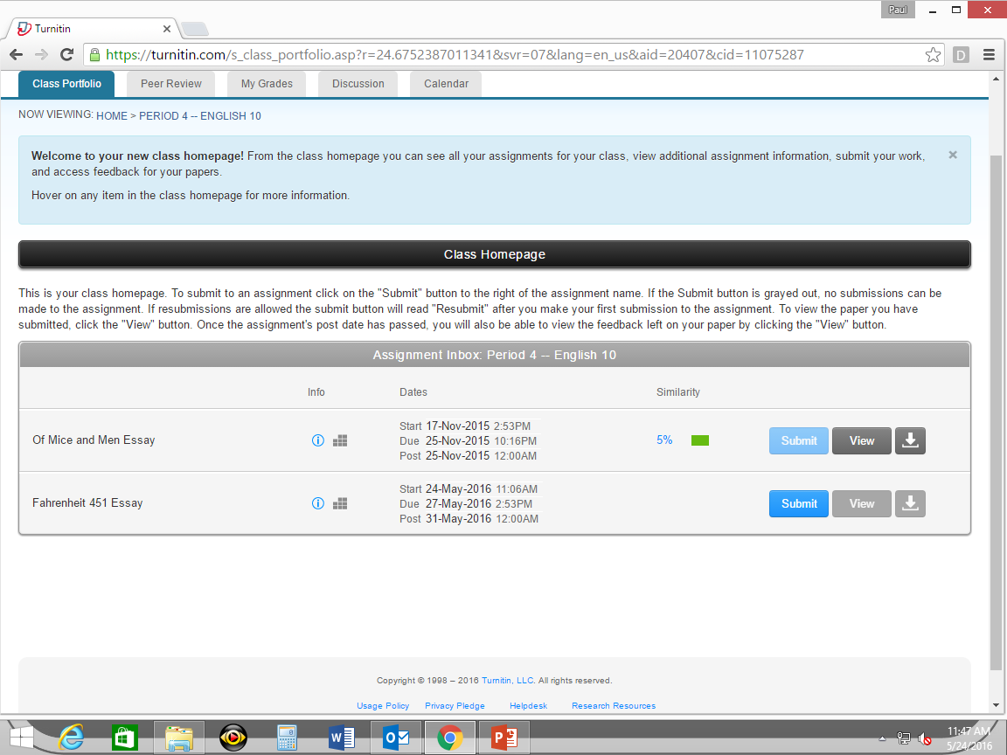
submit

Slide 16
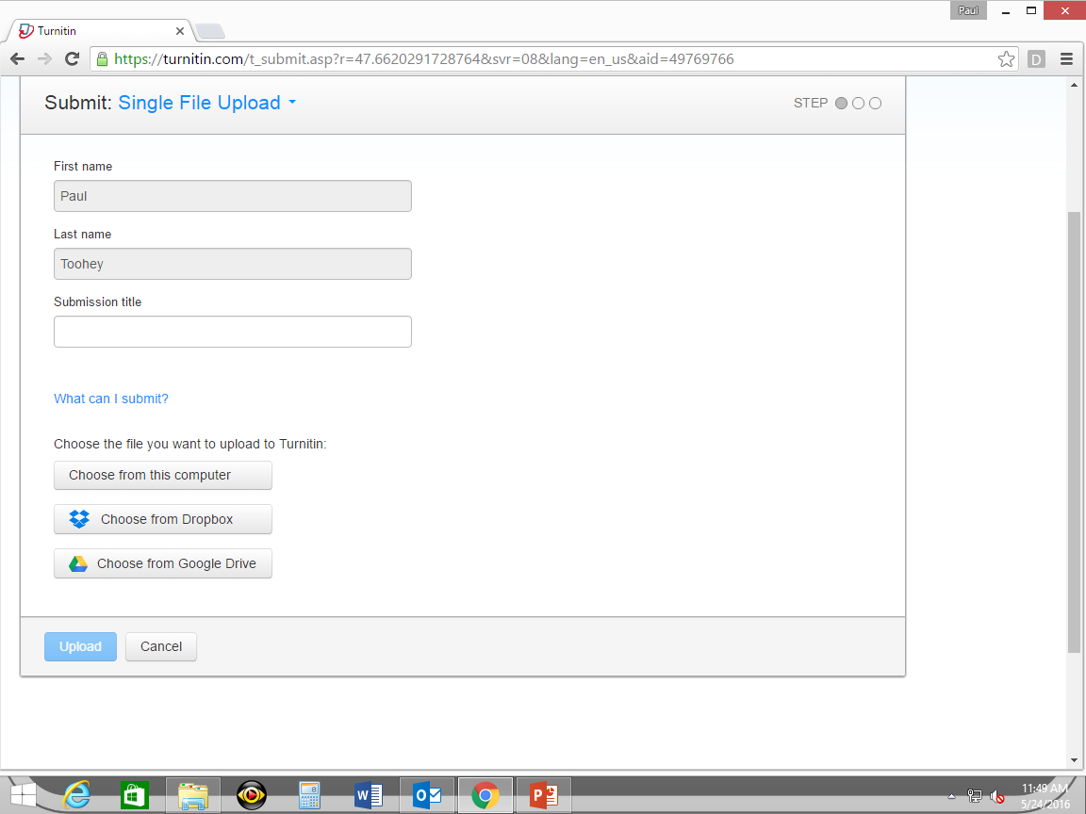
1. Click here to select cut-and-paste option
(current selection is to upload file)
2. Insert title of your essay
3. Choose upload method

Slide 17
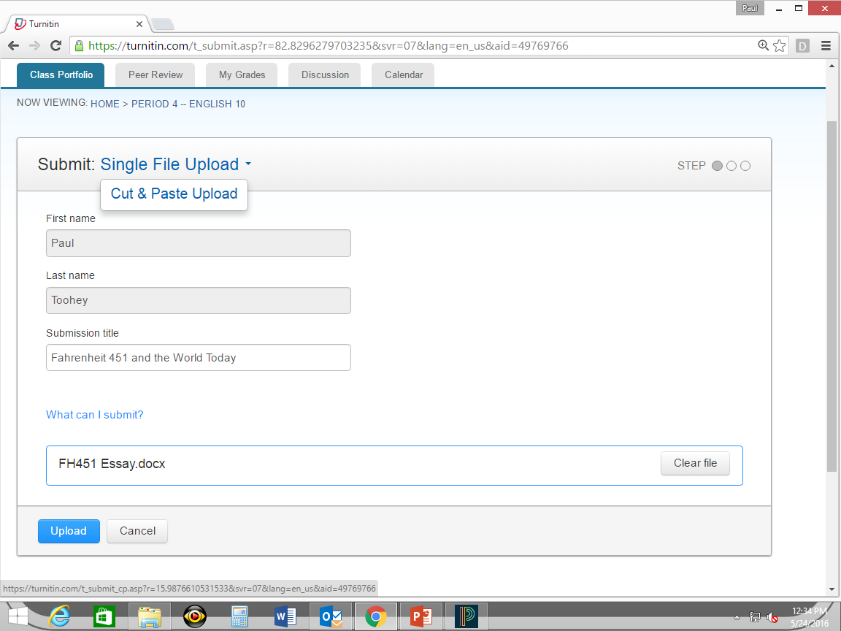
1. Click here to select cut-and-paste option
2. Type in the title of your paper
3. Check file before submitting
4. Click “upload” to submit paper
(you’re not done yet!)

Slide 18
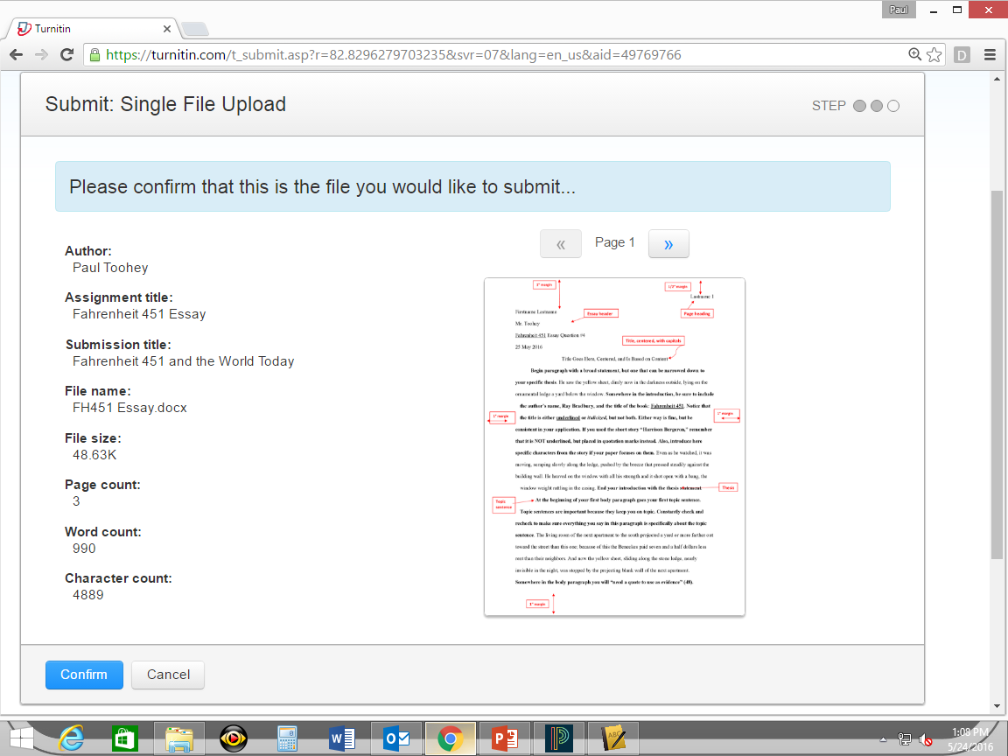
1. Is this the paper you want to submit?
2. Then click here.

Slide 19
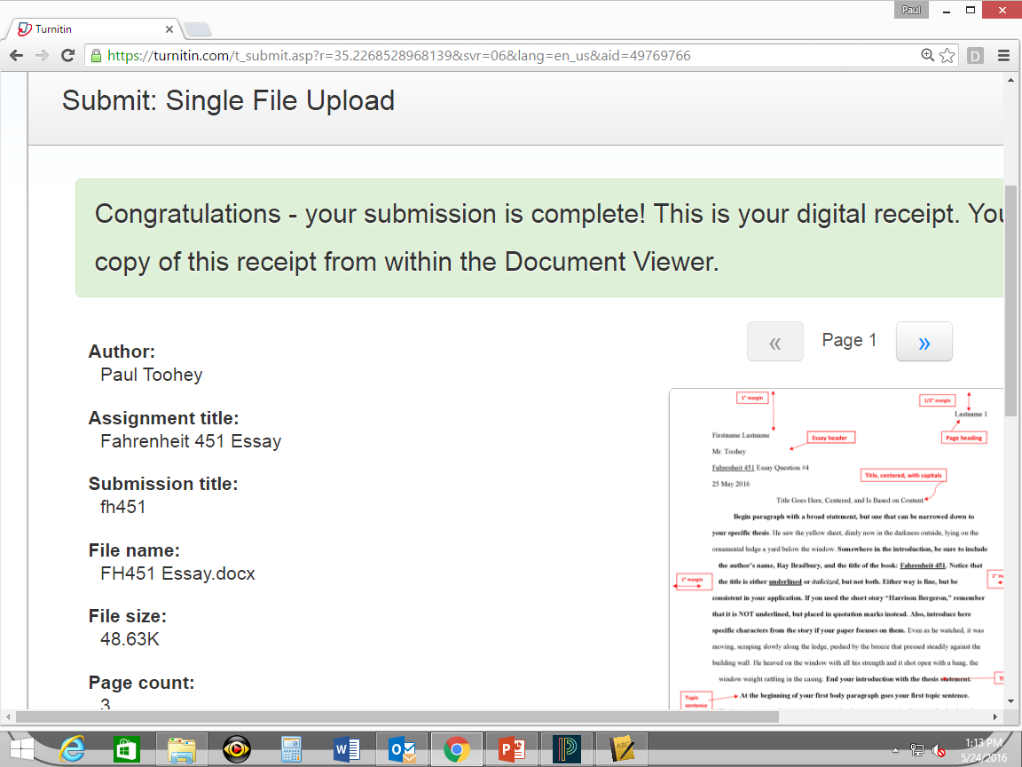
DONE!

