Slide 1
VERBS
The verb indicates action:
The children ran home from school.
Or state of being:
The book is very interesting.
Every sentence must have a verb; every clause must have a verb.

Slide 2
-ed and –ing are common verb suffixes; verbs can be past tense, present tense, or future tense; only verbs show tense.

Slide 3
All sentences can be broken down into two parts:
Subject: who or what the sentence is about
Predicate: the verb and the rest of the sentence; tells “What about the subject?”
Example: I ran to the park.
“I” = who the sentence is about; “ran to the park” = what “I” did.
So . . .
“I” is the subject; “ran to the park” is the predicate.

Slide 4
Verbs can be a single, simple word:
It is late.
Verbs can also be complex, multi-word verbs:
He should have been given more time.
“Should have been given” is called a verb phrase —a single verb of more than one word.

Slide 5
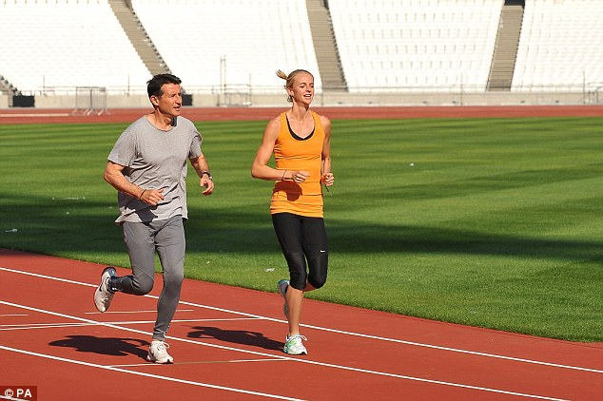
Conjugating verbs:
subjects taking the pronouns he, it, and she will have verbs which end in –s or -es, when in the present tense.
I run around the track.
Bob (he) runs around the track.
Bob and Sally (they) run around the track.

Slide 6
How do we know which ending?
I play we play
You play they play
He/she/it plays
I go we go
You go they go
He/she/it goes

Slide 7
These are the only necessary pronouns, as they are the NOMINATIVE pronouns—I, you, he, she, it, we, they—(which are used for subjects) and the verb need only “agree” with the subject.
The OBJECTIVE pronouns—me, him, her, us, them—never take a verb, as they are never subjects of sentences.
Or, to see it a different way:

Slide 8
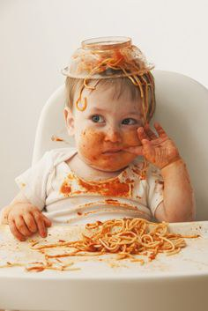
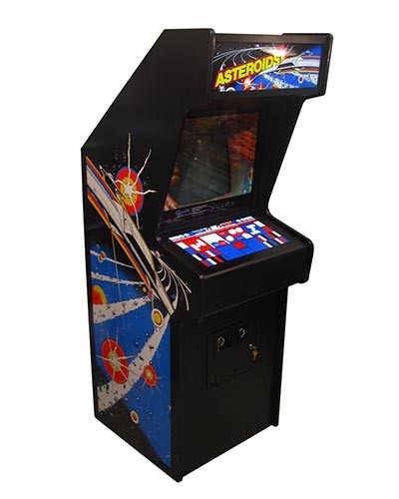
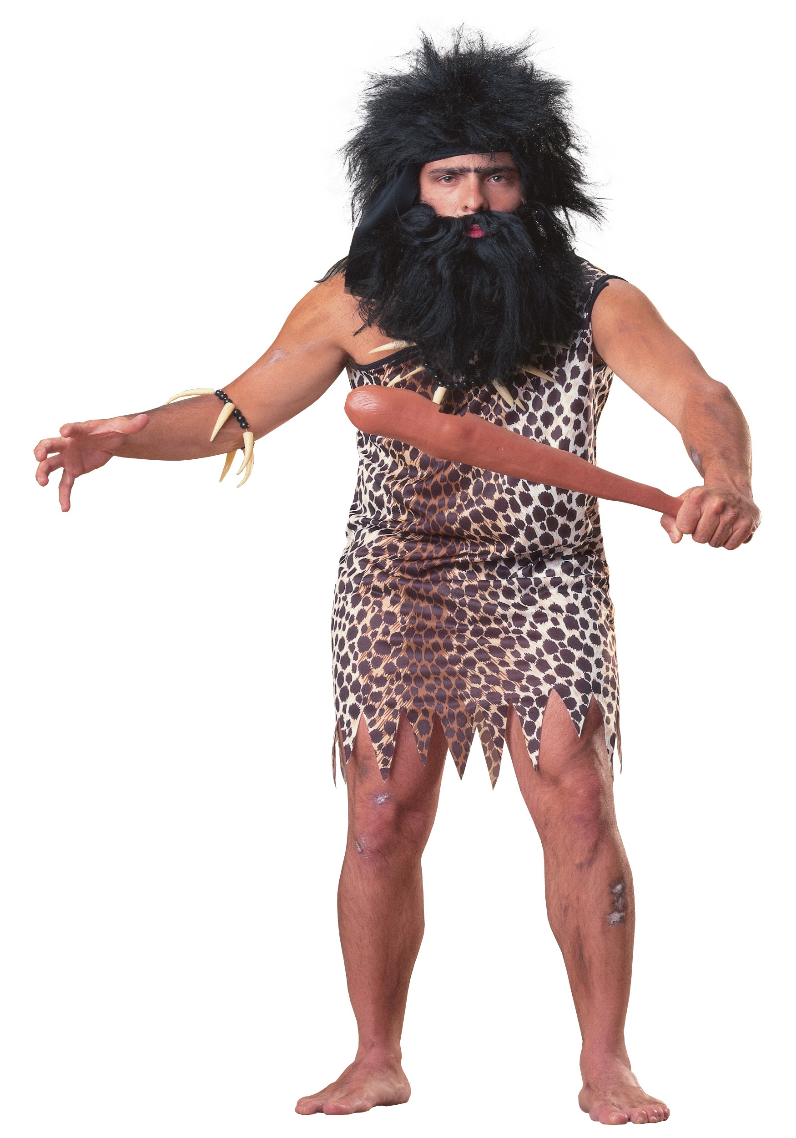
For instance, “I” will always be a subject for some verb:
I ate dinner last night.
“Me” will never be a subject for a verb:
Me and my friends played video games this weekend.
“Me played video games.”

Slide 9
Nominative Pronouns Objective pronouns
(always a subject for a verb) (never a subject)
I me
you you
he him
she her
it it
we us
they them

Slide 10
CLASSWORK:
Use each of the nominative pronouns correctly in a sentence. Then, use each of the objective forms in a sentence.
I went home after school
. . .
She read the book to me.
5 – 7 word sentences.
Pair up the nominative pronoun sentence with the objective pronoun sentence.

