Slide 1
Great Railroad Strike of 1877
Isabella Flores & Jahnetta Cleveland

Slide 2
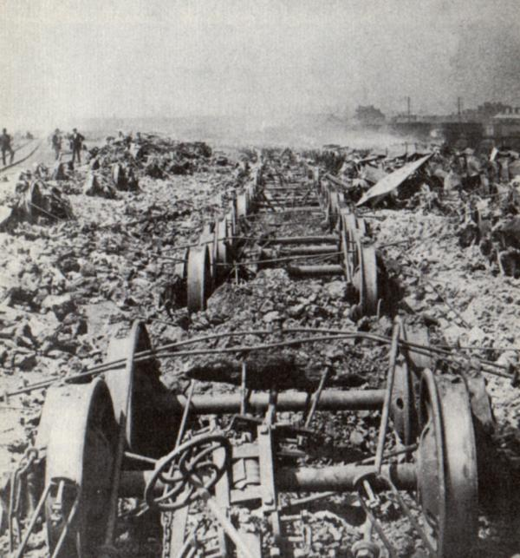
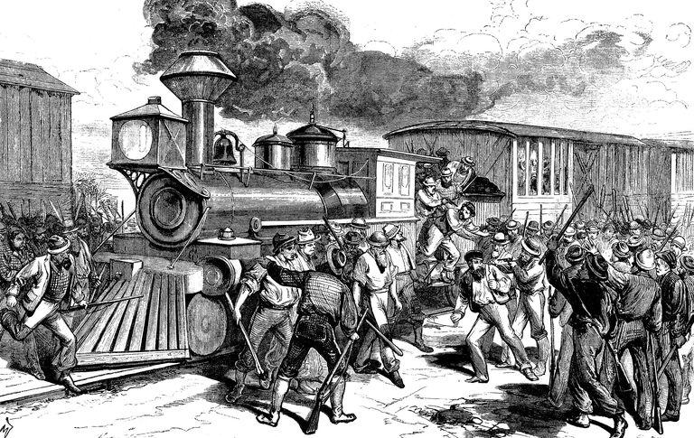

Slide 3
15 Facts: Who, Why, and How
John W. Garrett, President of the Baltimore and Ohio Railroad, signed off on a 10 percent wage cut, which caused workers to strike.
Railway work was already poorly paid and dangerous.
It knocked a brakeman's daily wage to $1.35 and was the second such cut in a year.
President Hayes stopped the Great Railroad Strike due to pleas from several governors.
By 1877, 3 million people were unemployed or losing their jobs.
The PA railroad began slashing at the beginning of the year then another 10 percent was added in june.

Slide 4
Who, Why, and How Continued...
7. They laid off workers, cut wages, and then announced they would increase their eastbound trains to Pittsburgh without hiring more crew.
8. Furious workers took control of the switches and blocked the trains, igniting the madness.
9. Around the same time, the Baltimore and Ohio cut wages, and reduced work weeks.
10. On July 16, Brakemen and Fireman stopped working.

Slide 5
15 Facts: Continued… made by Jahnetta Cleveland
The Great Railroad Strike started on July 14, 1877.
It took place in Martinsburg, West Virginia.
Striking workers would not allow any of the trains, mainly freight trains, to roll until the wage cut was revoked.
More than 100,000 workers participated in the Great Strike
The U.S. had to attempt to stop this riot which was leaving thousands without transportation. It also stopped trade which hurt business.
President Rutherford B. Hayes began moving troops from forts on the East Coast toward railroad towns such as Pittsburgh and Baltimore.
This broke the strike and maintained peace along the lines.
By the time the strikes were over, about 1,000 people had gone to jail, 100 killed, with the strike accomplishing very little.

