Slide 1
The haymarket riot
Isaiah Pruitt
Bailey Graventi
Period:4

Slide 2
Who?Where?What?When?Why?How?
When: The Haymarket riot occurred May 4th 1886.
Who:-Albert Parsons, A former confederate soldier turned radical anarchist
-Chicago Mayor Carter Harrison was even in attendance to ensure the protest was peaceful.
What: The Haymarket affair was the aftermath of a bombing that took place at the labor demonstration at haymarket square.
-The haymarket riot created alot of panic and hysteria in Chicago and increased anti-labour and anti immigration sentiment.
-It created suspicion of the international anarchist movement, throughout the country
Why- The haymarket riot happened because they tried to protest the killing and wounding of several workers by the chicago police department.
Why did it happen? Because someone at the rally threw a bomb at the police.
At least 8 people died on the incident of that day.

Slide 3
Where: -The riot took place in Chicago.
-It was at a labor demonstration.
-It began at the Haymarket square.
How: -The Haymarket riot was organized by radicals.
-Police had arrived to control the crowd population.
-During the riot police arrived and an individual through a bomb at them. Right after that police fired back.

Slide 4
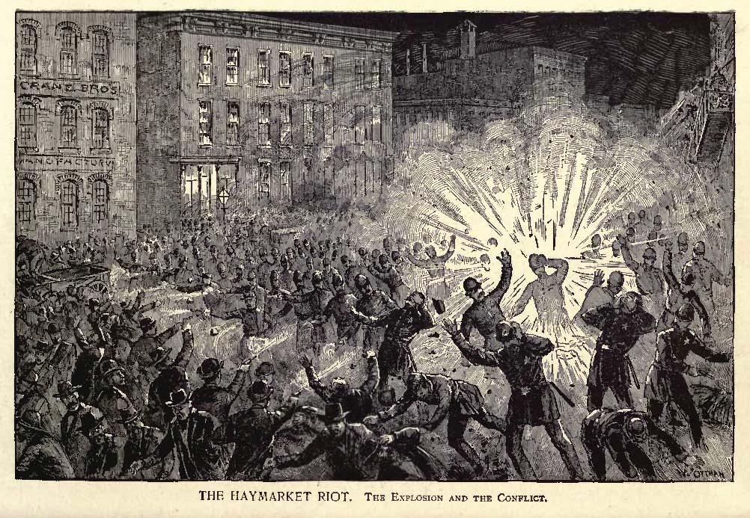
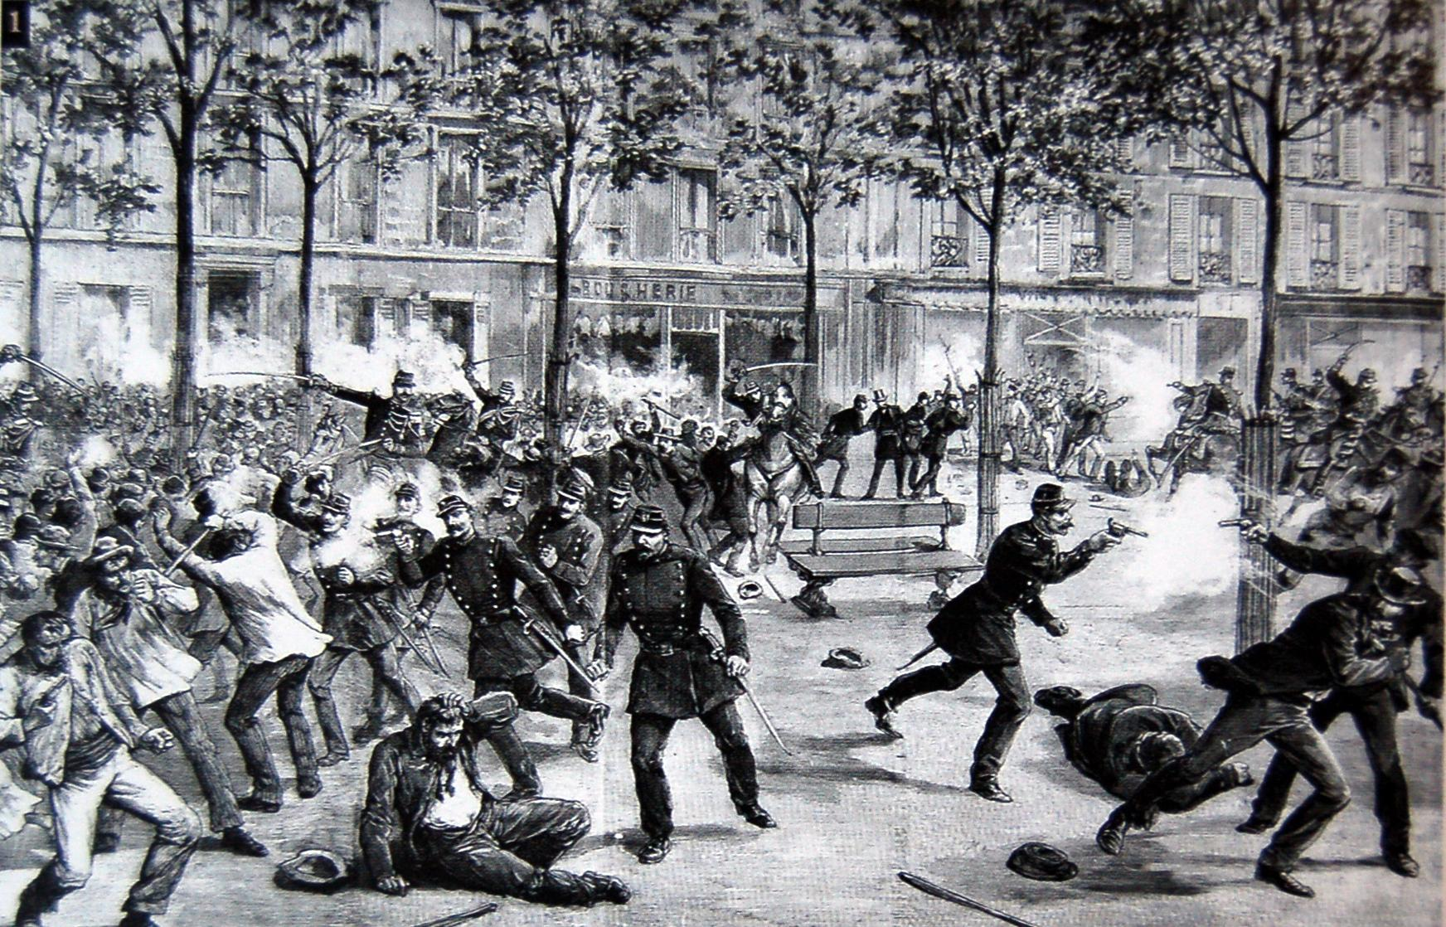
2 Photos of the Haymarket riot

