Slide 1
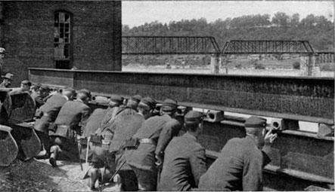
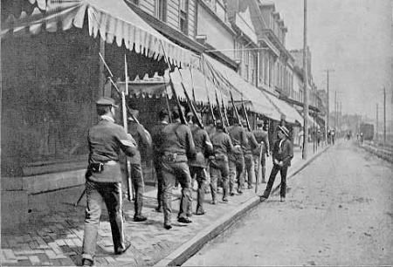
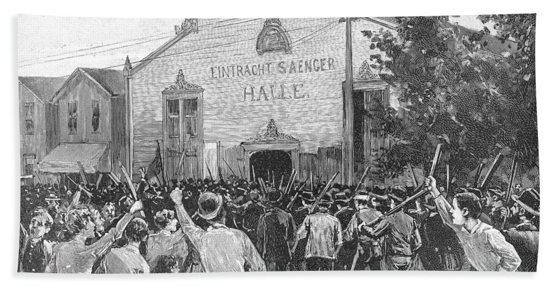
Homestead Strike
By Donnie Requeña and Adrian Brito

Slide 2
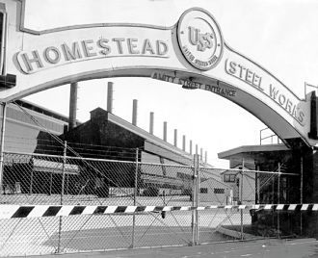
When
And
Where?
When: The Homestead strike occurred on July 1st, 1892 in the golden age of steel production; the prime ruling of Andrew Carnegie’s steel company. The strike ended in November, 1892.
Where: The “Homestead Strike” has nothing to do with homesteads, Homestead refers to the location of the strike, Homestead Pennsylvania at the prime headquarters of Carnegie Steel company.

Slide 3
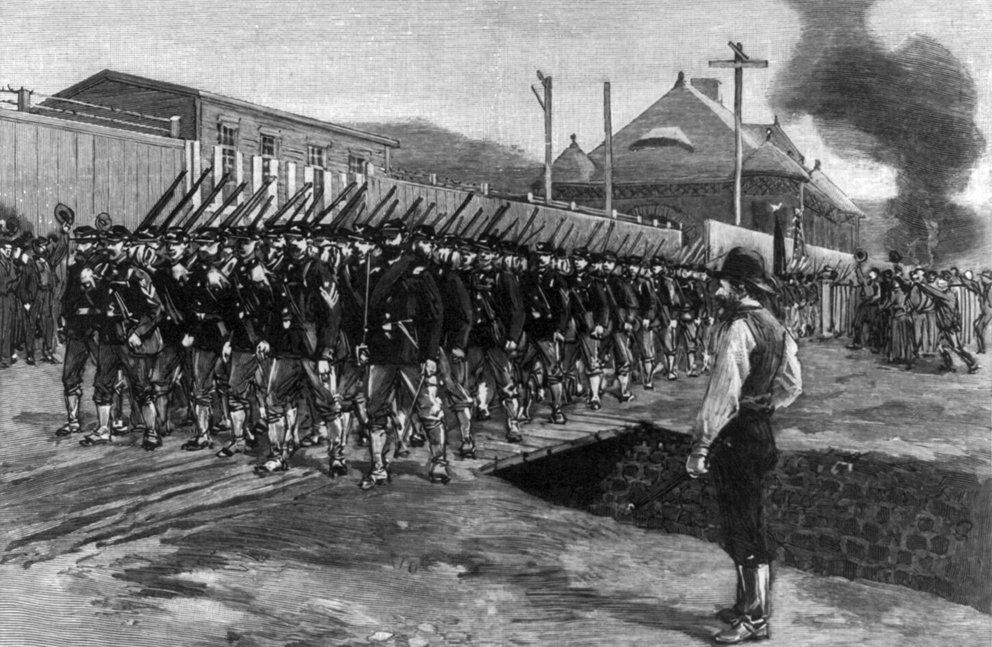
Who
And
How?
Who: The prime authority of the Homestead Strike were the workers of the Carnegie Steel Company who found Carnegie’s motive to break the union unethical.
How: The workers struck by grouping in tens of thousands of workers, a mass majority armed, up against Henry Frick’s militia of guards. The workers won the gruesome war between Henry Frick’s “army” and themselves, but ultimately resulted in hundreds of strikers being arrested. In the end, the workers got sympathy and many were released from jail with labor laws going into effect.

Slide 4
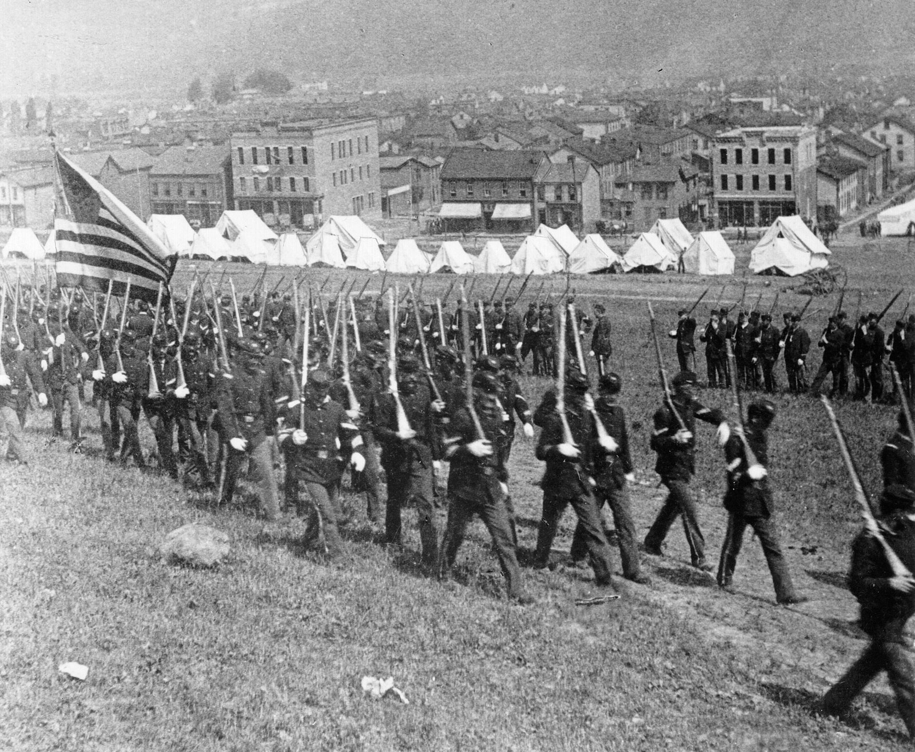
What
and
Why?
What: The Homestead Strike was a strike on the Carnegie Steel Company, one of the most dominating corporations at the time, that resulted in ten thousand armed strikers, leaving 16 dead and many injured.
Why: The Homestead act occurred due to Andrew Carnegie longing to break a union that had caused a previous strike in results for a 3 year labor contract. After Carnegie’s manager, Henry C. Frick, raised working standards, workers were uncooperative and were forced outside factories, resulting in the unions spark of the strike.

Slide 5
15 Facts
The Homestead Strike was located in Homestead, Pennsylvania, July 1st, 1892.
Andrew Carnegie was the main cause of the Homestead Strike.
In 1889, workers had hosted a different strike for a 3 year contract that led up to the Homestead Strike.
The Carnegie Steel Company was one of the largest and profitable steel companies in the US.
The union consisted of skilled workers and craftsmen, they also had the support of 3,000 nonunion workers.
When Fricks wage cut campaign was rejected he locked the workers out and surrounded the plant with barbed wire.
The workers called the plant “Fort Frick”.

Slide 6
8. On July 2nd Frick fired all 3,800 workers.
9. In the early hours of july 6th, 300 Pinkerton agents traveled upriver to occupy the plant.
10. The nonunion labour workers who were replacing the previous workers were called “scabs”.
11. Thousands of workers stormed the plant and went for the dock.
12. After 12 hours of exchanging shots, the Pinkertons surrendered.
13. The Pinkertons were jailed for protection.
14. The battle resulted in at least three dead Pinkertons and seven dead workers.
15. By July 15th the plant was again operational with replacement workers.

