Slide 1
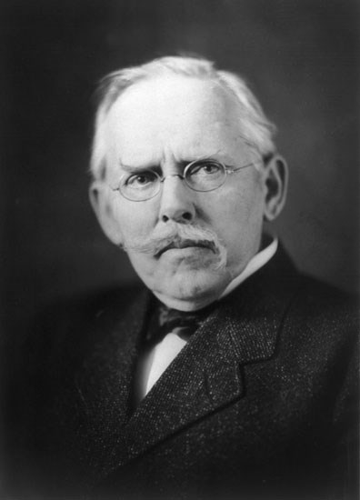
Jacob Riis
By Ember Clark And Nathan Reyes

Slide 2
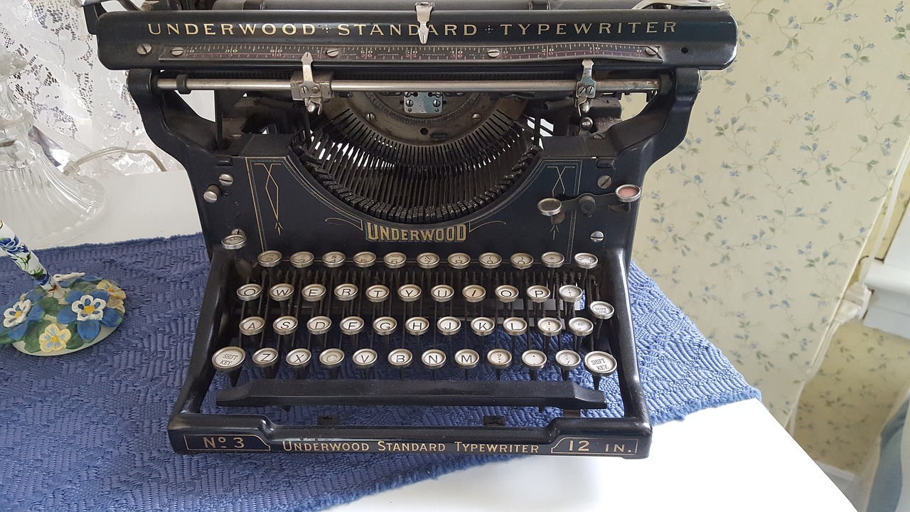
The Beginning
born on May 3, 1849
Jacob August Riis was a Danish-American social reformer, "muckraking" journalist and social documentary photographer.
He contributed significantly to the cause of urban reform in America at the turn of the twentieth century.
Died on May 26, 1914,
Who was Jacob Riis?

Slide 3
Jacob’s accomplishment
Riis wrote a couple books to cause social reformation.
He wrote many books on it in his home Massachusetts
Jacob wanted to expose the rich class
He successfully did this by becoming a police reporter and exposing and bring light to the public
Where did he do it? What did he do? And Why?

Slide 4
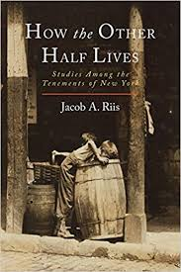
How did he accomplish this?
He started out as taking photos of New York realizing how bad it was
He used thoughts images to create books
He also became a police reporter to get more information
He opened peoples eyes by writing How the Other lives in 1890
Which is why he also wrote Children of the Poor in 1892
All these books helped accomplish his goal
All this exposed the rich causing change to the conditions the poor had to endure
How?

