Slide 1
John Mitchell Labor Project
Angelica Derdak P.4

Slide 2
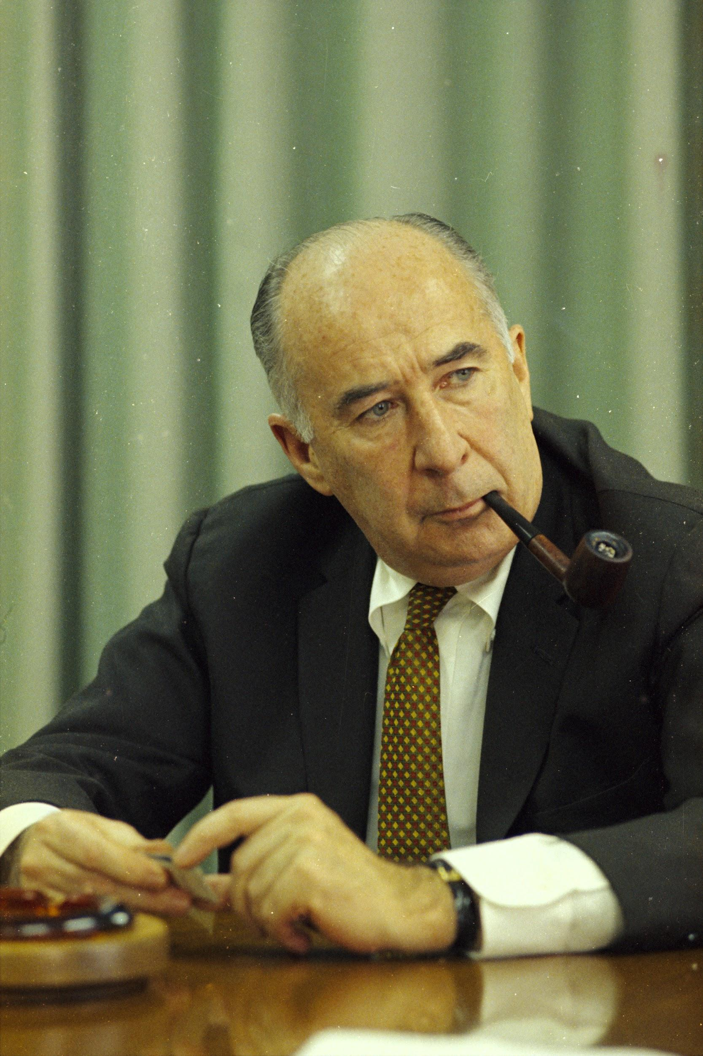
John N. Mitchell was the 67th attorney general of the United States under president Richard Nixon. Prior to this , John Mitchell had been a municipal bond lawyer, chairman of Nixon's 1968 presidential campaign, and one of Nixon's closest friends. After Nixon became president in January 1969, Nixon appointed John N. Mitchell as Attorney general of the United States while making an unpredicted direct appeal to the FBI director. John MItchell remained in office from 1969 until he resigned in 1972 to manage president Nixon reelection campaign. Due to multiple crimes he committed in the Watergate affair. Mitchell was sentenced to prison in 1977 and served 19 months. As the attorney general, he was noted for personifying the law and order positions of the Nixon administration, amind several high power anti war demonstrations.

Slide 3
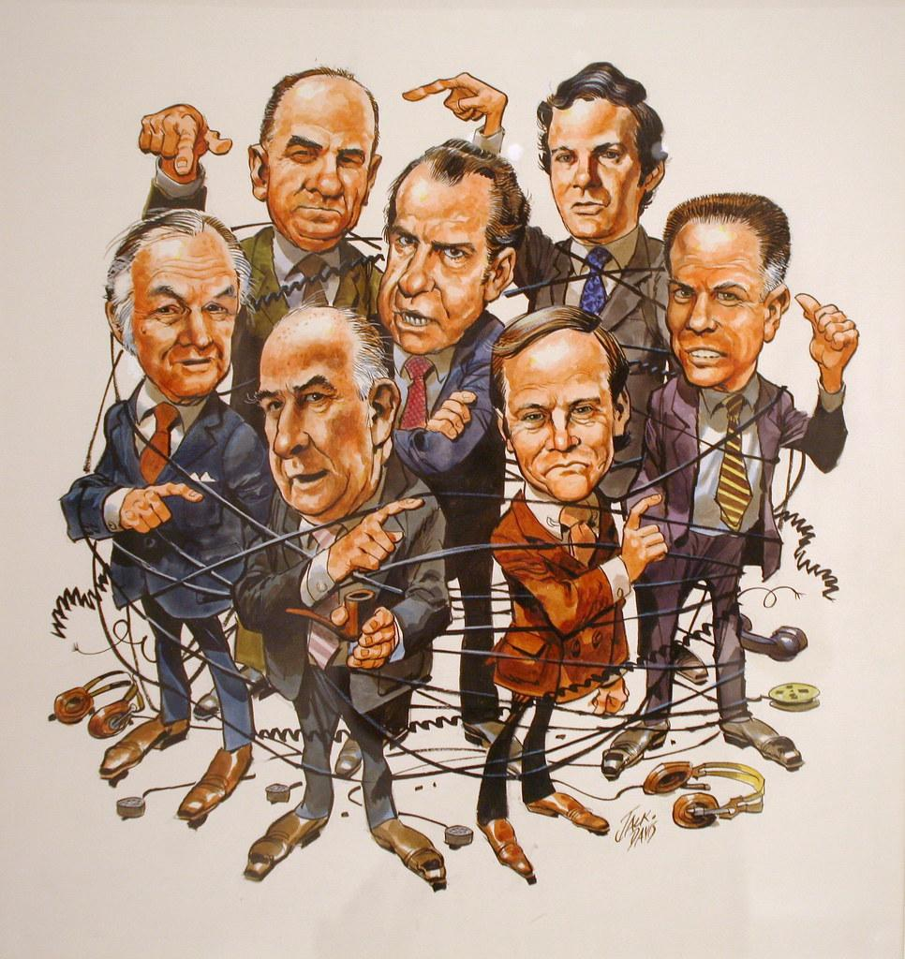
Watergate scandal
The watergate scandal was a scandal during and after the 1972 presidential election
United states president and republican Richard Nixon was running for the election against democrat George McGovern
The watergate scandal was a major federal political scandal in the U.S
Involving the administration of the U.S president Richard Nixon from 1972 to 1974 that resulted in the end of Nixon presidency
The name watergate comes from Washington D.C where the first crime took place and is often associated with political scandals
Richard Nixon was stealing information and abusing his presidential powers to try and stay in the office

Slide 4
John Mitchell
John Mitchell was born on September 15, 1913 in Detroit, MI and he passed away on November 9, 1988 in Washington DC
Mitchell was president Richard Nixon former attorney general
John resigned as head of the committee for the reelection of president in 1972, shortly after the arrest of several men that was discovered burglarizing the headquarters of the democratic in the watergate complex
In 1974, Mitchell was indicated on charges that he had conspired to plan the break in .
He had obstructed justice and perjured himself during the subsequent cover up to the affair
Mitchell was convicted in 1975 and sentenced to 2 ½ to 8 years in prison
He entered prison in 1977 and was released on parole in 1979
John MItchell was the only United States attorney general to serve a prison sentence
Mitchell served 19 months in prison for his participation in the watergate scandal

