Slide 1
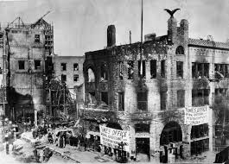
The LA Times Bombing
Taylor Berquist
Justin Failla

Slide 2
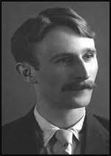
Who?
J.B. McNamara, was linked to an ironworker union that ordered the attack on the LA times building.
Twenty-one people died in the early hours of Oct. 1, 1910, when the explosive device ripped an entire wing off The Times building.
A night editor and a telegraph operator were among the dead, and dozens of others were wounded and maimed.

Slide 3
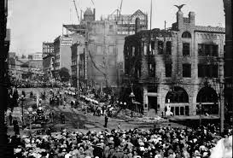
What?
The target was the old Los Angeles Times building, an 1886 brick-and-granite edifice known as “the fortress,” on Broadway and First Street.
The weapon of choice was 16 sticks of dynamite and a windup alarm clock.
On the evening of 30 September 1910, J. B. McNamara left a suitcase full of dynamite in the narrow alley between the Times building and the Times annex, known as "Ink Alley."

Slide 4
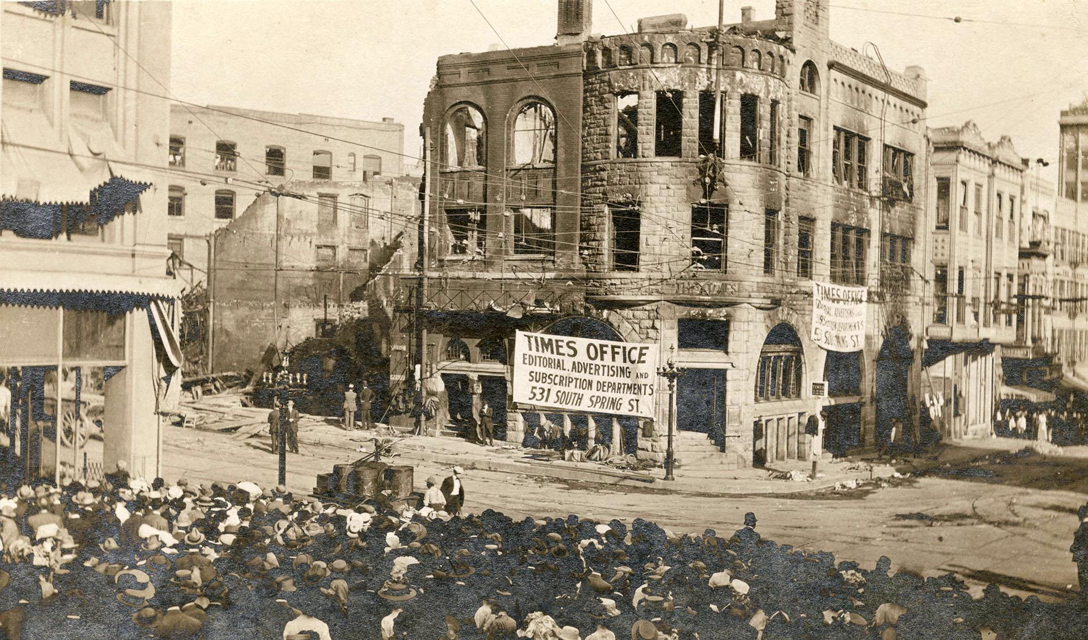
Where? When?
Outside of the LA Times building on Broadway and First Street in “Ink Alley”
The Los Angeles Times bombing took place in Los Angeles, California, on October 1, 1910
Shortly after 1 a.m., a series of explosions rocked the Los Angeles Times building

Slide 5
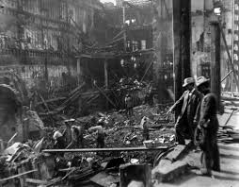
Why?
Hockin had been caught taking money earmarked for bombing jobs, and J. J. McNamara no longer trusted him.
McNamara asked another dynamiter, Jack Barry of St. Louis, to go to California, but Barry turned down the job when he learned of the targets.
Previously, only nonunion workplaces had been targeted. Now the Iron Workers union was expanding the targets to the homes of anti-union leaders, and a newspaper noted for its anti-union editorial policy

Slide 6
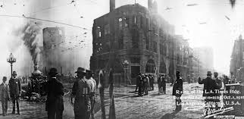
How?
J. B. McNamara left a suitcase full of dynamite in the narrow alley between the Times building and the Times annex, known as "Ink Alley." The suitcase was left near barrels of flammable printer's ink.
The dynamite had a detonator connected to a mechanical windup clock, set to close an electric battery circuit at 1 am, and set off the explosion.
He left similar bombs, also set to explode at 1 am, next to the home of Times publisher.

