Slide 1
Ludlow Massacre 15 facts
Destiny garcia

Slide 2
Ludlow Massacre
About 10,000 miners under the direction of the United Mine Workers of America (UMWA) had been on strike since September 13, 1913, protesting low pay and abysmal working conditions in the coalfields of Colorado.
Evicted from the company towns by the operators of industrialist John D. Rockefeller’s Colorado Fuel and Iron Company, striking miners constructed tent colonies, the largest of which housed about 1,200 strikers, in Ludlow. The striking miners were a polyglot of ethnicities, including a large number of Greeks and Italians.
Tensions ran high between the armed strikers and the company-hired detectives. The Colorado National Guard, which had been deployed to reduce violence, favoured the operators by escorting strikebreakers to the mines and overlooking the violent actions of the detectives. Labour activist Mary (“Mother”) Jones led a campaign to bring national attention to the strike.

Slide 3
In April 1914 the cost of maintaining the troops led to a reduction in the National Guard presence, resulting in increased violence. On Sunday, April 19, 1914, the National Guard encircled the Ludlow camp and deployed a machine gun on a bluff overlooking the strikers. Although no one knows exactly what instigated the violence.
some accounts suggest that officers of the National Guard demanded that the miners turn over at least one individual, possibly a striker or even a hostage that they were holding, but the miners refused. The National Guard then opened fire on the camp, initiating a pitched battle that lasted throughout the day.
Three of the striking leaders, including labour organizer Louis Tikas, were captured and killed by the National Guard; anecdotal evidence suggests that Tikas had been lured out to discuss a truce. As the strikers ran out of ammunition, they retreated from the camp into the surrounding countryside.

Slide 4
Women and children, hiding from the bullets that strafed the camp, huddled in cellars that had been dug underneath their tents. In the evening the National Guard troops soaked the tents in kerosene and set them on fire. In one cellar 11 children and 2 women were found burned and suffocated. In all, 25 people were killed during the Ludlow Massacre, 3 of whom were National Guard troops.
In retaliation for the massacre, miners attacked anti union town officials, strikebreakers, and the mines, taking control of an area about 50 miles long and 5 miles wide. As many as 50 people died during the reaction to the Ludlow Massacre.
Fearing a further escalation of violence, U.S. President Woodrow Wilson sent in federal troops to restore order. Unlike the National Guard, the federal troops were impartial and kept strikebreakers out of the coal mines. The strike ended on December 10, 1914. While the workers got little in the way of tangible benefits from their strike, the UMWA gained 4,000 new members.

Slide 5
miners were not given an hourly pay. Instead, they were paid by the tonnage, as defined by the mine owner. Each miner at the Rockefeller Colorado mines received a mere 80 cents for every 2,400 pounds of coal they produced. Any other work the miners did was not paid for.
The Colorado coal mines were the most dangerous mines in the United States. Their fatality rate was almost double what it was for the entire nation at that time. In 1912, the death rate in the Colorado mines was about seven deaths per 1,000 workers.
The reasons for such a high death rate are many. First, the mountains over the mines were cracked and extremely unstable. The land was harsh and unforgiving. Second, the miners were not paid to make the mines safer. In fact, any safety work done inside of the mines, such as fixing unstable roofs, was referred to as “dead work” because the miners were not paid for it.

Slide 6
While long hours, terrible pay, and safety issues all led up to the miners’ strike, there was also the problem with miners and their families being owned by the company. They lived in company shacks, shopped in company stores, and were often settled in areas that were far from the prying eyes of law enforcement, newspaper reporters, and the unions. The people were isolated and the mine superintendent ruled over them like a little dictator.
As soon as the miners went on strike, the company went into action to try and break the men and their families. The miners, their wives and children were immediately evicted from their shacks. The United Mine Workers Union helped the miners set up a tent colony nearby.
While the striking miners picketed the mine, Rockefeller bought gunmen to harass the miners and their families. These hired criminals would shoot rifles and Gatling guns at the tent colony. They would raid the tents and beat up the strikers.

Slide 7
The strikers wanted a mere ten percent pay raise and eight hour work days. They also requested the right to live outside of the company owned towns and to purchase items at stores not owned by the company.Rockefeller’s Colorado Fuel & Iron Company refused these basic demands and eventually brought in the Colorado National Guard. When the state troops arrived, the miners hoped that they were there to help them, but they were so wrong.
Rockefeller paid the Guards’ wages and encouraged the Guards to continue harassing the strikers. Tensions were high and it wasn’t long until the whole situation exploded into bloodshed.
Gunfire rang out. No one knew where it came from, but everyone reacted to it. The militia and the National Guard began shooting at the tent colony. Terrified miners grabbed their guns and ran for the hills. Women and children desperately tried to stay out of the gunfire.

Slide 8
Congress held hearings but took no concrete actions. The trials of more than 400 miners dragged on until 1920, but none were convicted. Twelve National Guardsmen were exonerated before a court-martial.
Considered one of the darkest moments in American industrial labor history, the Ludlow massacre was a war between coal miners and the rich and powerful. Dangerous working conditions and terrible pay, coal miners and their families were owned and ruled over by the Colorado Fuel & Iron Corporation, a Rockefeller company.
The workers, helped along by the United Mine Workers Union, went on a strike that eventually led to the massacre that killed men, women, and children.
First, there was no such thing as part time work in the coal mines. When you were hired to work the mines, you could expect to work twelve hour days for at least six days a week. Some miners worked twelve hour shifts seven days a week with no time off. At that time, there was no such thing as overtime pay or paid vacations. You either worked or you and your family went homeless and starved.

Slide 9
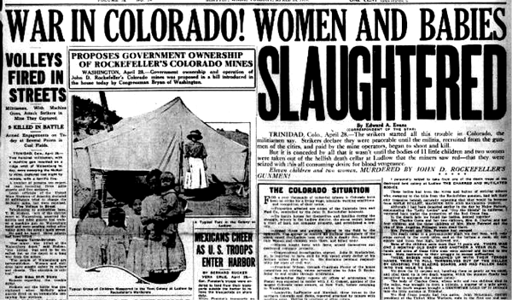
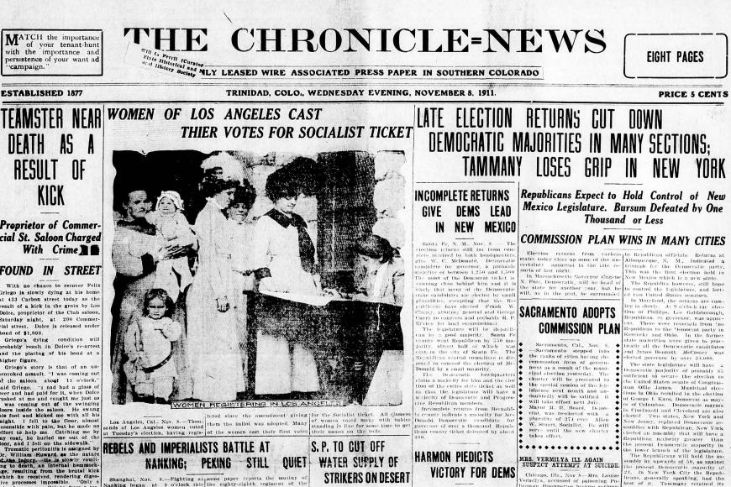
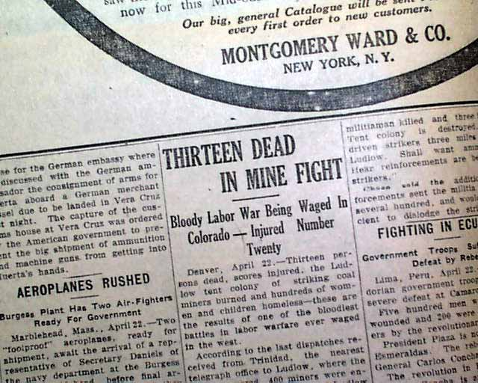
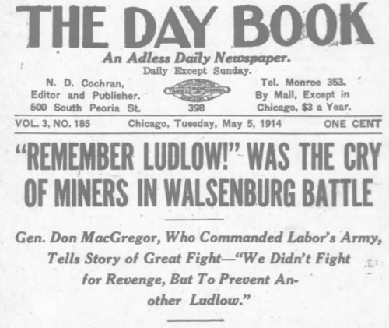
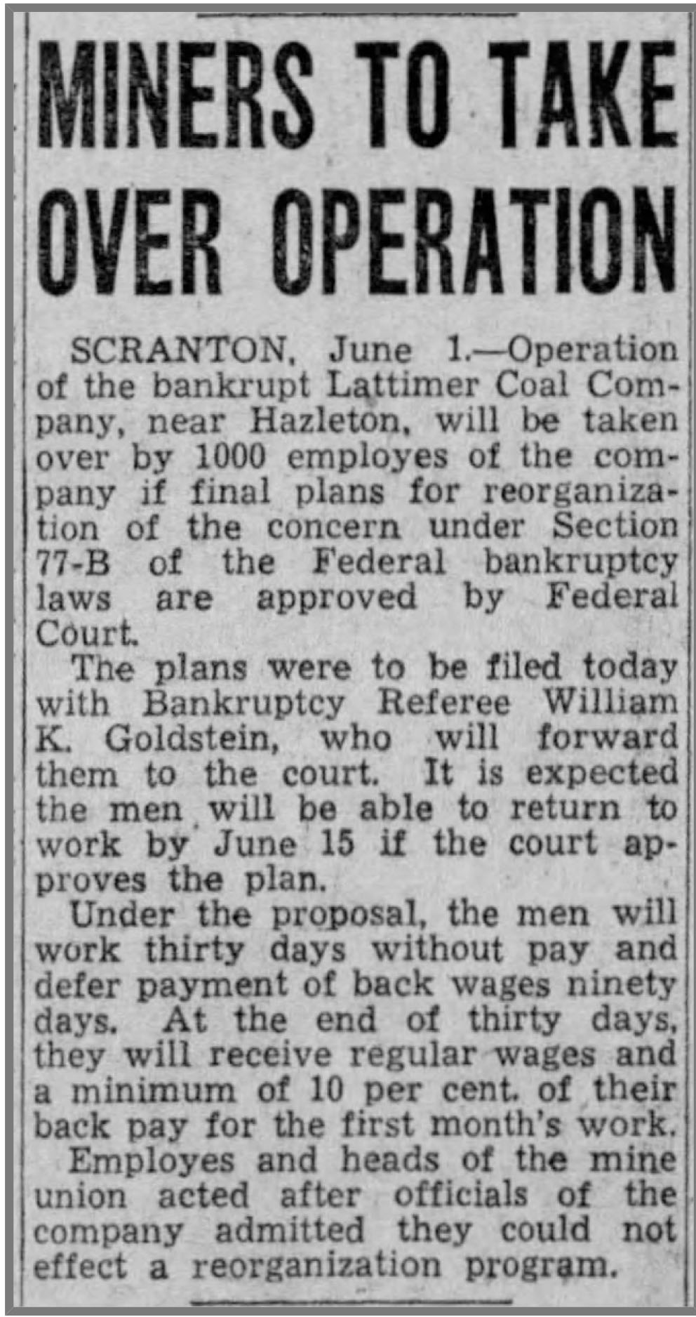
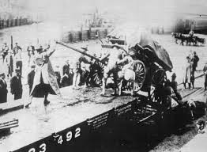
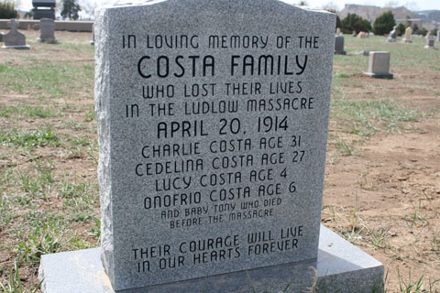

Slide 10
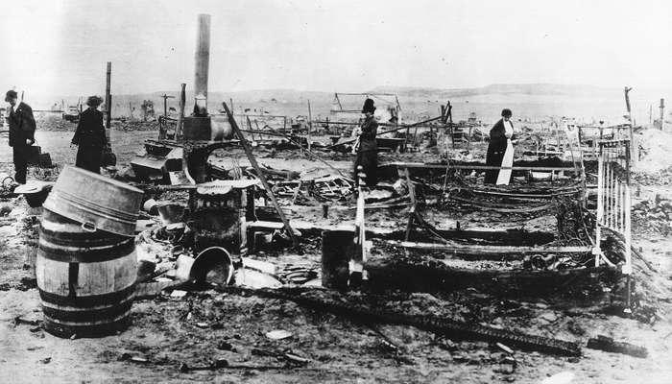
Ludlow Massacre, attack on striking coal miners and their families by the Colorado National Guard and Colorado Fuel and Iron Company guards at Ludlow, Colorado, on April 20, 1914, resulting in the deaths of 25 people, including 11 children.
Ludlow Massacre
Ruins of the Ludlow camp in Colorado, 1914.
Library of Congress, Washington, D.C.

