Slide 1
Molly MaGuires
Robert Rosales
Jachimike Denis

Slide 2
Who? What? Where?
Who were the Molly MaGuires? The Molly MaGuires were a Irish 19th secret society active in Ireland. Liverpool and parts of the Eastern United States best known for their activism among Irish-American and Irish immigrant coal miners in Pennsylvania. They were convicted of killing 16 mine owners. They took their name from a rural secret society in Ireland.
What did they do? They did a mining job during their time. They were a rare transatlantic outgrowth of this pattern of Irish rural protest. They were supposedly responsible for acts of terrorism in the coalfields of Pennsylvania and West Virginia, U.S. in the period 1862 to 1876. The group named itself after a widow who led a group of irish Antilandlord agitators in the 1840s.
Where did the Molly MaGuires work? They had worked in United States coal fields of Pennsylvania. They were executed and hanged in Carbon county prison in Mauch Chunk, Pennsylvania. The trials of the Molly MaGuires began in 1876 with the star witness for the prosecution being James McPartland. To others Molly MaGuires represented a hangover from the old country that they wished to escape.

Slide 3
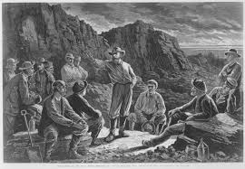
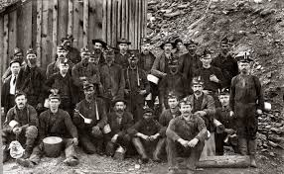
When?Why?How?
When did the killing rampages of the “molly maguires” started?
Between 1861 and 1875”
How did the Molly Maguires come to be?
The Molly Maguires was an offshoot of many rural secret societies.
Why did the Molly maguires do this?
They did this in response to terrible working conditions.

