Slide 1
The Pullman Strike :0
Pull man, c’mon!
Joaquin “Jaq” Medina & Ashley “UglyBoy” Torres

Slide 2
What Was The Pullman Strike?
In between May 11 and July 20, 1894, a widespread railroad strike and boycott that disrupted the midwest’s rail traffic severely.

Slide 3
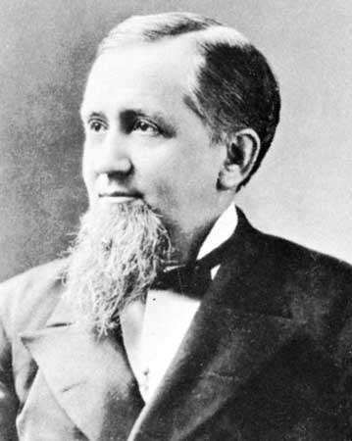
Sum Fax, Yo!
The president of the company was George R. Pullman
Due to the economic depression, the Pullman Palace Car Company cut the wages even lower than they already were by 25%
They cut wages without lowering the price of rent
Many families of workers faced starvation
When workers tried to present grievances for low wages, Pullman would threaten to have them fired
35% of Pullman’s workers were represented by the American Railway Union
The ARU refused to handle and Pullman cars or trains with pullman cars attached
The switchmen joined the ARU

Slide 4
More Fax, Yo
By June 30, 125,000 workers went on strike across 29 different railroads
Eugene V. Debs, the ARU’s leader, urged the workers on strike to not result to violence

