Slide 1
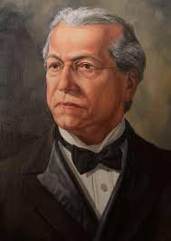
Samuel Gompers
The founder of the American Federation of Labor
By: Joshua Johnson and Samuel Baywood

Slide 2
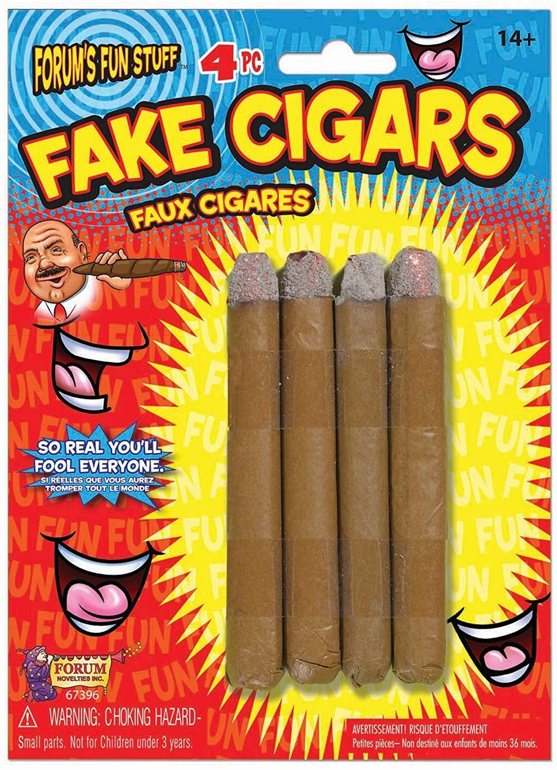
Who?
He was the first and longest-serving president of the American Federation of Labor.
He was also a Jewish immigrant that became part of the labor movement.
Gompers also founded the AFL to help in the labor movement.
Gompers started making cigars with his father and then became the president of the local 144 Cigar Makers’ International Union.
Samuel also founded The Federation of Organized Trades and Labor Unions (FOTLU)

Slide 3
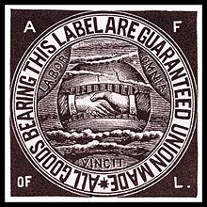
What?
He founded the American Federation of Labor (AFL).
Worked as a cigar maker with his father.
First president of the AFL
President of the CMIU as well as the vice president.
President of FOTLU for 40 years.

Slide 4
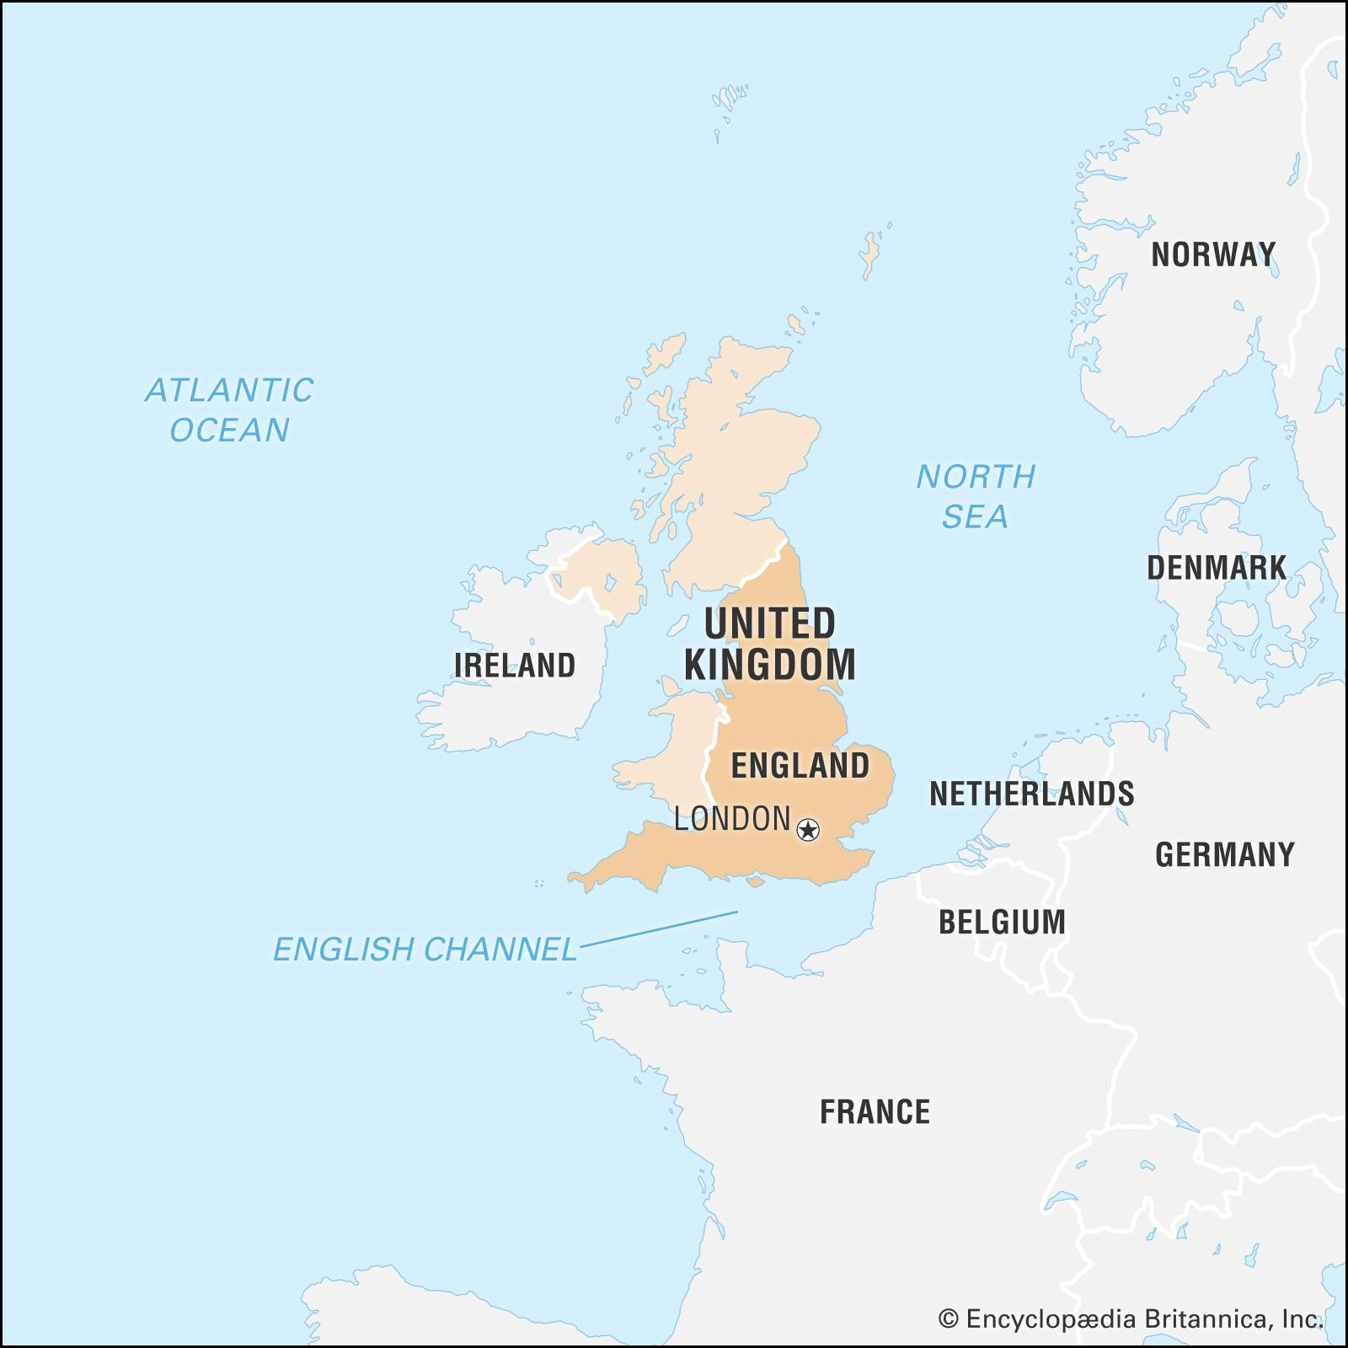
Where?
Gompers was born in London, England.
He moved to New York City, New York.
He went to Mexico City to talk to Mexico’s president.
Samuel died in San Antonio, Texas.
Gompers is buried in Sleepy Hollow Cemetery in Sleepy Hollow, New York.

Slide 5
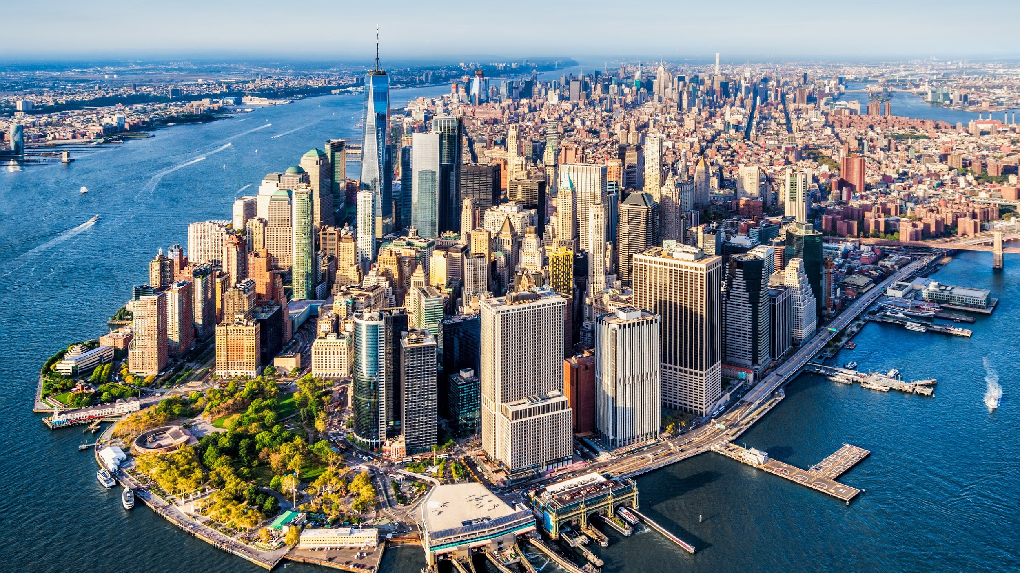
When?
Samuel was born on January 27, 1850.
He emigrated to New York City in 1863.
He became the president of the CMIU in 1875 and 1880.
He founded the AFL in 1886.
He died on December 13, 1924.

Slide 6
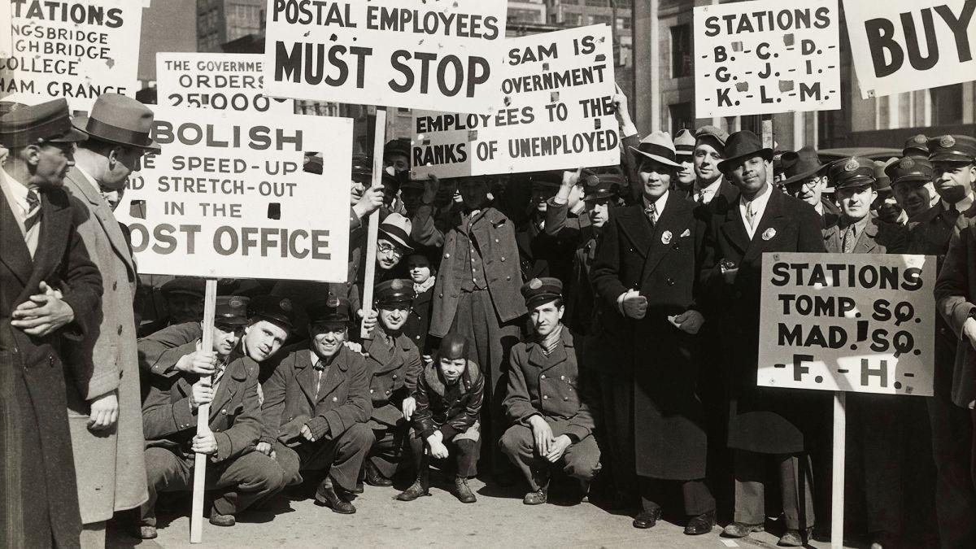
Why?
He founded the AFL because he wanted to have a shorter work day and more pay and to help with the labor movement.
He wanted a movement to change the social, political, and economic status of the working class.
He believed in pure and simple unionism.
Gompers sought to build a national federation of trade unions.
Samuel also wanted to secure the rights of labor workers.

Slide 7
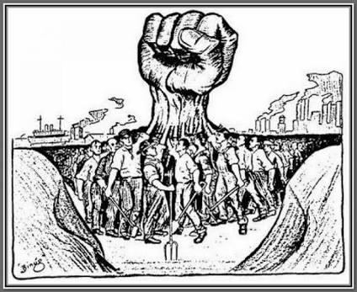
How?
Samuel worked his way up through the cigar making business and then was elected president of the CMIU.
In December 1886, Samuel Gompers met with other Craft unions to form the AFL.
Gompers followed the practice of political nonpartisanship.
Gompers went to a JFS School for his education.
When Woodrow Wilson was president Gompers was put on the Council of National Defence membership in the AFL-CIO soared.

