Slide 1
The Great Railroad Strike of 1887
By Amanda Diep, Maria Alverez

Slide 2
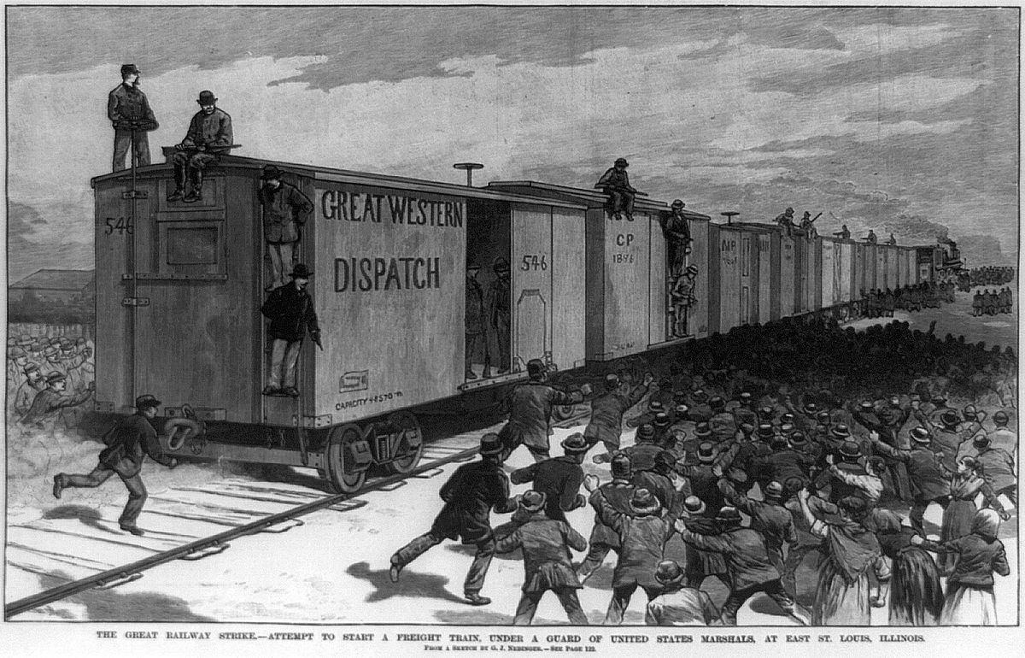
During the railroad buildings workers were often low wages, worked long shifts and worked in dangerous places. On july 16 workers for the B&O Railroad reached their limit with this treatment and they decided to go on strike. Wages were cut again and strikes blew up across the country. Martinsburg became the focal point of the strikes, worker gathered around the tracks, they uncoupled trains, blocked rails. They in total stopped 13 trains and 1,500 freight cars. Many copied the actions here and began following their actions. These strikers gained the sympathy of militia members as many railroad workers were relatives. Despite this conflict broke out with shots fired and one striker killed.

Slide 3
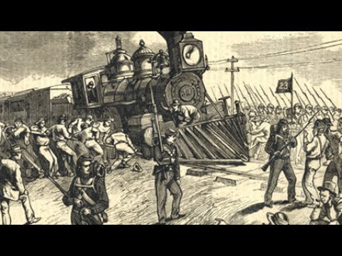
With militia shooting at railroad workers they decided to side with the workers rather than fight with them. With strikes spreading across the countries, President Rutherford B. Hayes ordered federal troops, these troops moved through cities and major cities. They successfully suppressed the strikes and forced workers back to their jobs. Martinsburg was one of the first city to feel the federal troops power and soon other cities fell to the troops, at the cost of some troopers and strikers killed. Cities like Pittsburgh, Philadelphia, and Chicago.

Slide 4
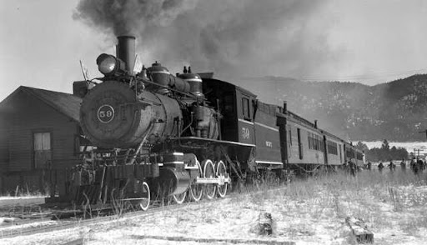
The nationwide strike ended in late August, workers didn’t gain much from this except a stronger concept of their own power and solidarity with other railroad workers across the country. The labor and management relations would go on for many years until workers finally got equal treatment. Those these strikers during 1887 didn’t win their battle they inspired others during this industrial age to fight for their fights.

