Slide 1
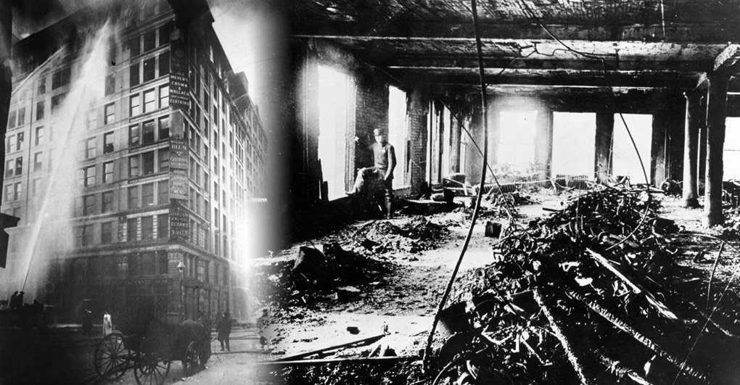
The Triangle Shirtwaist Fire
By: Taylor Neva & Rachel Franks
Period: 1

Slide 2
Who?
What?
The Triangle shirtwaist factory was owned by Max Blanck and Isaac Harris.
The factory owners employed young immigrant women who did not speak English.
The Triangle Shirtwaist Fire was a deadly fire that affected many. It claimed the lives of 164 young workers. Shocking others across the nation.
It pushed to new fire safety in workplaces.
It convinced people to hold the government accountable for the safety of workers in workplaces.

Slide 3
Where?
When?
The factory was named the Triangle Shirtwaist Company, which was located in the Greenwich Village neighborhood of Manhattan, New York City.
On March 25, 1911 the Triangle Shirtwaist Fire happened.
At the time of the fire, many workplaces had little to no fire safety. Back then it wasn't as much of a priority to have that kind of safety.

Slide 4
Why?
How?
High levels of corruption in the garment industry and city government ensured that there would be no useful precautions taken to prevent fires.
Due to a rotted hose and a rusted valve, the fire in the rag bin could not be extinguished.
The elevator in which the workers attempted to take in order to escape the flames, could only hold 12 people at a time and lasted four trips before it broke down.
The fire escapes and the exit doors were locked by the owners, leaving the workers no choice but to jump to their deaths.
It was claimed by the court that the fire was started by a discarded cigarette in the scrap fabric bin.
There was no prevention for fires in the workplace except for buckets of water that were said to be empty at the time of the fire.
The owners did not have appropriate safety precautions in the factory.

