Slide 1
Triangle Shirtwaist Fire
By: Arianna Gonzalez & Aaron Eubanks

Slide 2
On March 25, 1911, the Triangle Shirtwaist Company factory in New York City burned and ended up killing 146 workers. It is remembered as one of the most infamous incidents in American industrial history, as the deaths were largely preventable–most of the victims died as a result of neglected safety features and locked doors within the factory building. The tragedy brought widespread attention to the dangerous sweatshop conditions of factories, and led to the development of a series of laws and regulations that better protected the safety of workers.

Slide 3
There were logical reasons for most of the laws that were set. One being the locked doors, the doors were locked to prevent theft and unauthorized break-ins this was a common prevention at the time. After the fire laws were set, they helped prevent any other fires. A few laws that were enforced were mandatory fire drills,sprinkler system installations,regulated working conditions and limited working conditions for children. All these laws help prevent any other future fires and more importantly increased the safety of many workers then and now.

Slide 4
At the factory workers made clothing, working 13 hour days for a paltry 13 cents per hour. Most of the workers were teenage girls, immigrants from Italy and Russia.
In 1910, the workers at the Triangle Shirtwaist Factory joined forces with hundreds of small factories, striking for better work conditions and higher pay. This was the largest strike of women workers the country had seen.
The owners, Harris and Blanck, struck back, hiring policemen to beat the women. Anne Morgan, daughter of banker, J.P. Morgan, was appalled by their treatment and organized protests with other wealthy New York women. The owners eventually agreed to shorter hours and better pay, but they did not improve working conditions.
On March 25, 1911, a fire started on the eighth floor of the factory. The owners escaped, but the workers on the ninth floor were unaware of the fire and kept working until smoke began billowing into their workspace.
A few workers were able to reach an elevator. Some of the workers climbed onto a fire escape, which crumpled under their weight, falling 100 feet to the ground below. The only other door was locked. As the fire engulfed the workroom, factory workers jumped out the windows to their deaths.
Of the 240 workers on the ninth floor, 146 perished. Over half of them were teenagers.

Slide 5
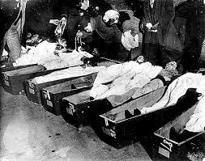
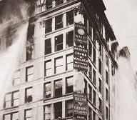
Pictures

