Slide 1
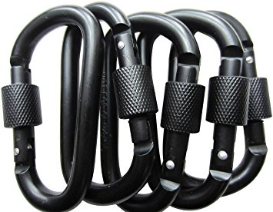
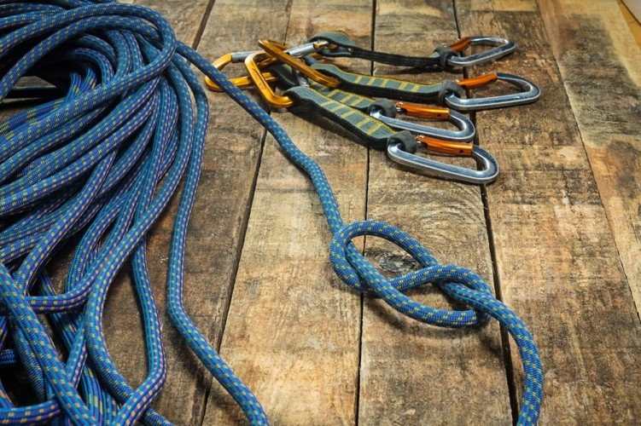
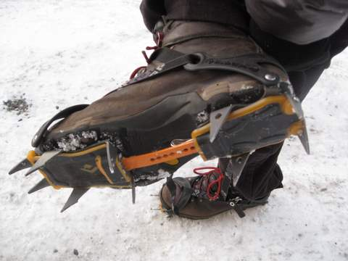
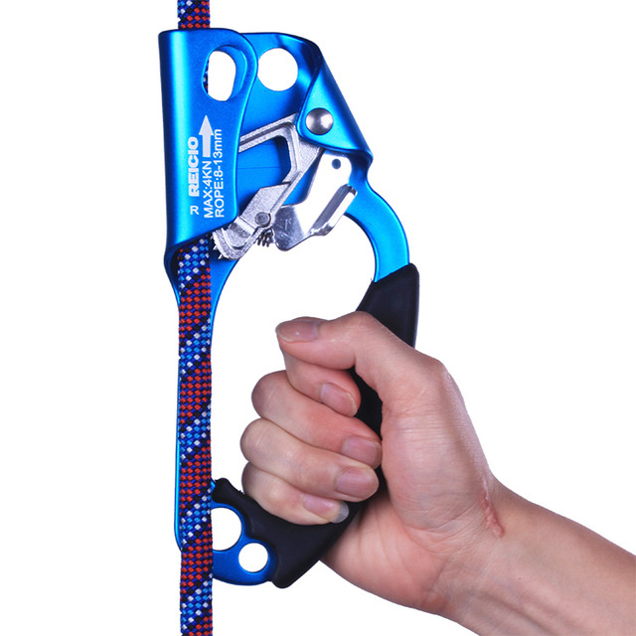
Tools for climbers:
Carabeaners
Nylon climbing rope
Crampons
Jumar

Slide 2
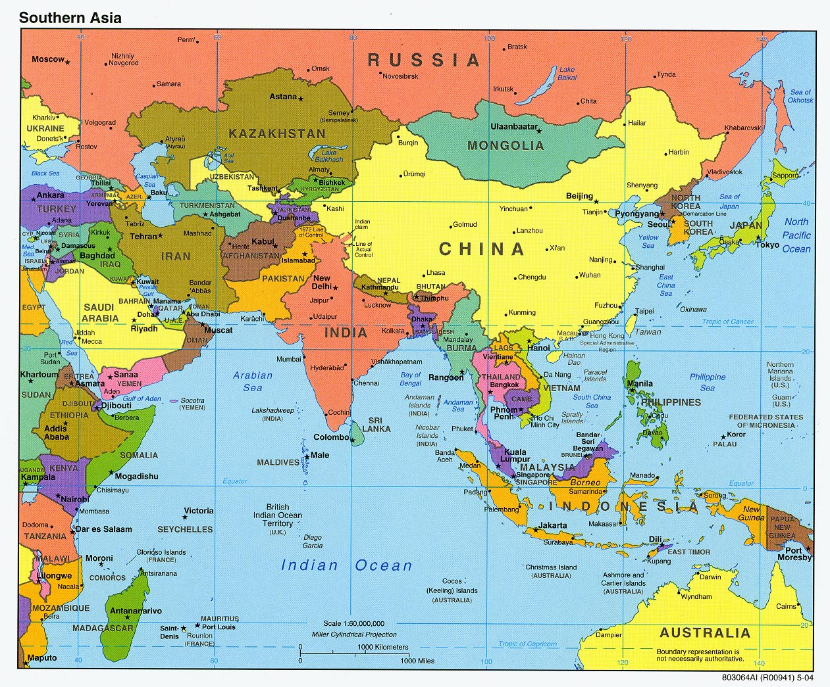
Map of Asia
Nepal

Slide 3
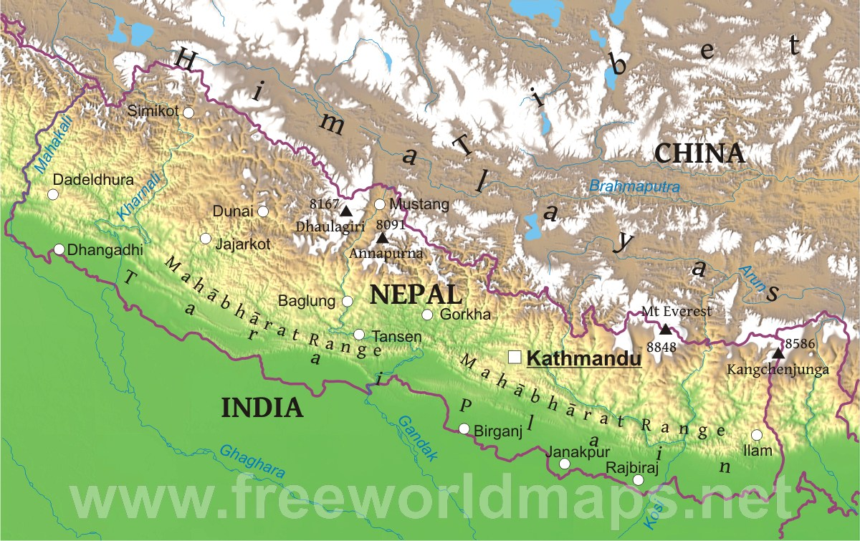

Slide 4
Kathmandu Airport, with Himalayan Mountains in the distance.

Slide 5
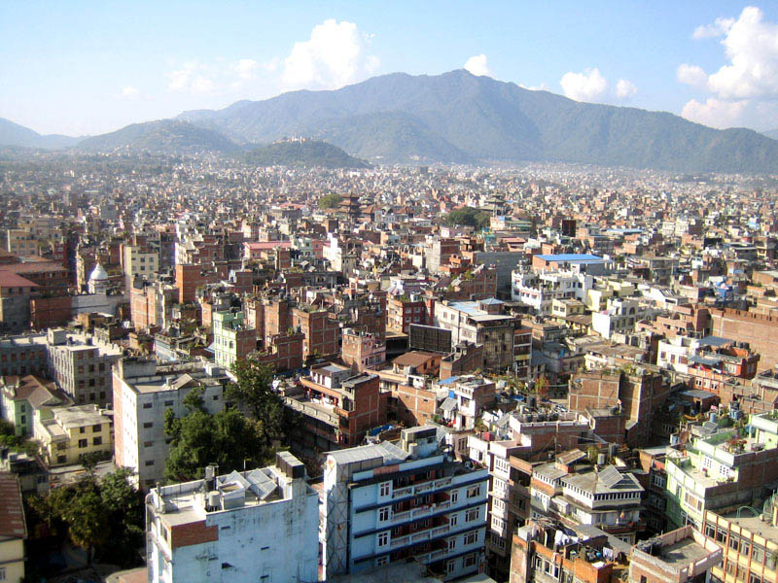
Kathmandu, Nepal

Slide 6
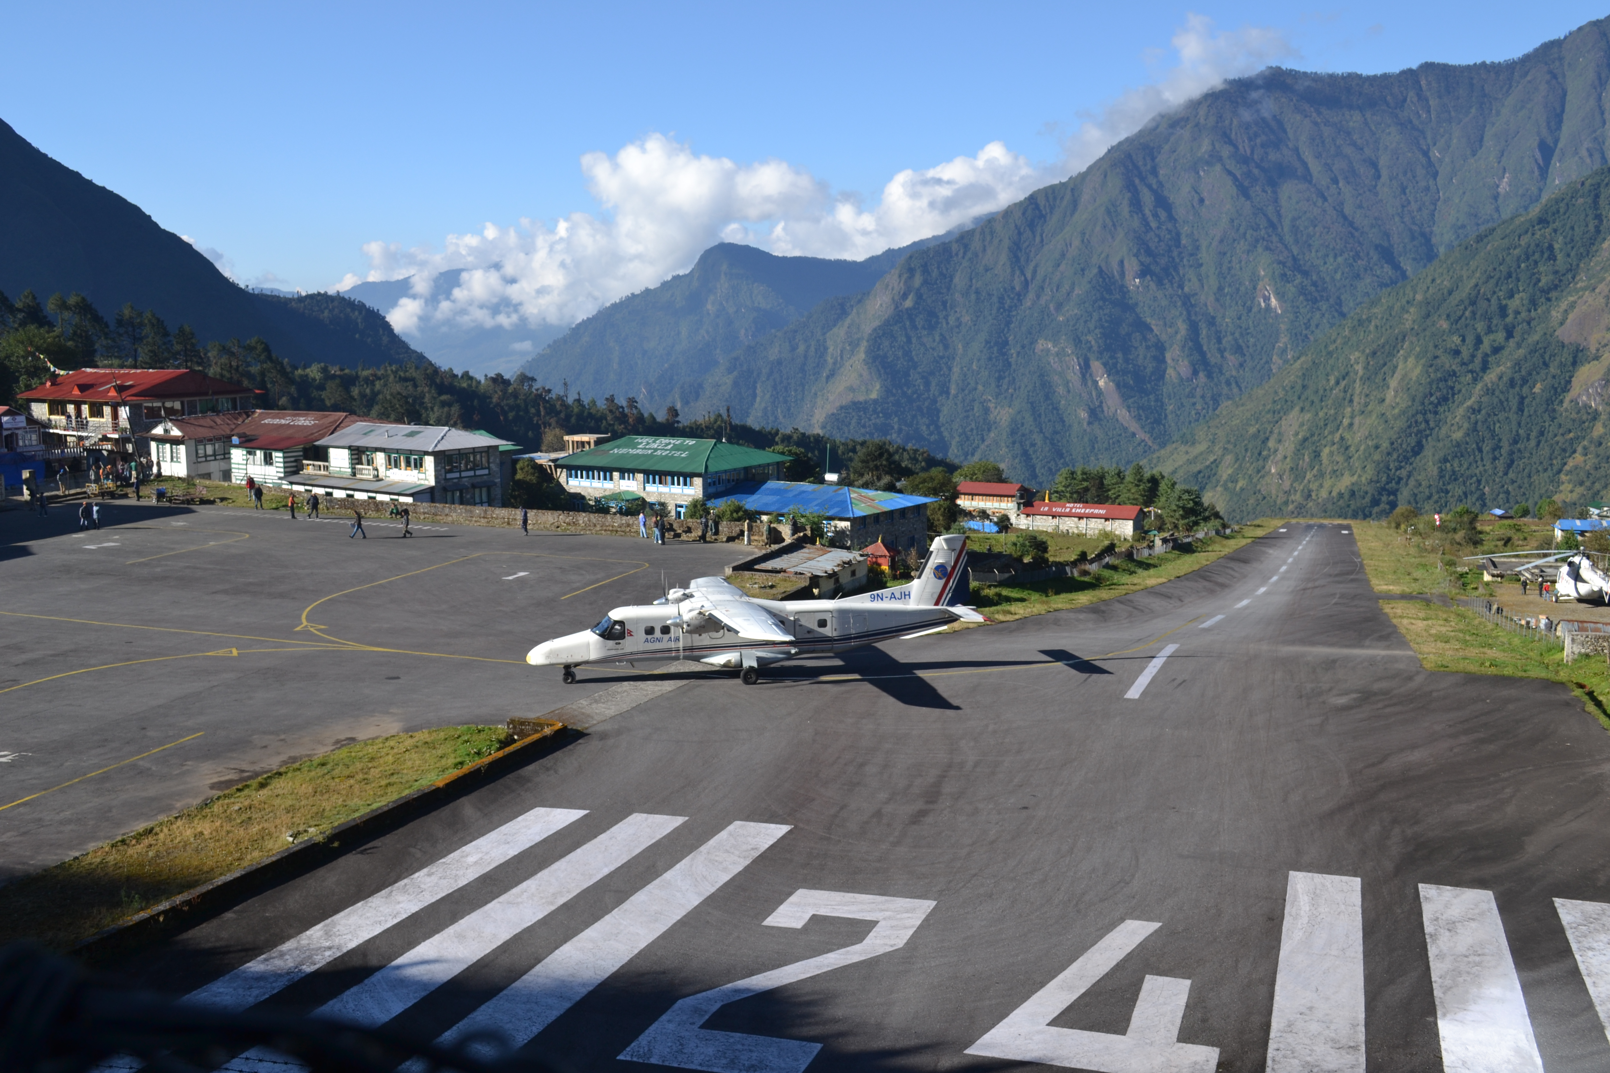
Lukla Airport

Slide 8
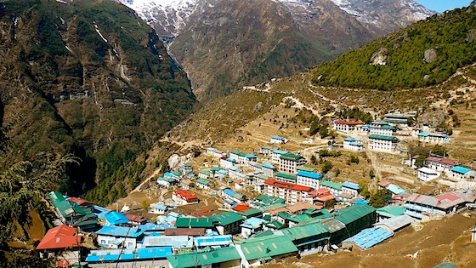
Namchee Bazaar, Nepal

Slide 9
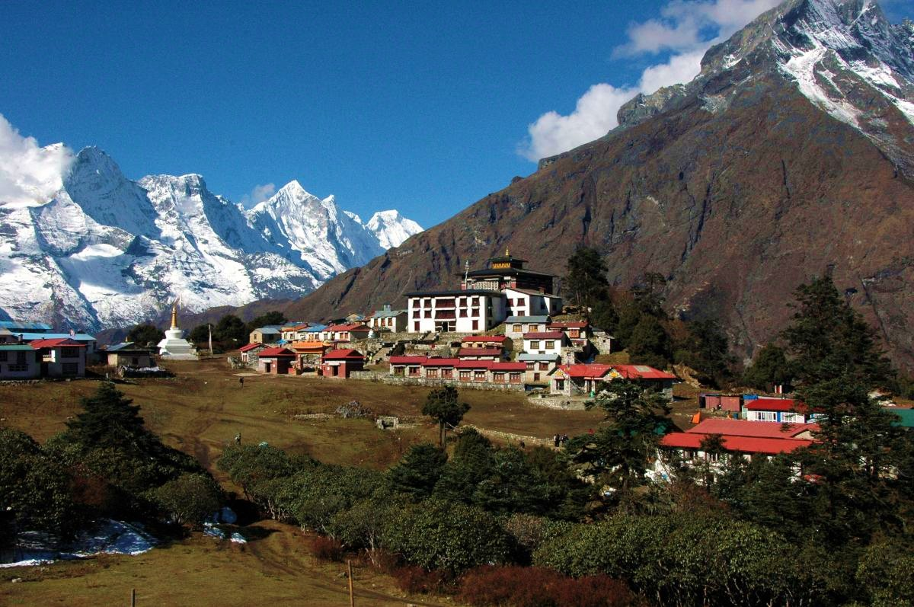
Tengbochee Monastery, Nepal

Slide 10
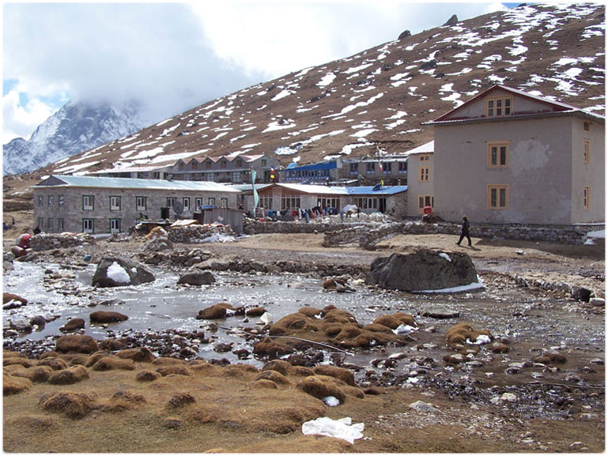
Lobuje
village

Slide 11
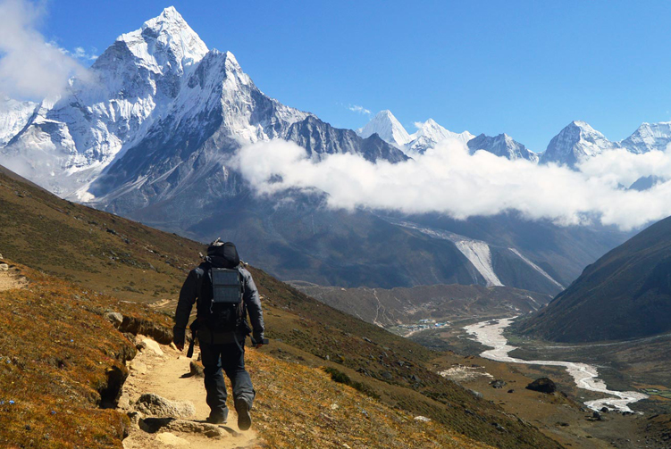
On the way to base camp

Slide 12
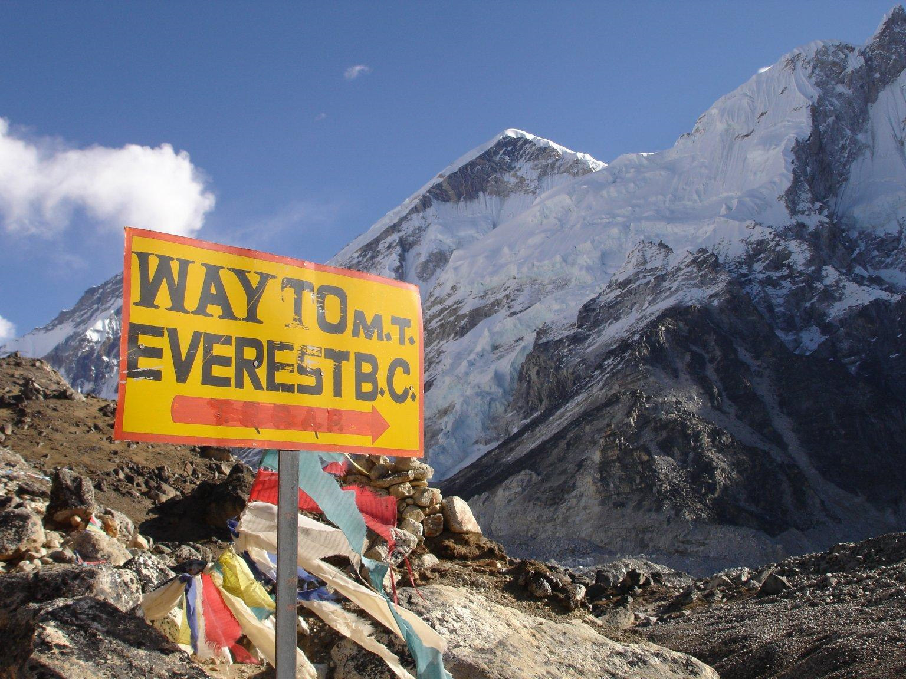
On the way to base camp

Slide 13
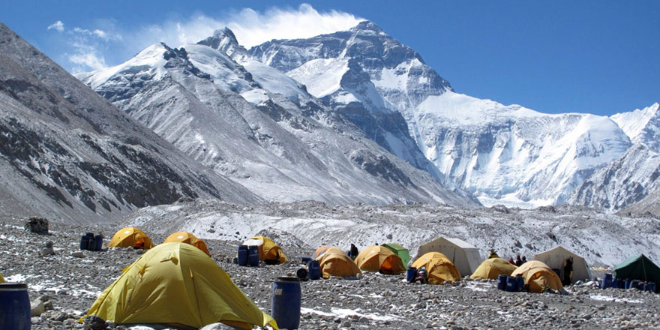
Everest Base Camp, 17,600’

Slide 14
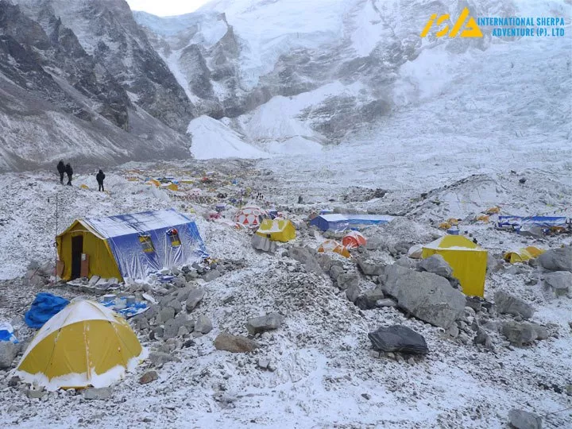
Everest Base Camp, 17,600’

Slide 15
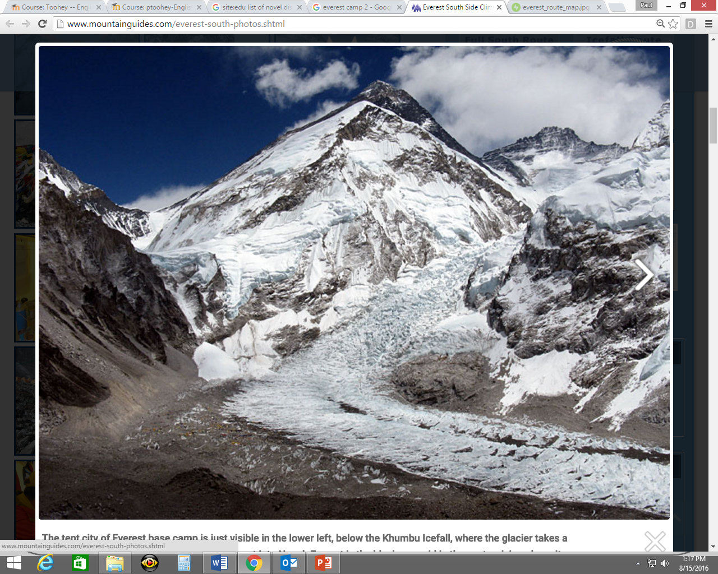
Everest base camp

Slide 16
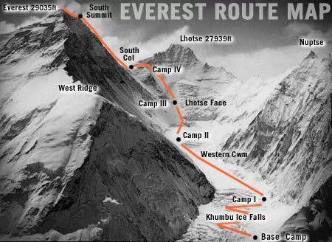
Route map

Slide 17
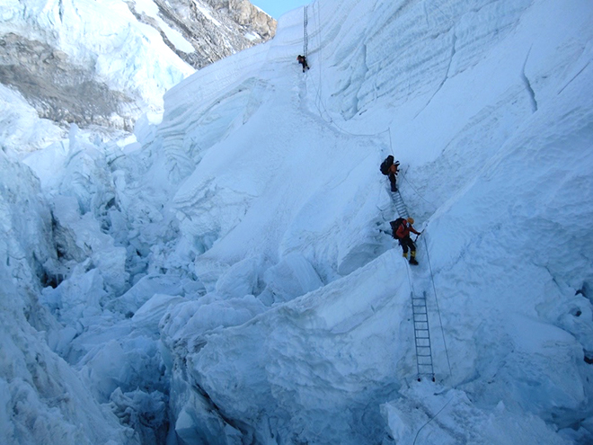
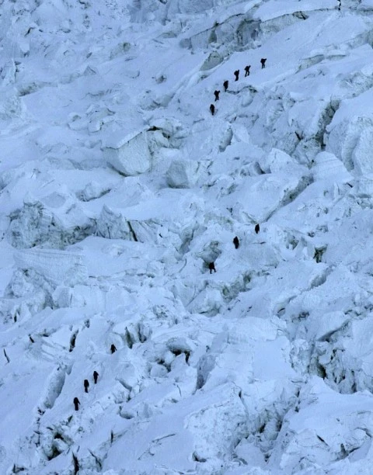
Khumbu Icefall

Slide 18
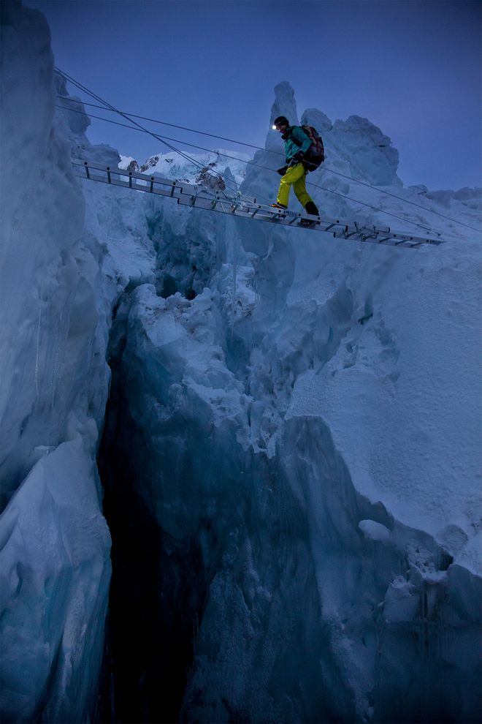

Slide 19
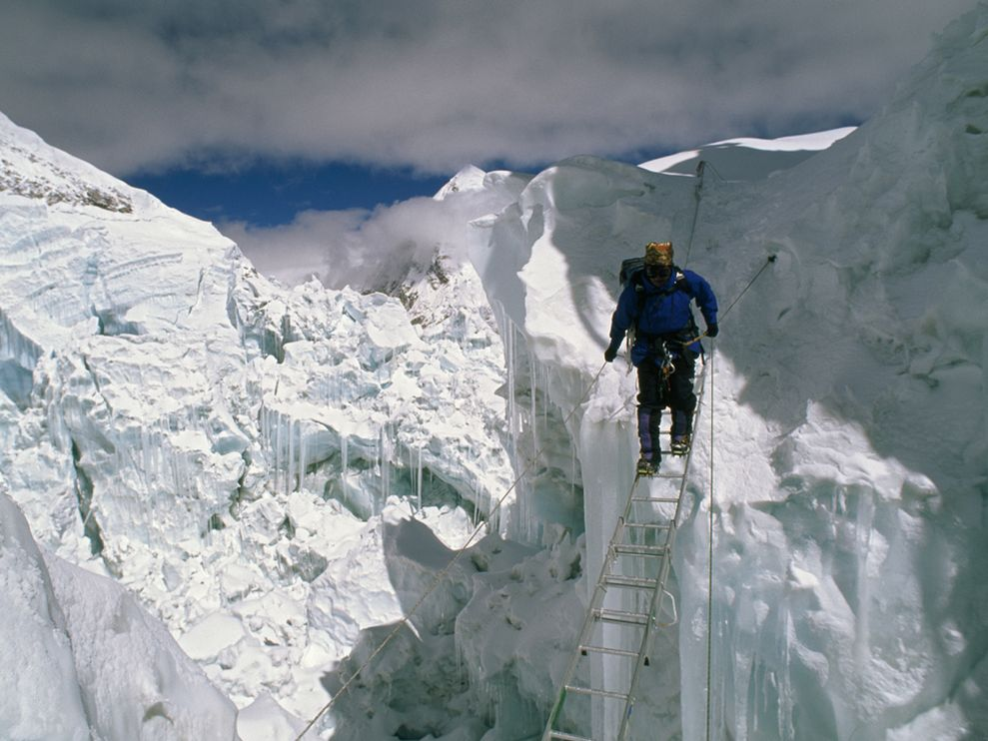

Slide 20
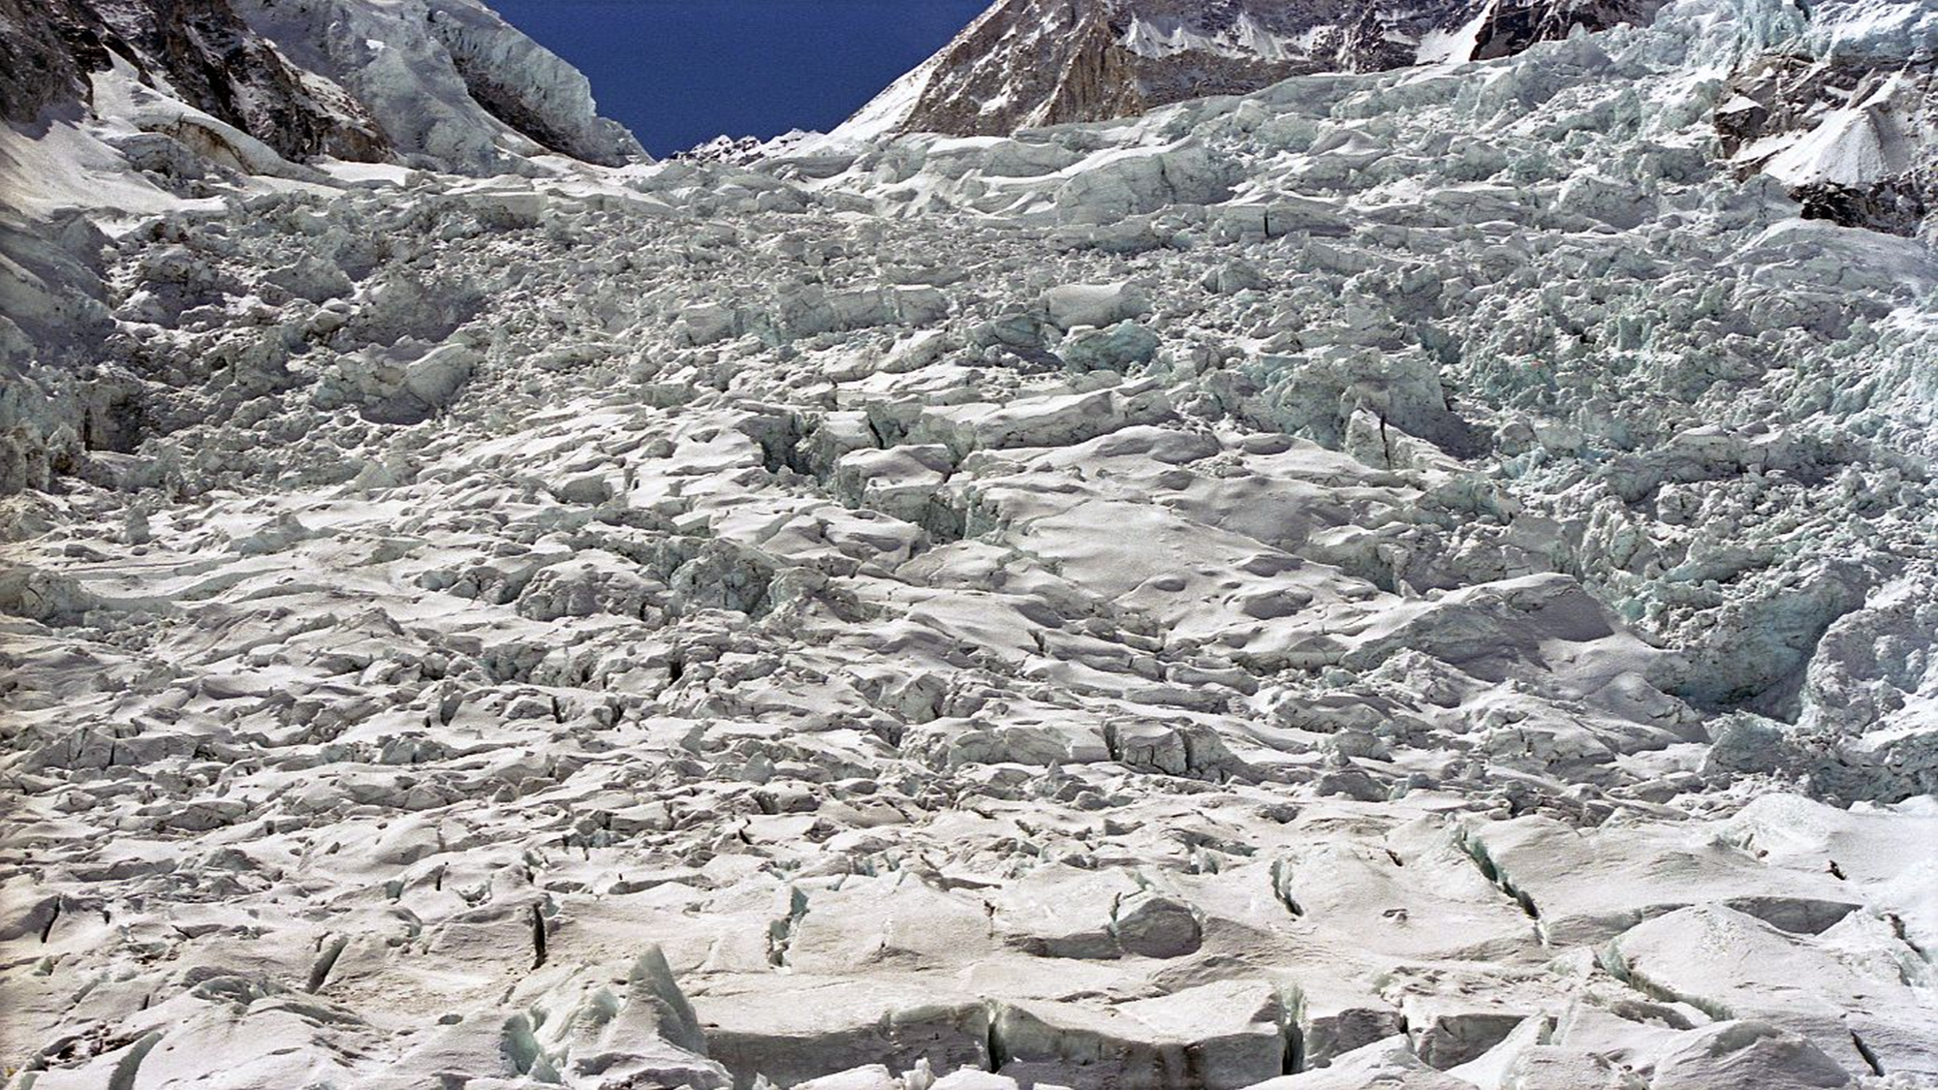

Slide 21
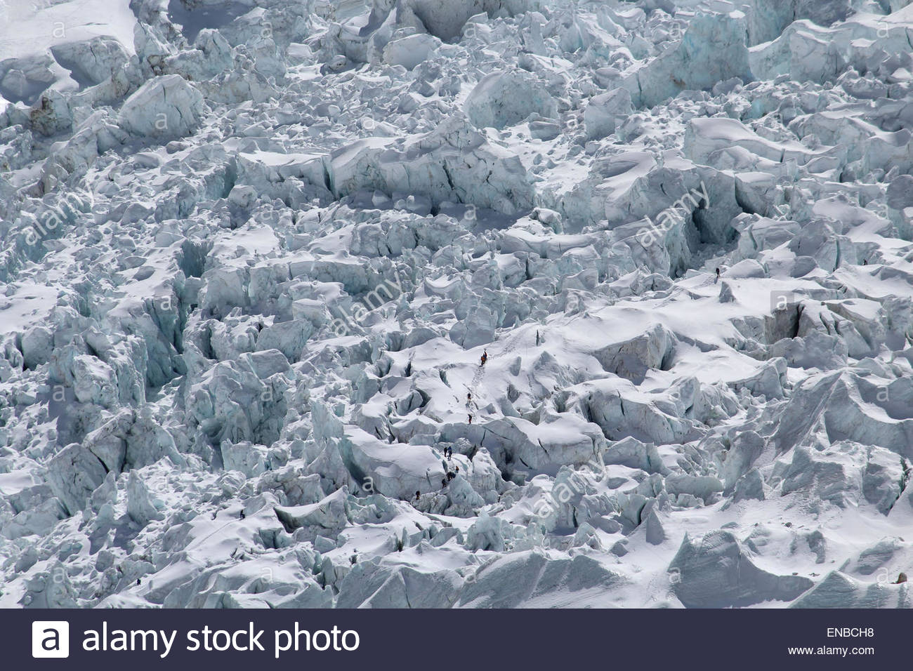

Slide 22
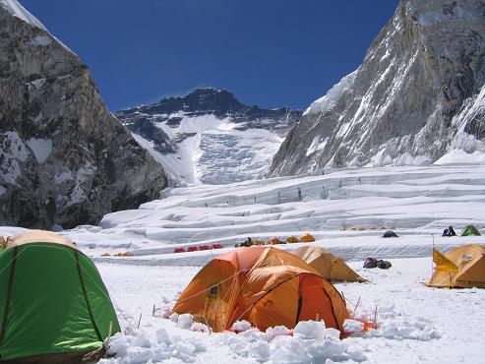
to Everest
Lhotse Face
Camp 1, looking up at the Western Cwm (Lhotse Face in the background)
19,685’

Slide 23
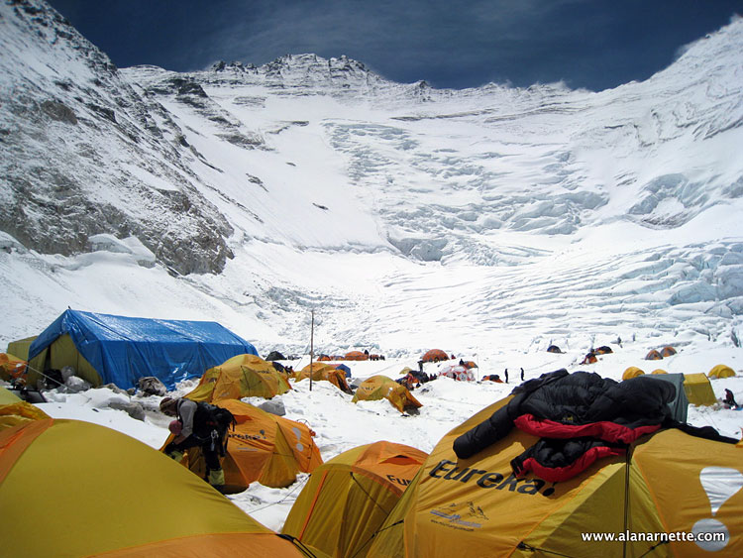
Camp 2, looking up at the Lhotse Face
21,000’

Slide 24
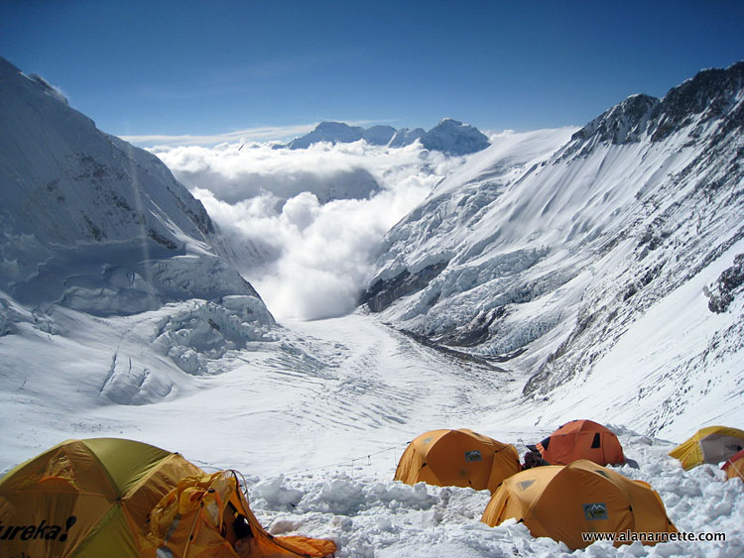
Camp 2, looking back upon the Western Cwm

Slide 25
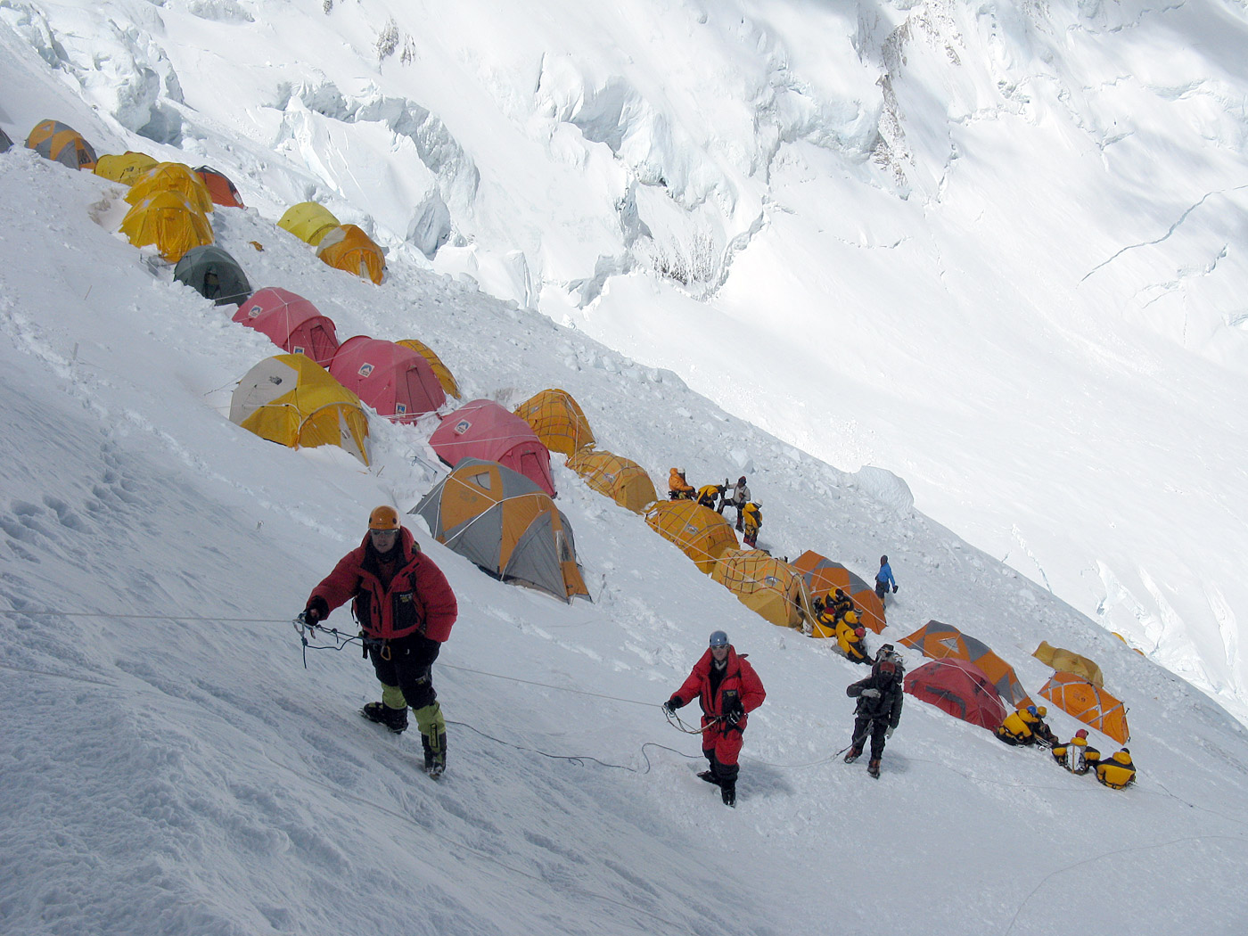
Camp 3, along the slopes
23,625’

Slide 26
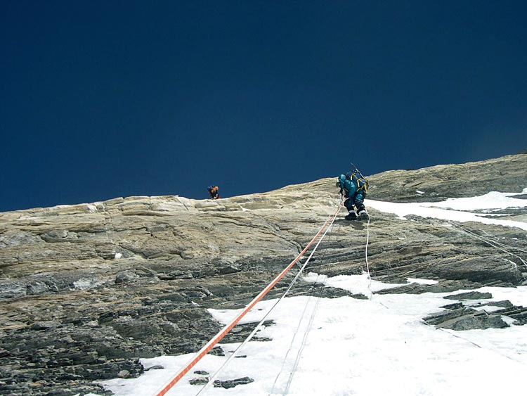
The Yellow Band

Slide 27
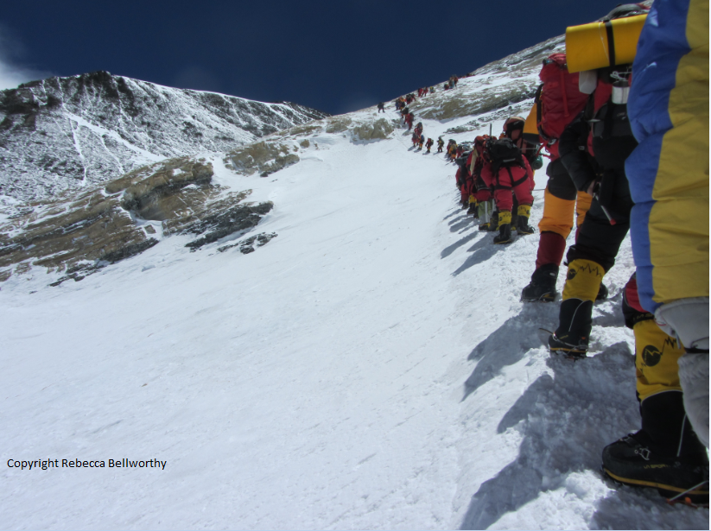
The yellow band
The Yellow Band

Slide 28
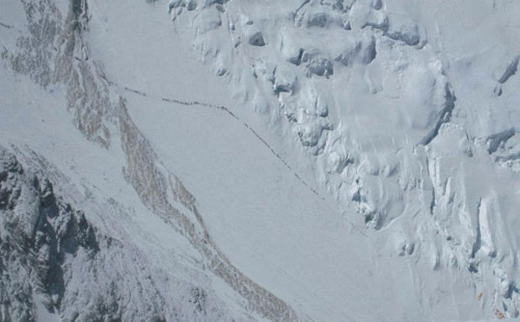
On the way to Camp 4

Slide 29
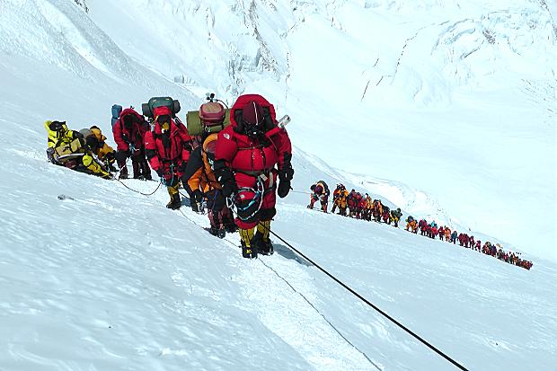
Crowds on Everest

Slide 30
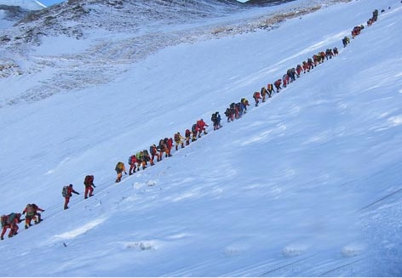
Crowds on Everest

Slide 31
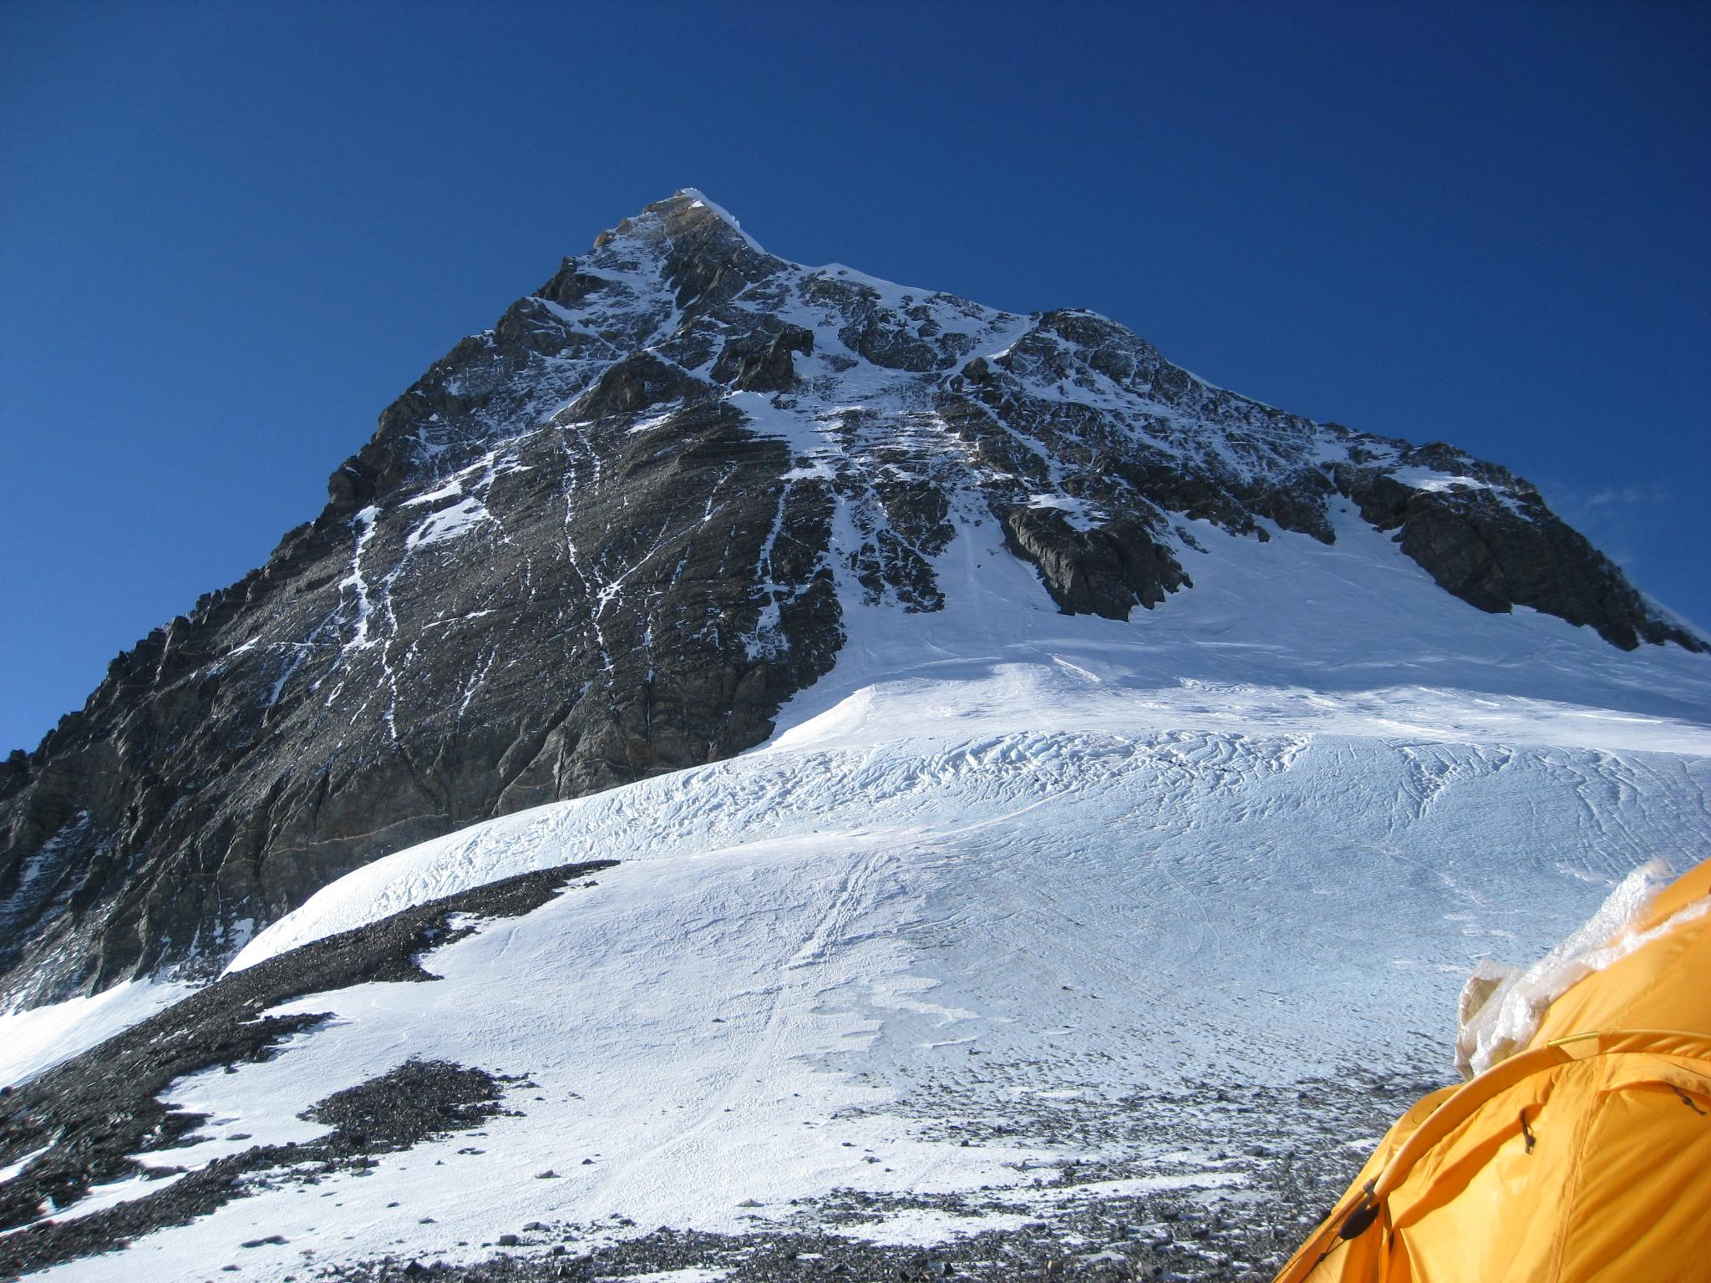
The peak of Everest
View from Camp 4 on the South Col
26,085’
The Balcony

Slide 32
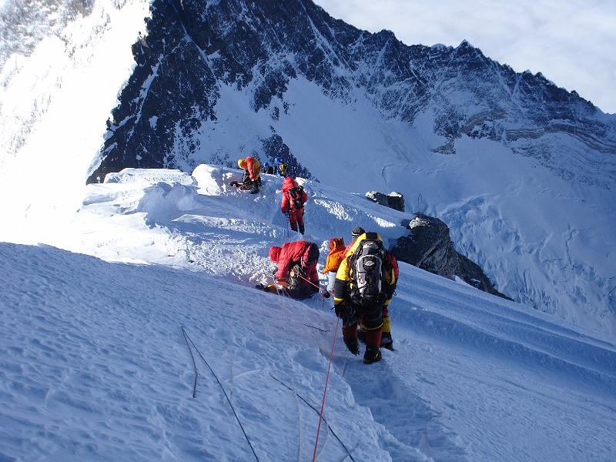
The Balcony

Slide 33
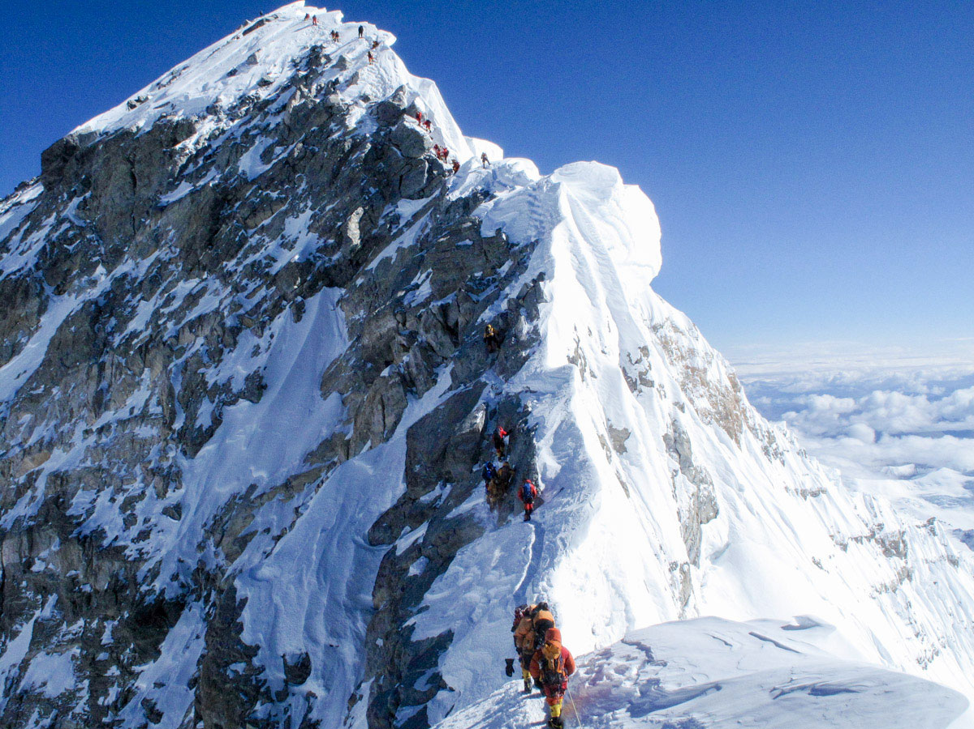
The Hillary Step
The Southeast Ridge

Slide 34
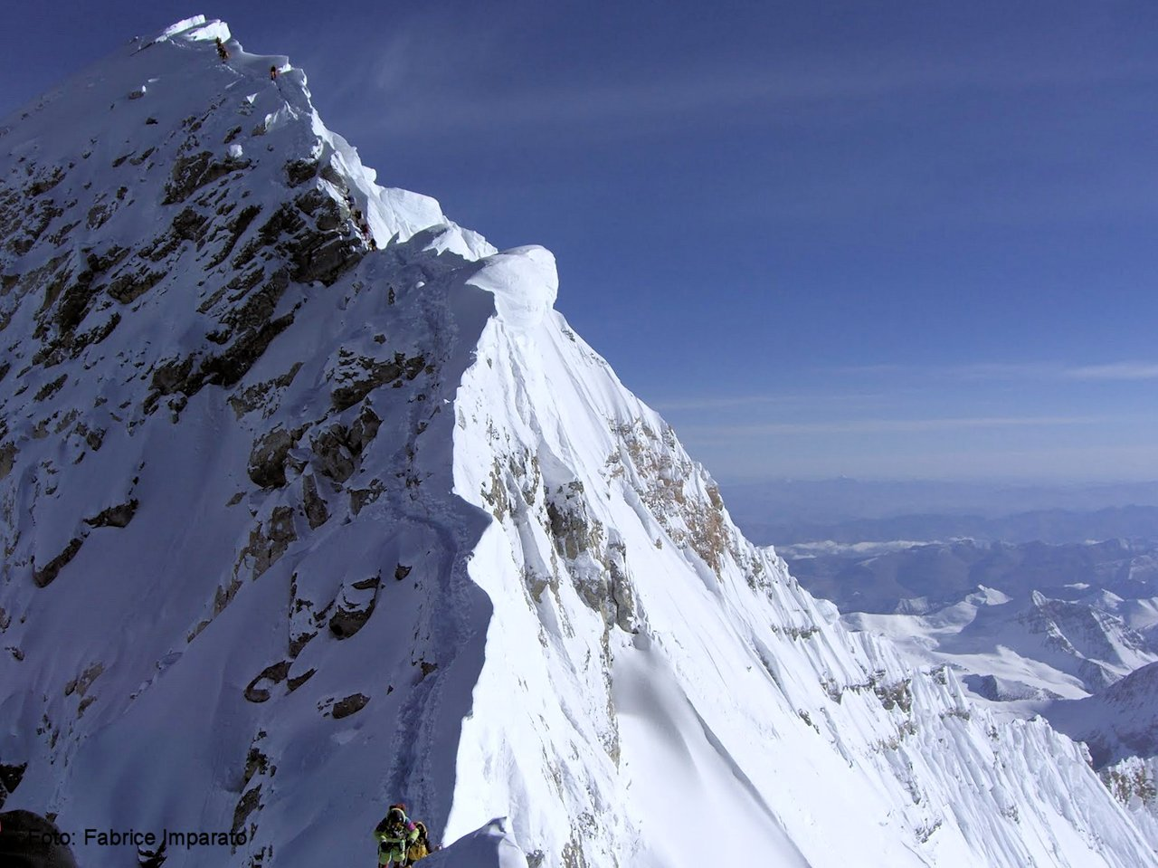
The Southeast Ridge

Slide 35
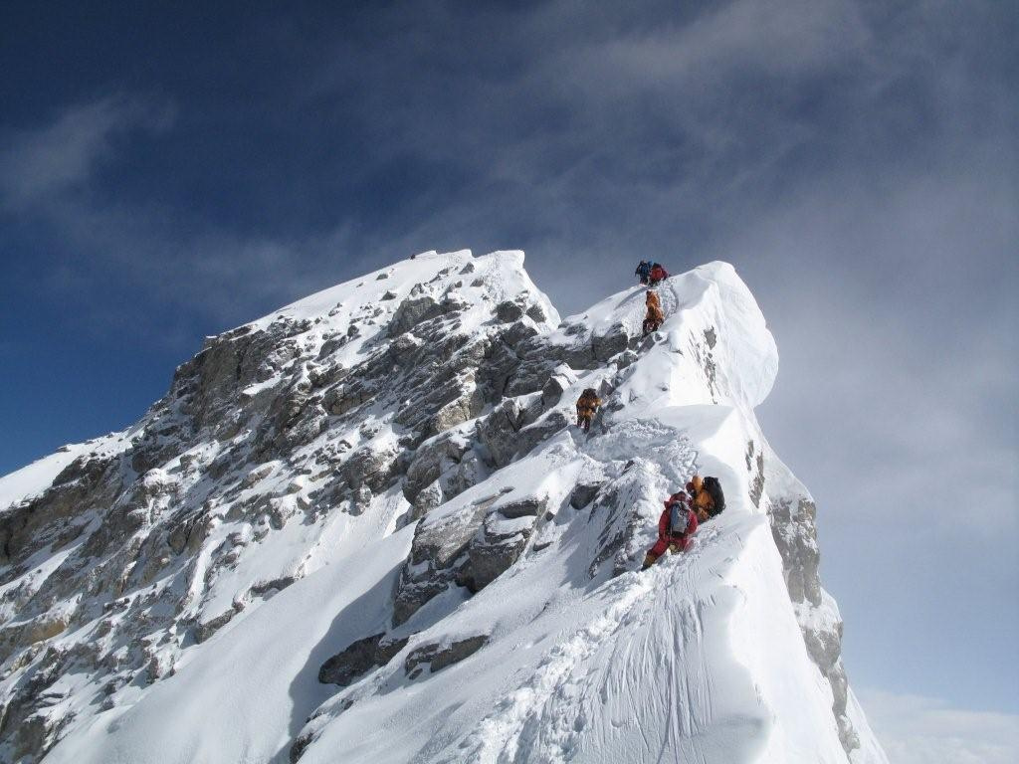
The Southeast Ridge

Slide 36
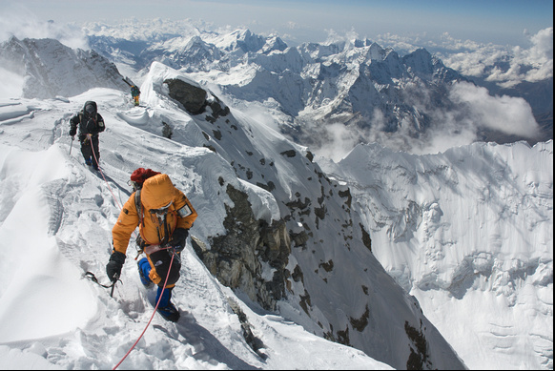
The Southeast Ridge

Slide 37
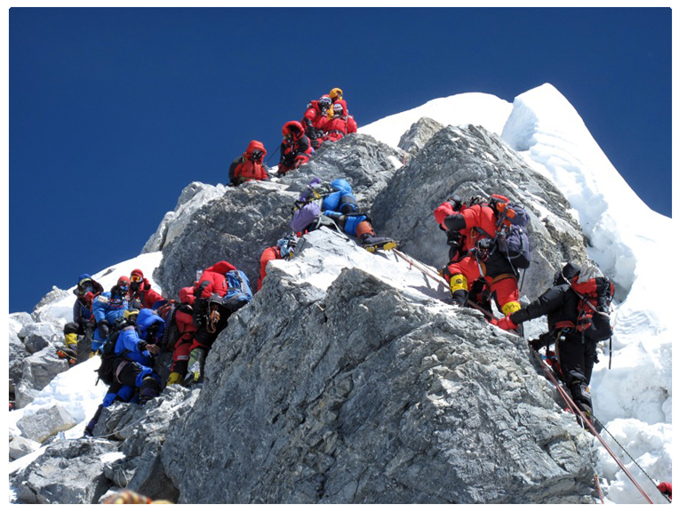
One of many problems with climbing Everest:
traffic
Coming down
The Hillary Step – the final hurdle to the top of Mt. Everest.
Going up

Slide 38
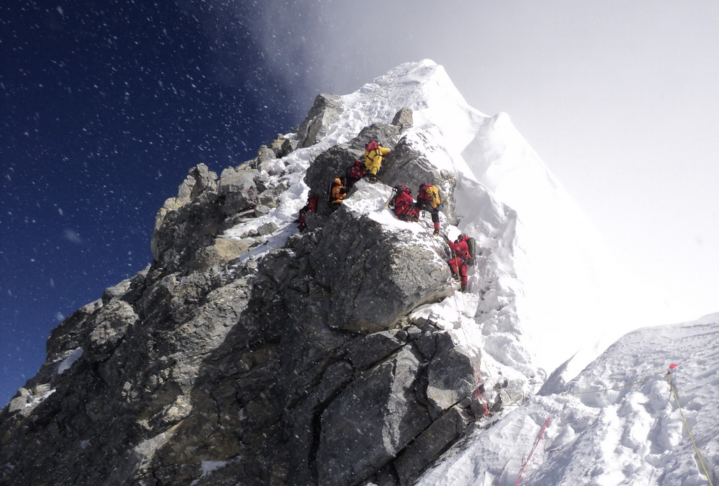
The Hillary Step – a technical part of the climb (notice the wind!)

Slide 39
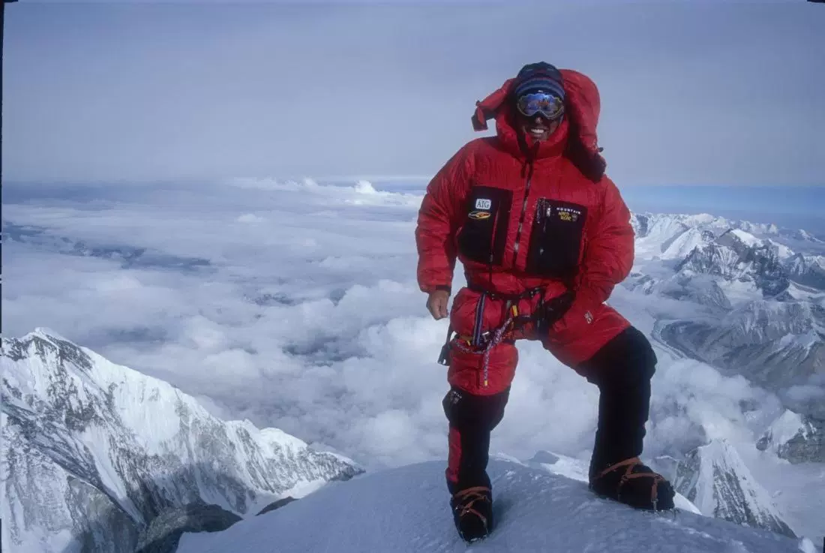
The view from the top

Slide 40
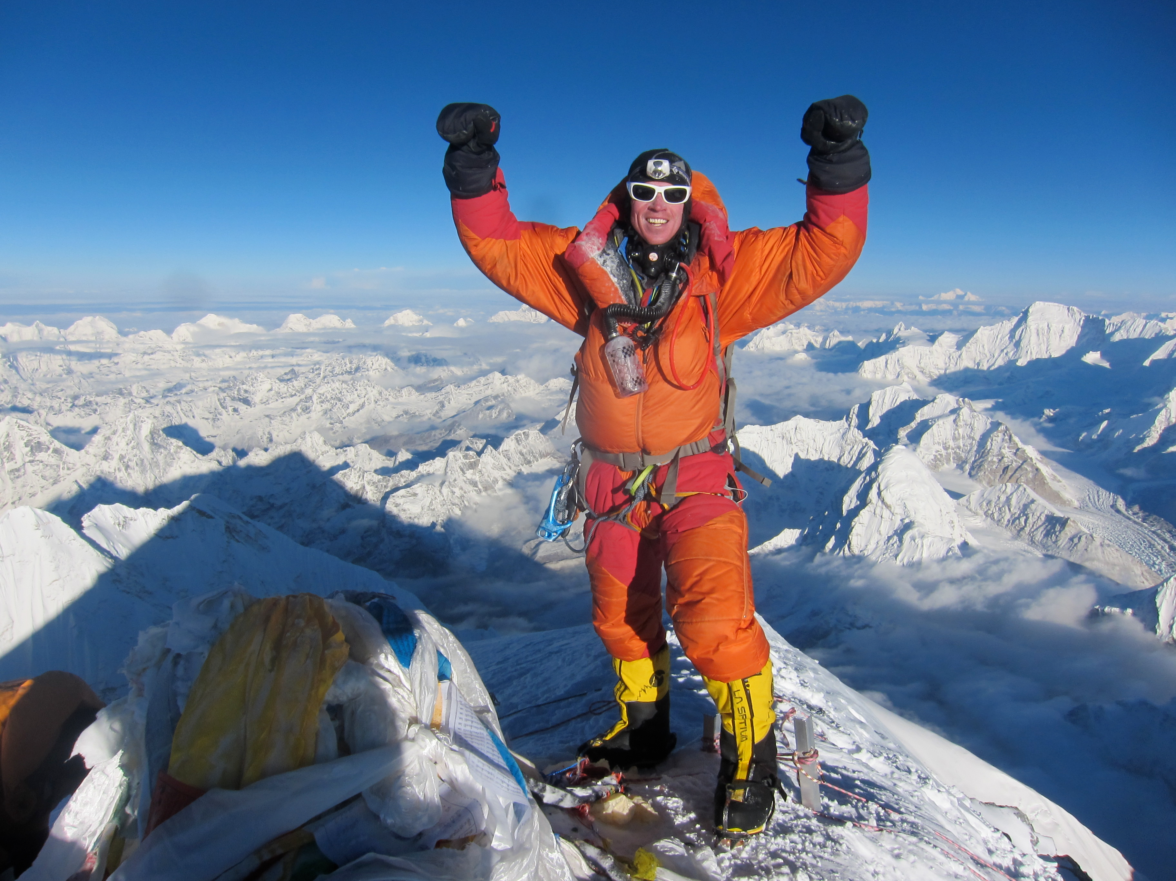
The view from the top

Slide 41
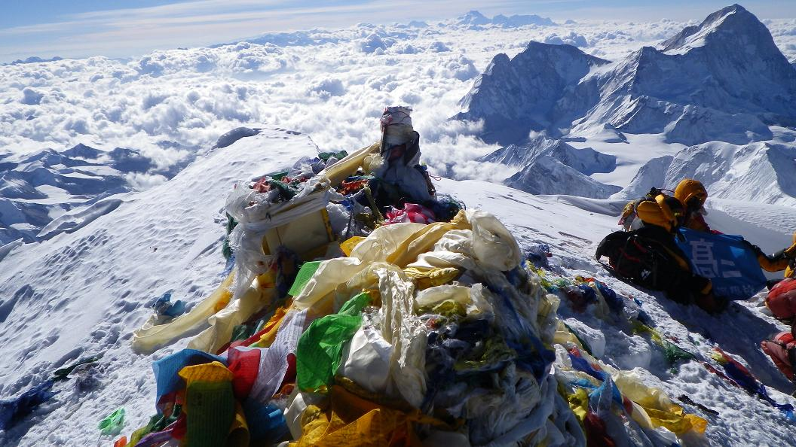
The view from the top

