Slide 1
Goals

Slide 2
One Year Academic Goal
I have straight As at the end of the year. This goal is important to me because I haven’t had straight As in a couple of years and this year I have been working really hard to earn them. When I achieve this goal I will be happy because all of my hard work will have paid off. To achieve this goal I will have to sacrifice spending time with my friends to stay home and study or do homework. While trying to achieve this goal at times it will be hard and I will feel less motivated and want give up but I will have to push through things like stress or laziness. To overcome these things I will keep reminding myself how happy and proud I will feel after I achieve this goal.

Slide 3
I had straight As the whole year

Slide 4
One Year Personal Goal
I am on the varsity tennis team this season. This is important to me because I love playing tennis and I would really like to be on varsity for my senior year. When I achieve this goal I will proud of myself because I will know that I worked hard for it and that I earned it. Sacrifices I will have to make are going to practice even when I want to stay home or hang out with my friends. When trying to achieve this goal there will be times when I get lazy or have a bad day and want to stop trying. I will have to work through these things and keep myself motivated to get passed them if I want to achieve my goal.

Slide 5
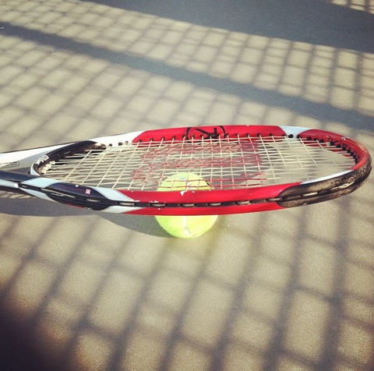
I am on the varsity tennis team

Slide 6
5 Year Goal
I am graduated from college. This goal is important to me because I know how important it is to go tot college and have a good education. When I achieve this goal I will feel very happy and accomplished because it is something that I will have put a lot of effort into. To achieve my goal I will have to sacrifice time that I would have liked to spend on things like being with my family or friends to focus on school. The biggest obstacle for me will be getting discouraged when I get too stressed or it gets hard. I will have to remind myself that in the end it will definitely be worth it.

Slide 7
I am graduated from college

Slide 8
5 Year Goal
I have finished writing my first book. This is important to me because I have loved writing for a long time and it is something I have always want to do. When I achieve this goal I will be very proud of myself because I know that I will have to work really hard and put a lot of time into it. I will have to devote a lot of time to writing it so I will have to give up some of the time that I may, at the time, want to spend doing something else. I will have to face things like writer’s block and wanting to give up when I get stuck or start doubting that I will ever be able to finish it. To overcome this I will have to make myself believe that I am capable of doing it and that I will get passed things like writer’s block, because it will be very rewarding to complete this goal.

Slide 9
I am done writing my first book

Slide 10
10 Year Goal
I am a published author. This is important to me because writing is one of my favorite things to do and I want to pursue it as a career. When I achieve my goal I will be very happy because I will have accomplished one of my dreams. Sacrifices I will have to make are having to miss out on some things like spending time with family or not getting out as much as I may like to. I will be overwhelmed with how time consuming it is. I will also have to overcome getting discouraged and having doubts in myself. I will remind myself that to achieve your dreams you have to work hard and it will be worth it. I will keep writing even when I feel like I want to give up.

Slide 11
I am a published author

