Slide 1
Motivation Project Setting Goals
-End of the year academic goal
-End of the year personal goal
-Two year goal
-Five year goal

Slide 2
End of the Year Academic Goal
My “end of the year academic goal” is to graduate Lancaster High School with a 3.0 Grade Point Average. At the moment I have a 2.9.

Slide 3
My goal of graduating LnHS with a 3.0 is important to me because I messed up my freshman year and I didn’t think I would come close, but now I know I can do it. It is also important to me because it would look good better than my gpa now, for calleges.
How I would feel when I achieve this goal would be accomplished and relieved.
There are definitely some sacrifices I would have to make to reach this goal. I need to manage my social life a little better, and I need to work harder.
My social life is definitely going to be the biggest obstacle in achieving my goal. It is going to be difficult for me to tell people “No I cant hang out, I have homework.” Another obstacle will be me wanting to be lazy but I just can’t do that.
To overcome these obstacles will just take willpower and self discipline.

Slide 4
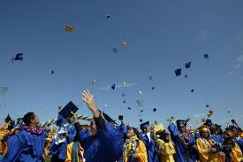
I am graduating with a 3.0

Slide 5
End of the Year Personal Goal
My “end of the year personal goal” is to be able to bench 275 pounds and to squat 365 pounds. My Max bench now is 235 and my max squat is 335.

Slide 6
These two goals are important to me because I love weightlifting and I love seeing my max numbers go up. These are just goals that I want to reach by the end of the school year.
How I will feel when I achieve this goal will be proud of how hard I worked and extremely happy that I reached my goal.
There aren’t many sacrifices I would have to make to reach my goal. I guess I would just have to sacrifice a little more time to being at the gym rather than doing other things.
Obstacles that can get in the way of achieving my goal would be either sickness, laziness or just random events I would have to attend rather than going to the gym.
To overcome the obstacle I listed I would just have to stay healthy, keep working hard, and trying to attend the gym as much possible

Slide 7
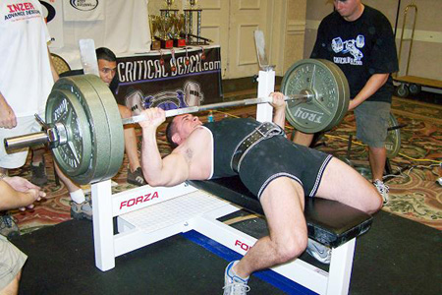
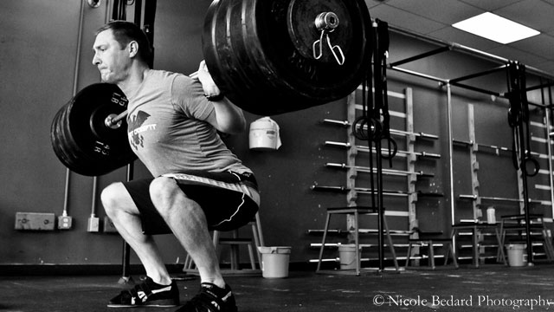
I can bench 275 and squat 365

Slide 8
Two Year Goal
My two year goal is to be finishing up my transfer classes at AVC and to have a full time job.

Slide 9
This goal is important to me because I want to be able to pay for my schooling and I want to finish the classes I need to transfer to another school.
When I achieve this goal I will be very happy with myself and very proud of myself for doing it myself
At that point in my life I will basically have to sacrifice my social life for the most part.
There will be a lot of obstacles getting in my way of this goal. The main obstacle will be money
How I will overcome that main obstacle of money is having a full time job and maybe some student loans.

Slide 10
I am attending AVC and have a full time job

Slide 11
Five Year Goal
My five year goal is to know what I want to do with my life and to be going to school for it.

Slide 12
This goal is important to me because it is what I'm going to choose to do for the rest of my life.
When I achieve this goal I will be very proud of myself and I will be content with life.
At that point there in my life there wont be much to sacrifice except time and money.
Obstacles in achieving this goal would also be time and money. Time because I need to work and money because school is expensive.
To overcome these obstacles I am just going to have to manage everything as much as I possibly can.

Slide 13
I am going to school for my future career

