Slide 1
Motivation Project: Setting Goals Booklet

Slide 2
End-of-Year academic Goal
By the end of this school year I want to have passed all of my AP classes. This goal is important to me because I never thought from the beginning that I could pass these classes and taking on these classes this year has been a challenge for me. When I achieve my goal I will feel really good about myself and that I can achieve any academic goal I put myself to. In order to achieve my goal I might have to sacrifice hanging out with my friends or even sometimes my family. I may not be able to achive my goal if the work gets too hard. I will over come these obstacles by trying my hardest and applying myself.

Slide 3
I turn in all of my AP books at the end of the year and feel accomplished.

Slide 4
End-of-year Personal Goal
My end of the year personal goal is to know where I want to go to college and what I want to do with my future. This goal is important to me because I’ve been very indecisive in what I want to do with my future and all I know is that I want to go to college. I might have to sacrifice a lot of my time to get where I want to be to get to college and put a lot of hard work into my studies. I will feel like I am now on a steady track and will be convinced of my readiness after I graduate. The obstacles that might get in my way are my mixed emotions and un-sureness but for the most part I should have no obstacles in my way.

Slide 5
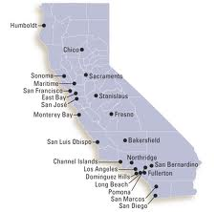
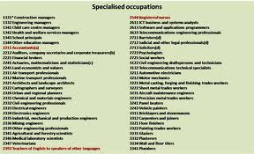
I narrowed these colleges down to one that I really want to go to. I also know what occupation I want.

Slide 6
Two-year goal
In two years I want to be on track to graduate and already have applied to colleges and sure of where I am going to college. This goal is important to me because it follows the life I have planned for myself. When I have achieved this goal I will feel like graduation is one step closer and I will finally be able to start my life. I will need to maybe sacrifice going to one college to go to another and leaving my family to go to the college I want to go to. Some obstacles that might get in my way is not getting accepted into these colleges or not having high enough SAT/ACT scores. I will improve these scores and reapply the next chance I get.

Slide 7
I am prepared to graduate and am excited to start my life.

Slide 8
ten-year goal
In ten years I want to be married to the love of my life and beginning a new family. This is important to me because family has always been really important to me. You have to have family in order to get you through life and I have always wanted that person that means the world to me and I mean the world to them. When I achieve this goal I will be the happiest I have ever been. Graduated and having a steady job and caring family. I might need to sacrifice eating sea food, which I love, and a little bit of extra time to work out more to make labor easier. The obstacles that might get in my was is not being able to have kids. I will over come this by adopting a kid.

Slide 9
I am finally starting my family with a baby on the way and my husband that I am madly in love with.

