Slide 1
Republican Philosophy about government
By: Michael Seabury
Antonio Campos
Brandon Rudney
Saahil Shah

Slide 2
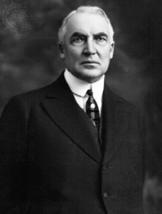
President Harding
Elected President on a pledge of a “return to normalcy”
Favored more conservative policies that aided the growth of business

Slide 3
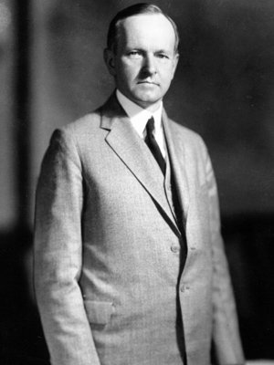
Calvin Coolidge
After Andrew Mellon’s death, Vice President Calvin Coolidge became President of the United States
Type of man that was quiet, honest, and a frugal-man who measured his words carefully
Placed his trust in business
He put his administration in the hands of men who held to the simple virtues of an older America
Followed goals of Secretary of Treasury Mellon
- Which was to reduce the national debt, trimming the federal budget, and lowering taxes to give incentives for businesses

Slide 4
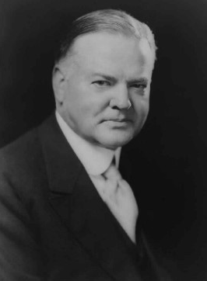
Herbert Hoover
The Secretary of Commerce
Worked with business and labor leaders to achieve voluntary advancements

Slide 5
Teapot Dome Scandal
A scandal during Harding administration in which the Secretary of the Interior leased government oil reserves to private oilmen in return for bribes
Corruption of the Harding administration

Slide 6
Isolationism vs. Internationalism
Isolationism is a policy of remaining apart from the affairs or interests of other groups
Internationalism is the state of process of being international
Isolationism expressed tariffs in 1922 and 1930 to set successful higher duties on foreign goods

Slide 7
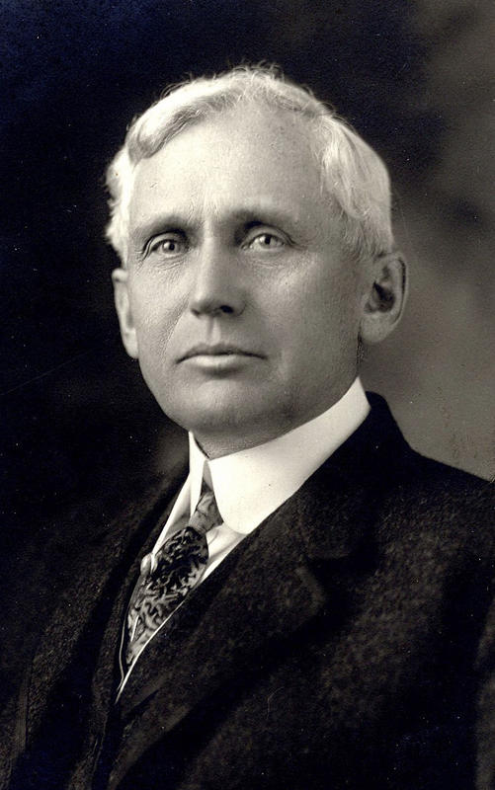
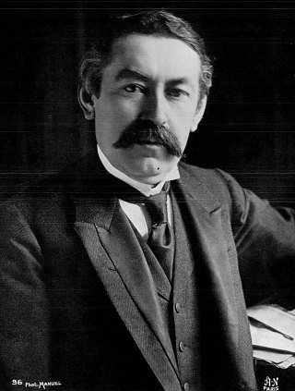
Kellogg-Briand Pact
An agreement in 1928 in which many nations agreed to outlaw war
Made by Frank B. Kellogg and Aristide Briand
Helped end WWI
Aristide Briand
Frank B. Kellogg

Slide 8
Dawes Act
An agreement in which the U.S. loaned money to Germany
-Allowing Germany to make reparation payments to Britain and France
Helped Britain and France repay their debts to the U.S.

